Slide 1
Federal Planning Finding (FPF) Update
MPO Summer Workshop
8/27/19
Andrew Emanuele, AICP
Community Planner

Slide 2
What is a Federal Planning Finding?
Formal verification of the statewide planning process. Issued with STIP approval.
Legal Basis
STIP: 23 CFR 450.220(b), 23 U.S.C. 135(g)(8) & 49 U.S.C. 5304(g)(8)
TIP: 23 CFR 450.330(g)
Required since SAFETEA-LU (2005)
Followed in varying degrees by FHWA Division Offices

Slide 3
CFR Language
“The FHWA and the FTA shall…make a joint finding on the extent to which the STIP is based on a statewide transportation planning process.”

Slide 4
MN FPF Now
Issued in letter w/ STIP Approval
Format not extremely rigid – up to Division Office
“Noteworthy Practices”
2018: D-3 Public Engagement Plan (PEOPLE), MPO ADA Transition Plan Assistance, TH 65 PEL Pilot Study
“Areas for Enhancement”
2018: Encouraging Community Connections, MPO Performance Management Integration, Linking TAMP strategies to investments/innovation

Slide 5
Change Catalyst
2011 – 2014: State of the Practice Reviews
14 Division Offices Reviewed
20 Recommendations Divisions and FHWA HQ
2017: Office of Inspector General Audit
5 Recommendations

Slide 6
Major Review Findings
Strengthen STIP Oversight
Strengthen Statewide Planning Oversight
National FPF Inconsistency
Need Better Guidance:
How to Conduct a FPF
What to Address
How to Document
Following Up

Slide 7
Planning Process
Component of Risk-Based Stewardship and Oversight
Can address all aspects of the statewide planning process, including MPO Planning Activities
MPOs can be referenced individually or as a group

Slide 8
MPO Relevance
MTP
UPWP
TIP
CMP
Public Participation Plans
Self Certification
ADA Transition Plans
Freight Planning
Scenario Planning
Title VI & EJ Compliance
ITS
Performance Measures
And many more!

Slide 9
New Document Structure
Based off TMA Certification Reviews
Working Knowledge, Risk-Based
Desk Review Component
Format now more ridged
Legal Basis and Background
Observations
Actions
Follow-Up
Three Possible Actions:
Commendation, Recommendation, Corrective Action

Slide 10
Commendation
Innovative procedures
Highly effective planning implementation
Represents national model (best practice)
Example for other agencies (Statewide or Nationally)

Slide 11
Recommendation
Most Common Action
Opportunities for Improvement
Statutory and Regulatory Requirements Still Met
Will consult OTSM for Emphasis Areas

Slide 12
Corrective Action
Areas of less than full compliance
Statutory and Regulatory Requirements not met
Requires an Action Plan

Slide 13
Action Plan
Tracks Corrective Action to a close
Requires:
Timeline w/ Target Completion Date
Approach to Resolve Issue
“Status” Category
Coordinated check-in with FHWA
National Database Update upon Resolution
MPO Corrective Actions would have MnDOT at the table

Slide 14
Example Observations & Actions

Slide 15
Final STIP Approval
Approvals make take longer
Desk Review Time
Will meet with OTSM prior
Issue Final STIP approval and FPF
Signed by FHWA DA & FTA Regional Administrator
Observations & Actions entered into National Database
Action Plan follow-up

Slide 16
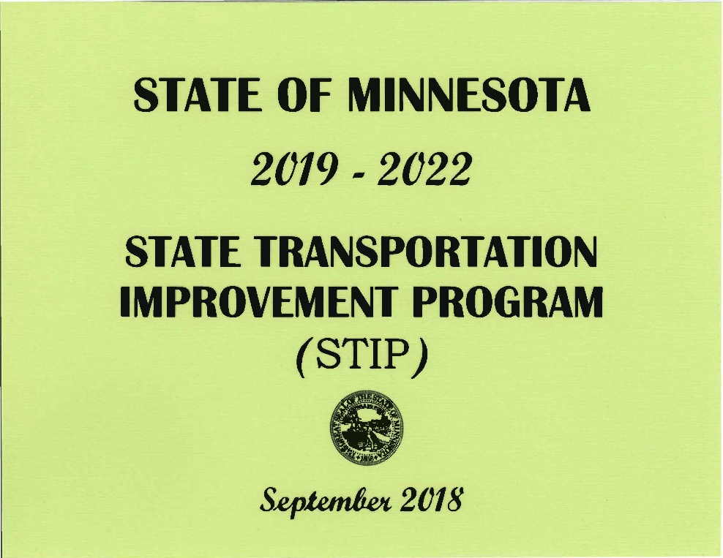
STIP Amendments
Technically require a new Finding
Could issue new actions
If no substantial changes/new risks, reference prior FPF
Approval letter language
Action Plan updates
Mods: No Action

Slide 17
STIP Amendments

Slide 18
MOA / SOP Update
Internal Presentation Only
CHECK ON ANY MOA/SOP Updates relative to MnDOT or the MPOS.
Reread Finding Document.

Slide 19
Your Program
If you have areas to push, let me know. Asset Management, Freight, Civil Rights
INTERNAL PRESENTATION ONLY

Slide 20
Questions?
Andrew Emanuele, AICP
Community Planner
Federal Highway Administration
Minnesota Division
380 Jackson Street, Suite 500
St. Paul, Minnesota 55101
andrew.emanuele@dot.gov
651-291-6124

