Slide 1
PTASP Guidance Overview for MPOs
Minnesota MPO Summer Workshop
August 27-29, 2019
Bill Wheeler

Slide 2
Notes:
The Public Transportation Agency Safety Plan (PTASP) is a new rule (published July 19, 2018, effective July 2019) that is designed to go hand and hand with the Transit Asset Management (TAM) Plan as part of FTA’s performance based planning and programming strategy.

Slide 3
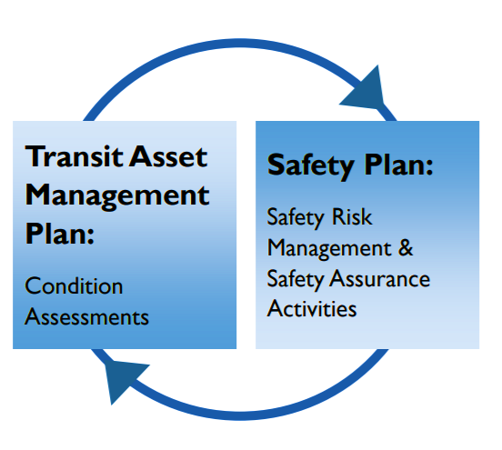
What is the Public Transportation Agency Safety Plan (PTASP)?
Certain Transit Providers are required to develop safety plans that include specific and effective policies and procedures for safety and accountability
Currently applies only to urban operators, FTA has deferred the requirement for 5310 and 5311 Operators
Notes:
You should recognize some similarities between TAM and PTASP required plans, and indeed we want them to feed into each other. Poor asset management becomes a significant safety risk, and good safety practices are a key to successful asset management at all transit agencies.
The PTASP Rule will require all operators of public transportation systems that are recipients and subrecipients of FTA 5307 (Urbanized Area Formula) funding to have a safety plan in place by July 20, 2020. The Plan must be updated annually. FTA has deferred the requirement to develop a PTASP for public transit operators that only receive funds through the 5310 Enhanced Mobility Of Seniors and Individuals with Disabilities Program and the 5311 Rural Area Formula Program. The rule also does not apply to agencies that are subject to the safety jurisdiction of another federal agency, including passenger ferry operators regulated by the U.S. Coast Guard and rail operators regulated by the Federal Railroad Administration.

Slide 4
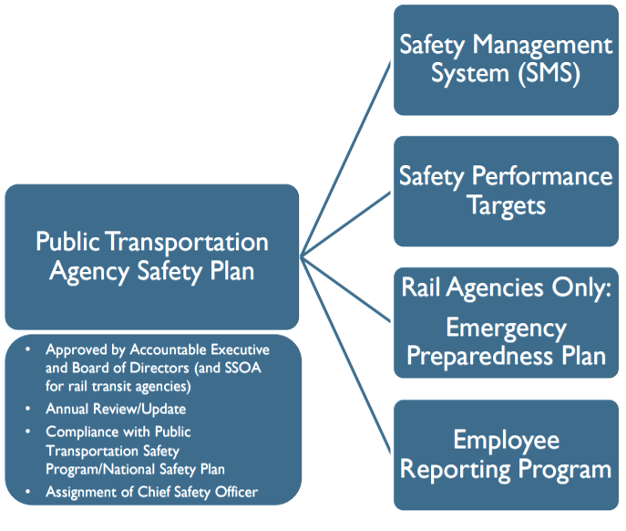
Safety Plan Elements
Notes:
Key elements of the safety plan include:
The implementation of a Safety Management System (SMS):
This is the written Safety and Risk Management Policy of the transit agency. It includes the processes and procedures for identifying safety hazards, assessing risk, and implementing mitigation. All transit agencies must develop written processes for continuing safety performance monitoring and evaluation.
Out of these risk management procedures, the transit agency implements a process for setting safety performance targets. The Plan will include the Safety Performance Targets and a process for evaluating progress toward meeting those targets
Additionally for agencies that operate rail transit, they will need to establish an emergency preparedness plan
A key part of Safety Management Systems is implementing an employee safety reporting program that actively seeks input from front-line drivers, mechanics, dispatchers, and staff regarding safety improvements. This program will be required for transit agencies as part of their Public Transit Agency Safety Plan.
Once the Plan is complete,
Each transit agency will assign a Chief Safety Officer to oversee implementation and continued safety efforts.
Each transit agency’s plan will have to be approved by that agency’s Accountable Executive and Board of Directors and undergo an annual review and update process.
Transit Agencies’ Safety Performance Targets will have to be reported to the MPO and State DOT.
Small Public Transportation providers (operating less than 100 vehicles in peak revenue service and no rail operations) may have the State draft a safety plan on their behalf, or draft their own. Large transit providers will each have to draft their own safety plan.
Each transit agency should consider the results of its TAM Plan asset condition assessments while performing safety risk management and safety assurance activities. The results of the condition assessments and subsequent SMS analysis should inform each transit operator’s investment priorities.
(Further info on each component of SMS, if necessary):
Safety Management Policy
Safety objectives
Confidential employee reporting program
Organizational accountabilities and safety responsibilities
Designation of a Chief Safety Officer
Safety Risk Management
Processes for hazard identification
Risk assessment
Mitigation development
Safety Assurance
All operators develop processes for:
Safety performance monitoring and measurement
Rail and large bus operators develop processes for:
Management of change
Continuous improvement
Safety Promotion
Comprehensive safety training program
Safety communication

Slide 5
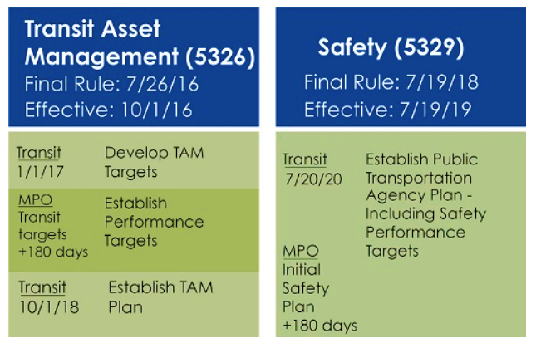
July 20, 2021: MPO reflects the transit safety measures and targets in all MTPs and TIPs updated or amended, by this date.
Notes:
Performance Based Planning and Programming requires close coordination between MPOs, the Transit Agencies in their jurisdiction, and the State DOT. The key deadline is just under 1 year from today. That’s 7/20/2020, when all 5307 funded transit agencies are required to have a Public Transit Agency Safety Plan in place with Performance Targets set. This plan will have to be shared with their MPO and the State DOT, so please make sure your MOAs or MPAs are updated to include that sharing of safety information.
Each MPO should adopt transit safety targets within 180 days of receiving targets from transit agency(ies) in their jurisdiction, which is a 1/20/21 deadline. After 7/20/21 FTA will not approve new or amended planning documents unless the transit safety targets are included.

Slide 6
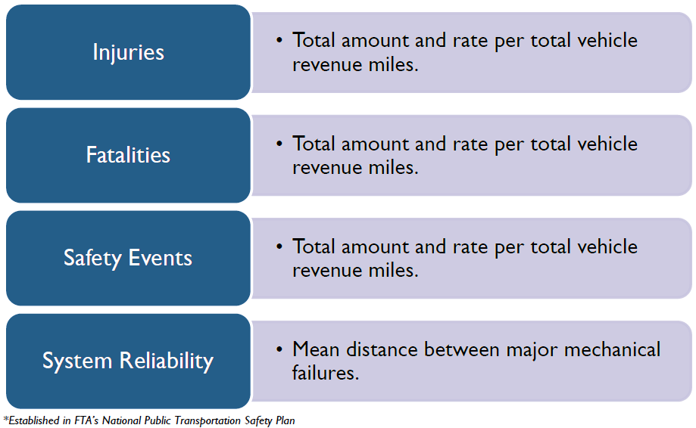
Safety Performance Targets
Specific numerical targets set by transit agency based on safety performance measures established by FTA:
+ Others (unique to local transit agency)
Notes:
Like the Transit Asset Management targets, each agency will have to establish safety performance targets. Here are the FTA performance measures that have been established:
Injuries (total) and Rate of injuries per total vehicle revenue miles (by mode)
Fatalities (total) and Rate of fatalities per total vehicle revenue miles (by mode)
Reportable Safety Events (total) and Rate of events per total vehicle revenue miles (by mode)
Mean distance between major mechanical failures (by mode)

Slide 7
NTD Reportable Safety Events
Fatalities
Injuries requiring immediate transport for medical attention
Property Damage > $25,000
Collisions that involve towing away any vehicle from the scene
Evacuation of a transit facility for life-safety reasons
https://www.transit.dot.gov/ntd
Notes:
Here is what FTA defines as a reportable safety event. These are events that already must be reported nationally by all transit providers to the National Transit Database. You can see data collected from the NTD by going to transit.dot.gov/ntd … also your local transit agency will have the latest reportable information.

Slide 8
TAM Plan Data:
Asset Inventory and Condition Assessment
PTASP Data: Hazard identification and Risk Assessment
Establishing performance targets (Safety and State of Good Repair)
Implementing TAM Plan and PTASP policies at transit agencies
Integrating Performance Targets through coordination with MPO and State
Prioritizing Investment based on targets
Performance-based TIP/STIP Programming
Monitoring and Evaluation of strategy
Ongoing review and update of data and plans
Notes:
Overview of linking performance based planning data into MPO planning and programming processes. Transit Safety Plans are to be completed for urban transit agencies by 7/20/20. Thereafter each agency will review their transit safety plan each year for possible updates (which includes updates to safety performance targets). States and MPOs should describe anticipated effects of STIPs and TIPs to make progress toward achieving performance targets.

Slide 9
System Performance Evaluation
The first MPO system performance report is a baseline of the existing conditions and safety performance targets to be included in TIP and Long Range Planning Documents, or amendments by:
TAM - October 1, 2018
PTASP- July 20, 2021
The second MPO system performance report is triggered by the next long range plan update (not an amendment).
Describes how the latest (existing) conditions have changed since the baseline report, and how they compare to the targets identified in the first baseline report.
Notes:
Both the Public Transit Agency Safety Plan and Transit Asset Management Plan will be used for the system performance reports provided by each MPO in their planning documents. The first system performance report is baseline of the existing conditions with the established PTASP and TAM Targets. Safety Targets must be included in the MPO’s TIP and any newly updated Long Range documents by the next upcoming deadline of July 20, 2021. Additionally this deadline denotes and future system performance reports will collect all of the latest information plus an evaluation of the difference between the baseline and the current year. The system performance report is triggered by the next long-range plan update that is not an Amendment and also will contain updated performance targets.

Slide 10
Resources
https://www.transit.dot.gov/PTASP
https://www.transit.dot.gov/regulations-and-guidance/transportation-planning

Slide 11
FTA Region 5
Bill Wheeler
Email: William.Wheeler@dot.gov
Phone: 312-353-2639
https://www.transit.dot.gov/about/regional-offices/region-5

