Slide 1
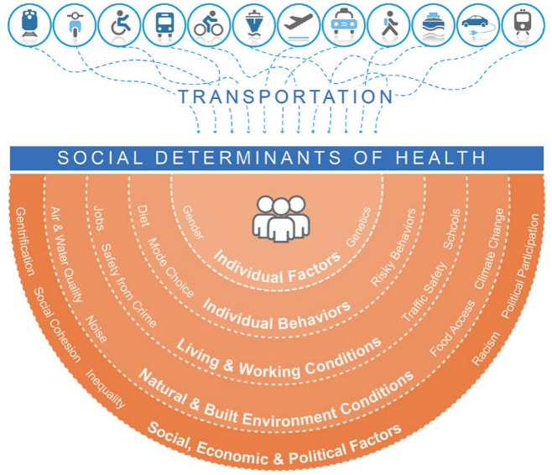
Sustainability and Public Health
MnDOT – OSPH Work Plan Development
Summer 2019

Slide 2
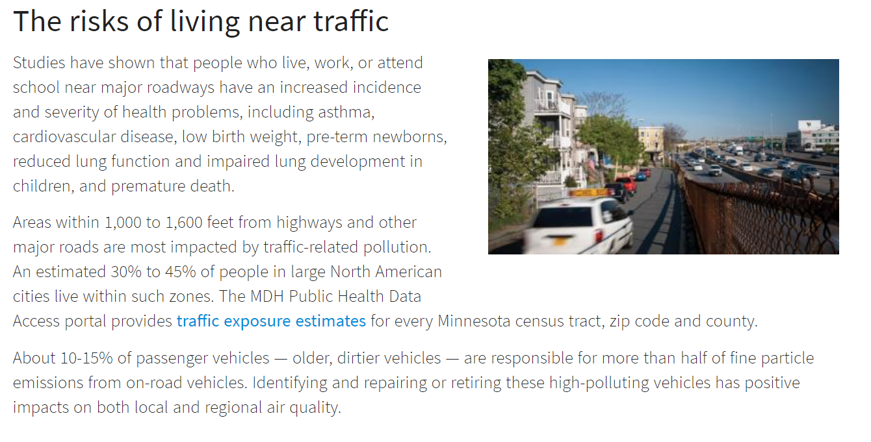
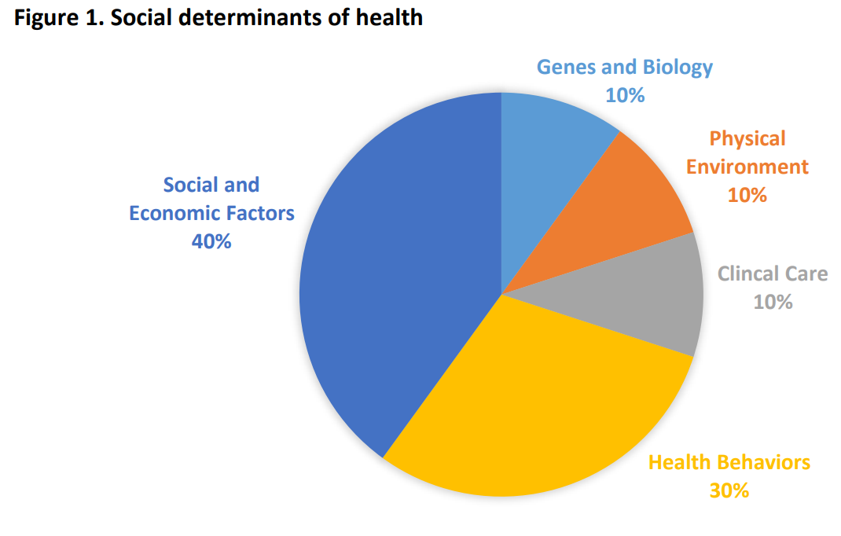
MPCA: Life and Breath Report
5-10% of all residents who died, and 1-5% of hospital or emergency room visits for heart and lung problems, was partly because of fine particles in the air or ground-level ozone.
2,000 to 4,000 deaths, 500 additional hospital stays, and 800 emergency room visits.

Slide 3
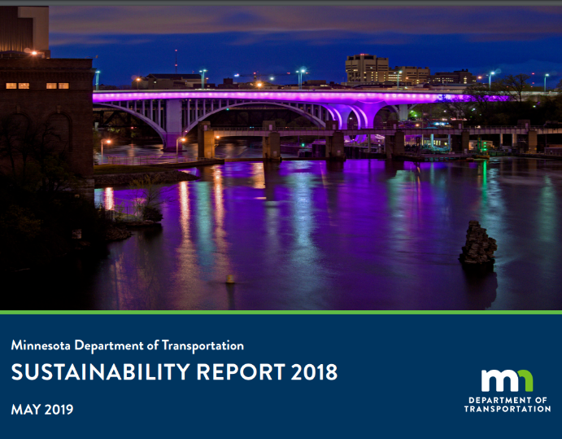
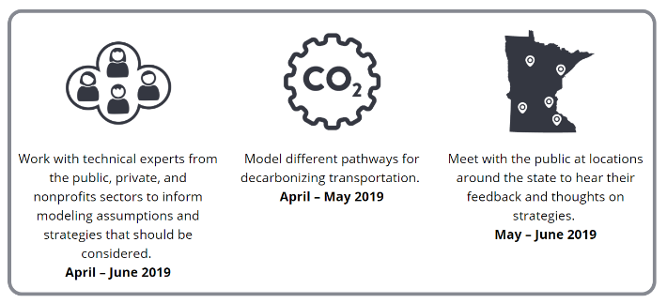
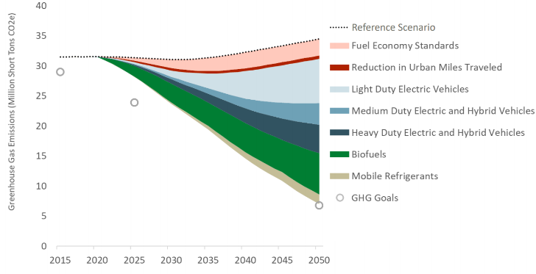
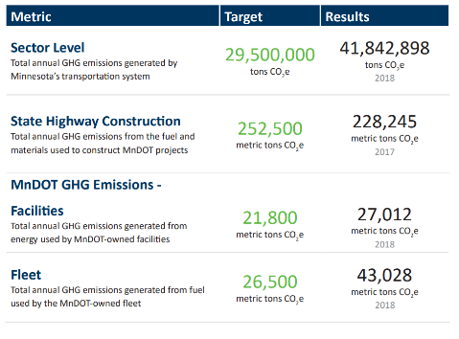
MnDOT Sustainability
Notes:
Agency Sustainability
Transportation Sector GHG reduction
Transportation system resilience

Slide 4
Health and Transportation - FHWA
FHWA Health and Transportation Strategies
1 | Built environment strategies to deter crime | 9 | Graduated driver licensing systems | 17 | In-vehicle monitoring and feedback
2 | Child Passenger Safety laws, child safety seat distribution programs, education and enhanced enforcement | 10 | Health impact assessment (HIA) | 18 | Multimodal access to public transportation
3 | Clean freight | 11 | Health performance metrics | 19 | Promote connectivity
4 | Complete Streets | 12 | High-occupancy vehicle lanes | 20 | Ride sharing programs
5 | Distracted driving | 13 | Impaired driving laws | 21 | Rural public transportation systems
6 | Encourage and promote safe bicycling and walking | 14 | Improve roadway safety | 22 | Safe Routes to School programs
7 | Expand bicycle and pedestrian infrastructure | 15 | Improve vehicles and fuels | 23 | Seat belt laws
8 | Expand public transportation | 16 | Integrate health and transportation planning | 24 | Strengthen helmet laws
 |  |  |  | 25 | Traffic calming to slow vehicle speeds
Notes:
https://www.transportation.gov/mission/health/strategies-interventions-policies

Slide 5
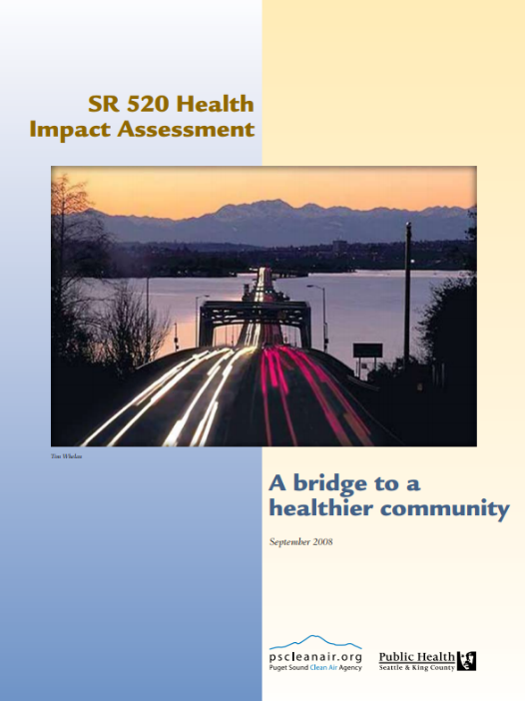
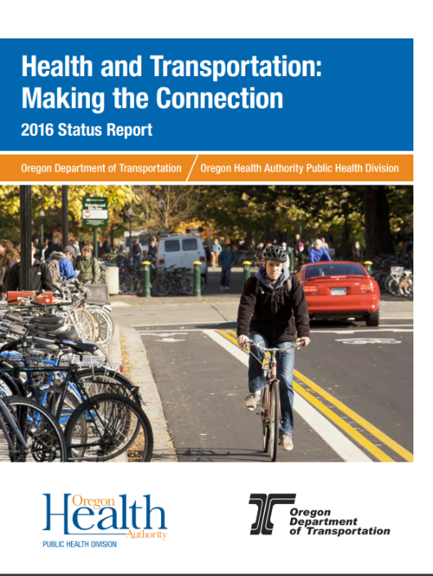
Health and Transportation – Other States
Notes:
WSDOT:
HIA for major bridge project
ODOT:
Disaster preparedness
Equity and equitable impacts of transportation; e.g., communities of color have greater reliance on transit, walking, biking
Active transportation in general, including safe routes
How the agencies work together through advisory committees, convenings, etc.
Climate adaptation and resilience
Traditional safety measures like crashes
https://www.oregon.gov/ODOT/Programs/TDD%20Documents/Health-and-Transportation-2016-Status-Report.pdf

Slide 6
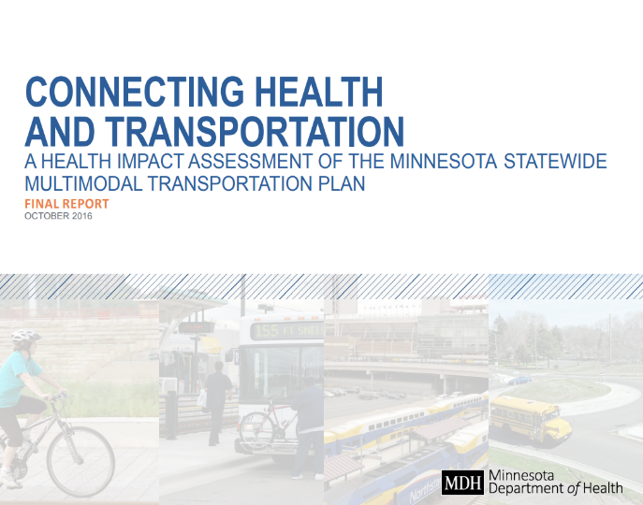
Health and Transportation - MnDOT
https://www.health.state.mn.us/communities/environment/hia/docs/mndothiafinalreport.pdf
While medicine and health care have received the most attention (and investment), they only contribute a small part to our health status. Other factors, such as our social and physical environments, play a greater role in shaping our health.
Notes:
HIA Focus Areas
Transportation Safety: focuses on safeguarding transportation users and the communities that the systems travel through, along with fostering a culture of transportation safety in Minnesota;
Healthy Communities: examines fiscally responsible decision making that respects and complements the natural, cultural, social and economic context; and
Critical Connections: addresses how to maintain and improve multimodal transportation connections to help achieve progress in meeting performance measures and to maximize social, economic and environmental benefits.
Goals of the HIA
Participate in the SMTP work groups.
Assess selected objectives and strategies for connections to health.
Provide recommendations to maximize health benefits and minimize health risks.
Demonstrate the value and feasibility of a HiAP approach.
Build capacity among MnDOT staff to conduct and use HIA findings.

Slide 7
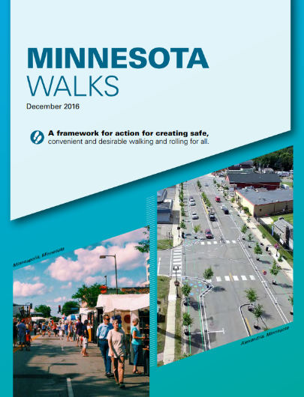
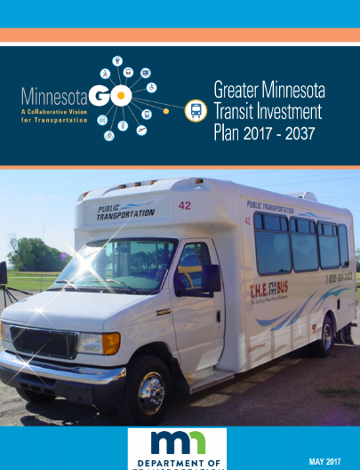
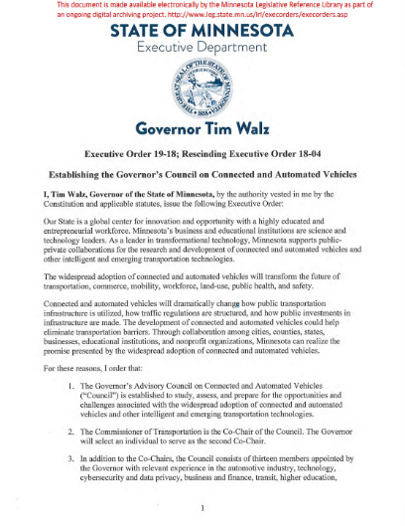

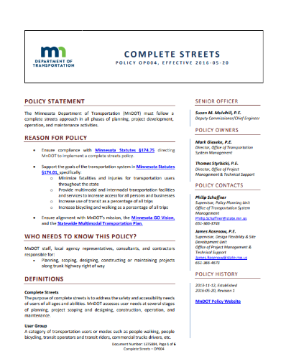
Health and Transportation - MnDOT
Notes:
The widespread adoption of connected and automated vehicles will transform the future of transportation, commerce, mobility, workforce, land-use, public health, and safety.
We also take about “Healthy Communities” in Minnesota GO/SMTP

Slide 8
OSPH Work Plan
OSPH engagement – Summer 2019
  MnDOT staff
  External stakeholders
OSPH work plan – Fall 2019
  Based on feedback, develop work plan for public health, including strategies and specific actions by Nov 1, 2019.

Slide 9
OSPH Outreach
Transit & Active Transportation (OTAT) | Project Management & Technology Support (OPTMS) | Public Engagement & Constituent Services (PECS) | Management Groups (Planning, Pre-Construction, Construction, and Operations)
Transportation Systems Management (OTSM) | Construction & Innovative Contracting (OCIC) | Office of Civil Rights (OCR) | District Engineers
State Aid (feedback on Counties) | Enterprise Sustainability (OES) | I-94 Project/Reconnecting Rondo | Connected & Automated Vehicles (CAVx)
Senior Leadership Team (SLT) | MnDOT Library - Survey | Administration Division | Organizational Planning and Management (OPM)
Government Affairs, includes Tribal Liaison | Traffic Engineering (OTE)
External Stakeholders
FHWA | MDH | MPCA | EQB
Met Council/Metro Transit | U of M; CTS/Humphrey | Regional Development Commissions | Tribal Governments
Mpls – Green Zones, Transportation Planning | St. Paul | Duluth | Rochester
Albert Lea | Mankato | Nordic countries/partners | Move MN (TMO)
Federal Transit Authority | MPOs | American Heart and/or Lung Association

Slide 10
Contact Information
Office of Sustainability and Public Health
Jeffrey Meek
jeffrey.meek@state.mn.us
651-366-4263
www.dot.state.mn.us/sustainability

Slide 11
Outreach Questions
What comes to mind when you think about people’s health and transportation?

Slide 12
Outreach Questions
How does transportation affect public health (positively or negatively) for people?

Slide 13
Outreach Questions
What would a transportation system that supports/promotes public health look like to you?

Slide 14
Outreach Questions
Are there things that MnDOT is already doing to support public health and healthy communities?

Slide 15
Outreach Questions
What work does your organization do that MnDOT can learn from?

Slide 16
Outreach Questions
Do you see opportunities for you/your office to promote public health and healthy communities?

Slide 17
Outreach Questions
What can our office do to add value/better promote healthier people and healthier communities?

Slide 18
Outreach Questions
What would be measures of success for how transportation supports and promotes public health?

