Slide 1

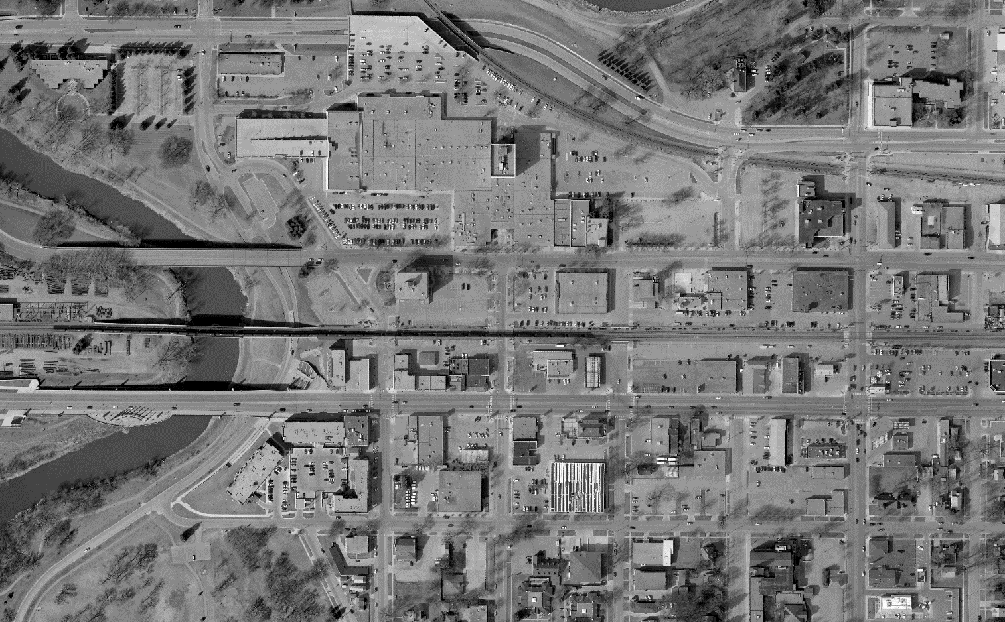


Center Avenue
Red River to 8th Street
Report on the
Planning & Preliminary Engineering Study
2019 Minnesota MPO Summer Workshop
August 28, 2018
Notes:
Welcome & Introductions – Jon

Slide 2
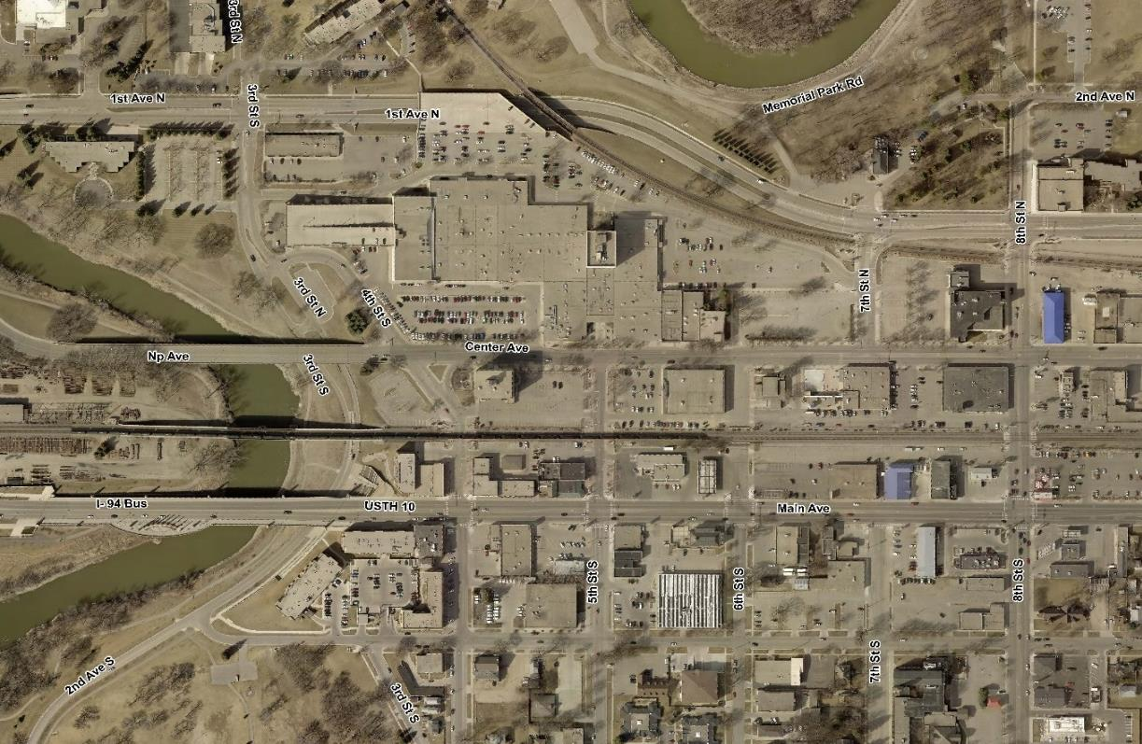
Project Location
Red River
TO
8th Street
Notes:
Jon

Slide 3
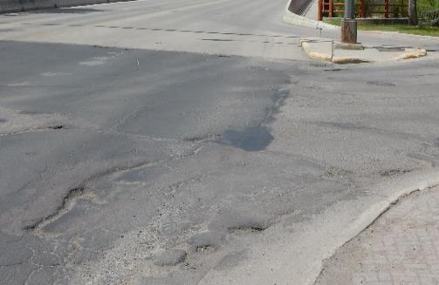
Needs Assessment
Driving the Project’s Need
Poor Pavement Condition
High crash rates along the corridor
High volume of access points with limited left turn lanes
Lack of designated east-west bicycle facilities
Sight distance issues for some accesses
Roadway alignment shifts
Center Ave & 4th Street
Notes:
Jon

Slide 4
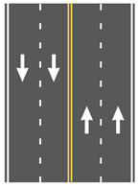
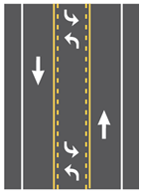
Alternative Development
WHAT IS RIGHT FOR CENTER AVENUE?
Developed 4 Base Alternatives
All Alternatives fix project need for existing pavement issues
Alternatives respond to needs assessment
4-Lane
3-Lane
Notes:
Peggy

Slide 5
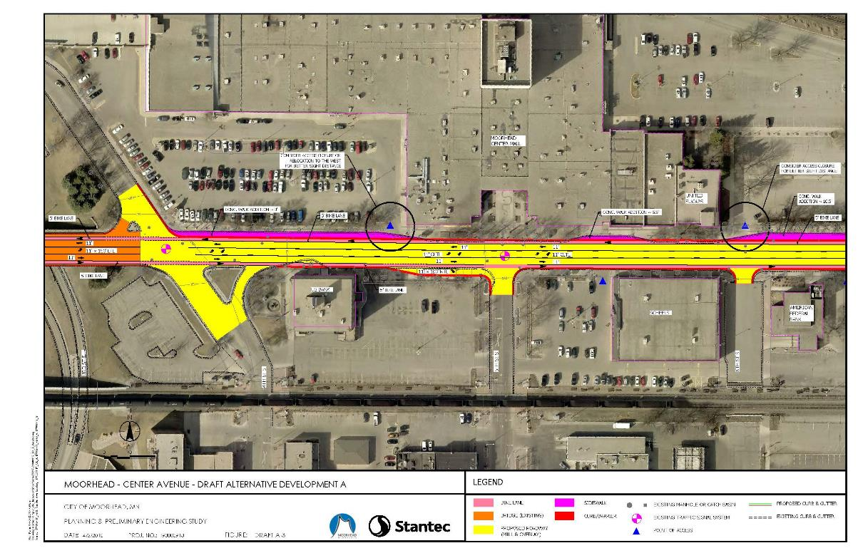
Alternative A
Mill & Overlay + 3-Lane Section +
Designated Bike Lanes
Notes:
Peggy

Slide 6

Alternative A
Mill & Overlay + 3-Lane Section +
Designated Bike Lanes
Alternative Improvements | Issued Addressed/Impacts
Mill & Overlay | Fixes pavement deficiencies
Roadway Section (3-Lanes) | Serves 2040 traffic volumes Eliminates alignment shifts Estimated corridor crash reduction of 24% Removes 4 Trees
Bike Facilities Across Bridge | Creates bike connection across bridge
Bike Facilities Along Center Ave | Provides on-street dedicated bicycle facilities
Transit | Removes transit pullout per request Maintains existing transit routes Creates vehicle delays when bus is stopped
Removal of 7th Street Signal | Allows coordination between signals Signal is not warranted
Pedestrians | Removes conflict between bikes and peds Improves ADA compliance
Access | Options to do nothing, relocate or close accesses
Parking | No Changes
Preliminary Cost | $975,000
Notes:
Peggy

Slide 7
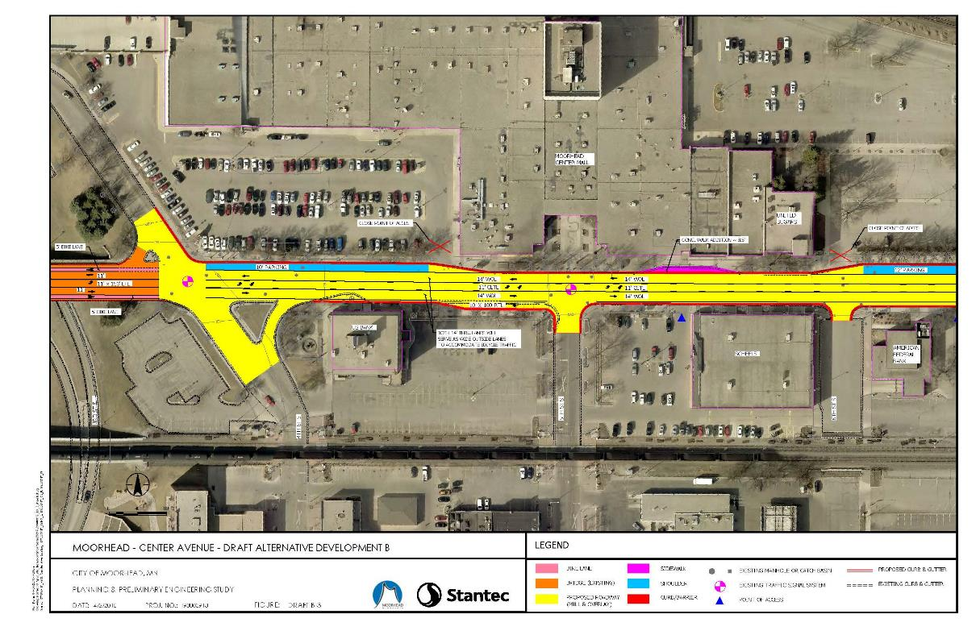
Alternative B
Mill & Overlay + 3-Lane Section +
On-Street Parking/Wide Outside Lanes
Notes:
Peggy

Slide 8

Alternative B
Mill & Overlay + 3-Lane Section +
On-Street Parking/Wide Outside Lanes
Alternative Improvements | Issued Addressed/Impacts
Mill & Overlay | Fixes pavement deficiencies
Roadway Section (3-Lanes) | Serves 2040 traffic volumes Eliminates alignment shifts Estimated corridor crash reduction of 24% Removes 4 trees
Bike Facilities Across Center Bridge | Creates bike connection across bridge
Bike Facilities Along Center Ave | Provides wide outside lane for bicycles
Transit | Removes transit pullout per request Maintains existing transit routes Creates vehicle delays when bus is stopped
Removal of 7th Street Signal | Allows coordination between signals Signal is not warranted
Pedestrians | Removes conflict between bikes and peds Improves ADA compliance
Access | Options to do nothing, relocate or close accesses
Parking | Adds on-street parking
Preliminary Cost | $816,000
Notes:
Peggy

Slide 9
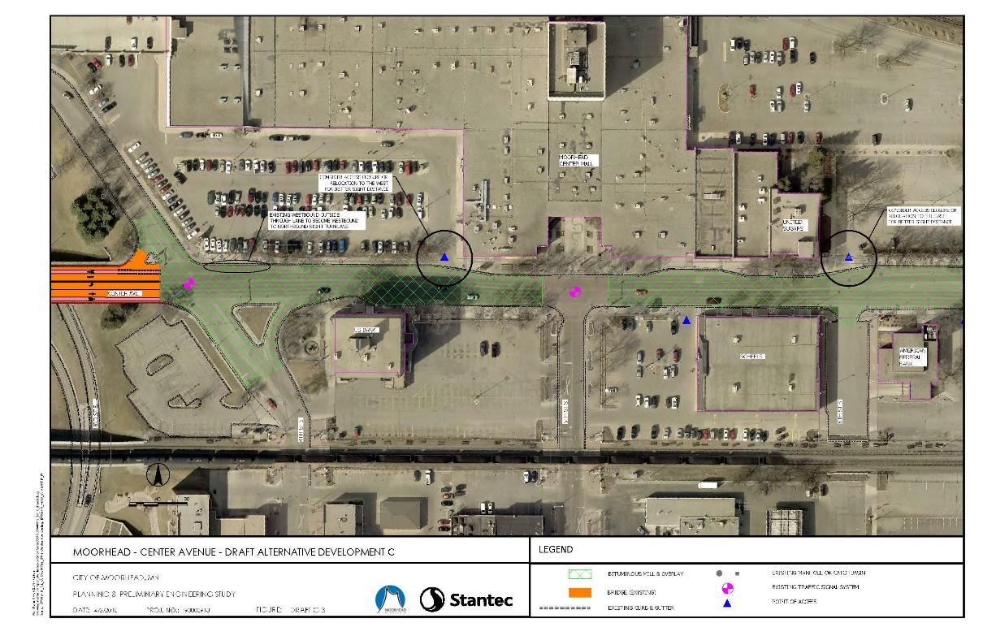
Alternative C
Mill & Overlay +
Re-stripe to Existing Lane Configuration
Notes:
Peggy

Slide 10
Alternative C
Mill & Overlay +
Re-stripe to Existing Lane Configuration
Alternative Improvements | Issued Addressed/Impacts
Mill & Overlay | Fixes pavement deficiencies
Roadway Section (4-Lanes) | Serves 2040 traffic volumes No corridor crash reduction
Bike Facilities Across Bridge | Creates bike connection across bridge
Bike Facilities Along Center Ave | No Changes
Transit | Maintains existing transit routes
Removal of 7th Street Signal | Allows coordination between signals Signal is not warranted
Pedestrians | No Changes
Access | No Changes
Parking | No Changes
Preliminary Cost | $556,000
Notes:
Peggy

Slide 11
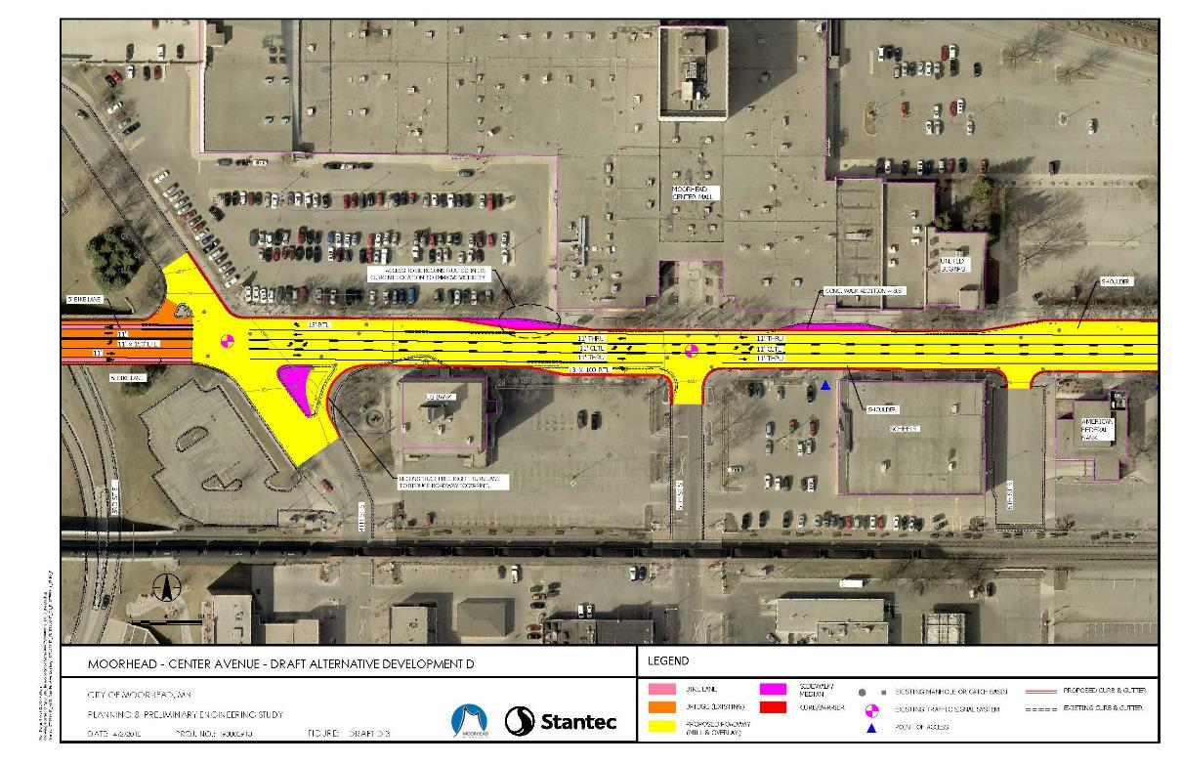
Alternative D
Mill & Overlay + 3-Lane Section + Roadway Shoulders
Notes:
Peggy

Slide 12
Alternative D
Mill & Overlay + 3-Lane Section + Roadway Shoulders
Alternative Improvements | Issued Addressed/Impacts
Mill & Overlay | Fixes pavement deficiencies
Roadway Section (3-Lanes) | Serves 2040 traffic volumes Eliminates alignment shifts Estimated corridor crash reduction of 24% Removes 4 trees
Bike Facilities Across Bridge | Creates bike connection across bridge
Bike Facilities Along Center Ave | No Changes
Transit | Removes transit pullout per request Maintains existing transit routes Creates vehicle delays when bus is stopped
Removal of 7th Street Signal | Allows coordination between signals Signal is not warranted
Pedestrians | Sidewalk improvements Improves ADA compliance
Access | Consideration to Reconstruct Thai Orchid Access in its Current Location
Parking | No Changes
Preliminary Cost | $948,000
Notes:
Peggy

Slide 13
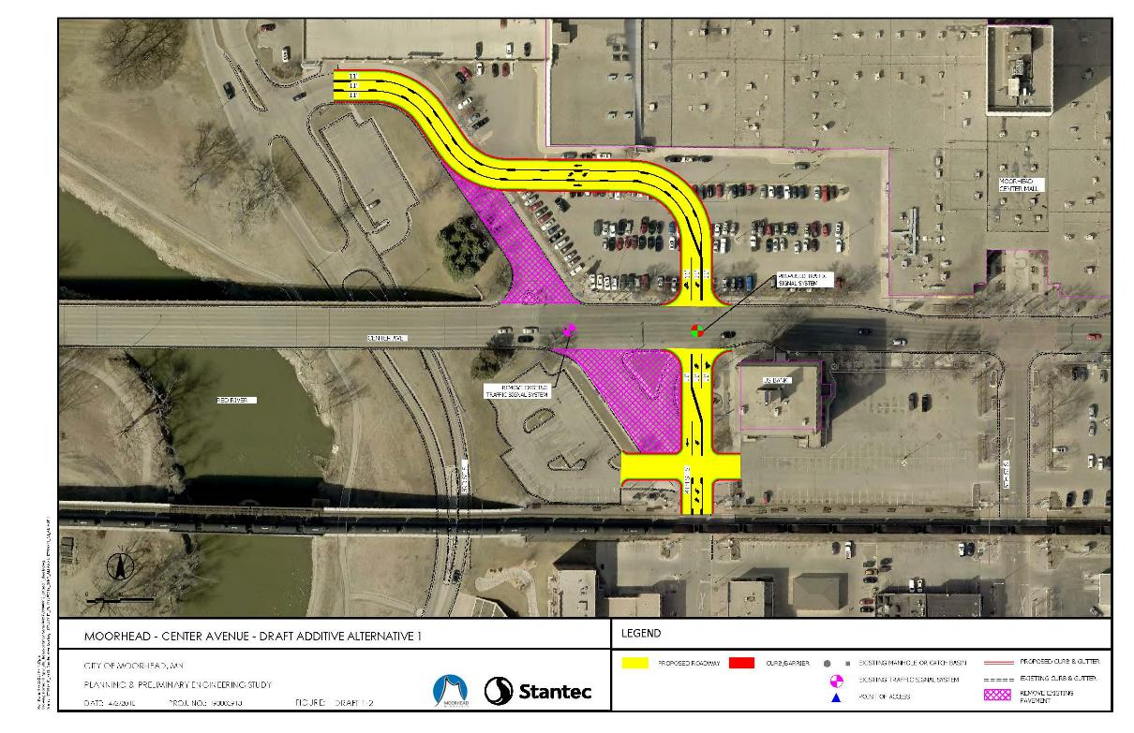
Additive Alternative 1
4th Street Realignment
Alternative Improvements | Issued Addressed/Impacts
Transit | Maintains existing transit routes
Access | Changes the 4th Street intersection and mall accesses
Preliminary Cost | $774,000
Notes:
Peggy

Slide 14
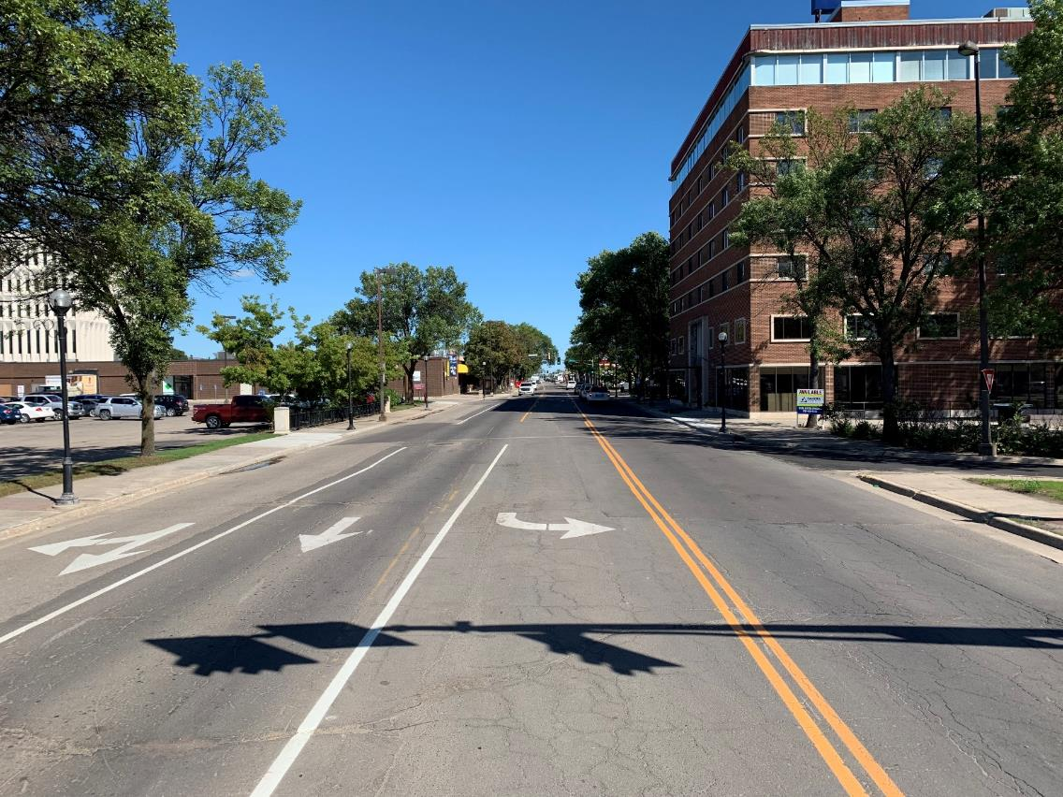
Public Education:
Road Diet Facts & Myth Busters
Notes:
Road Diet Info – All Peggy’s slides
Jon add photo of Center Avenue as a 3-lane

Slide 15
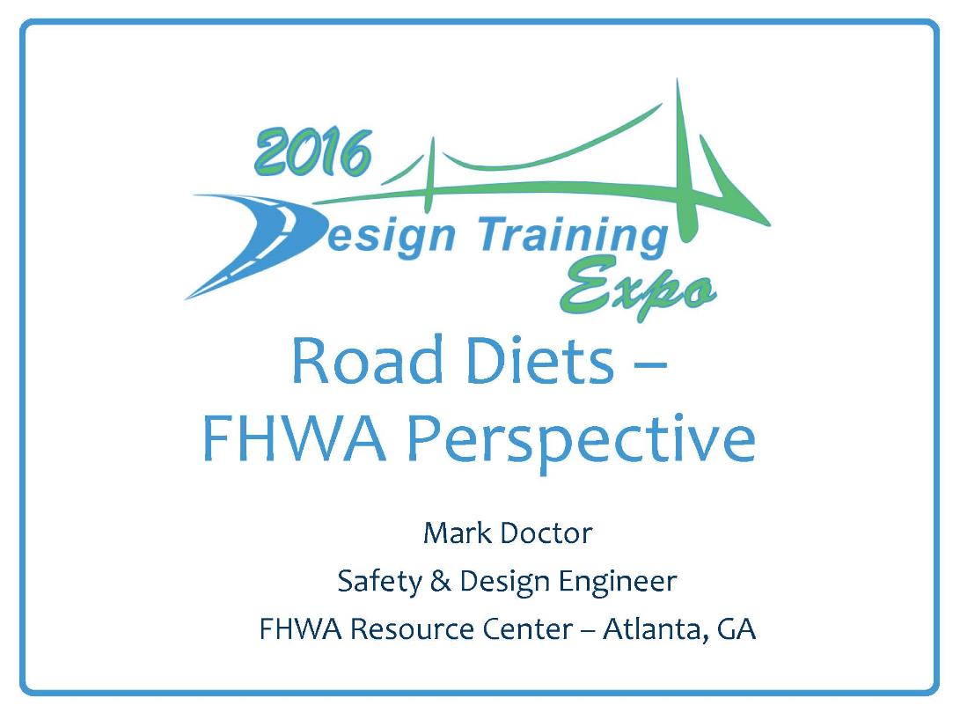


Slide 16
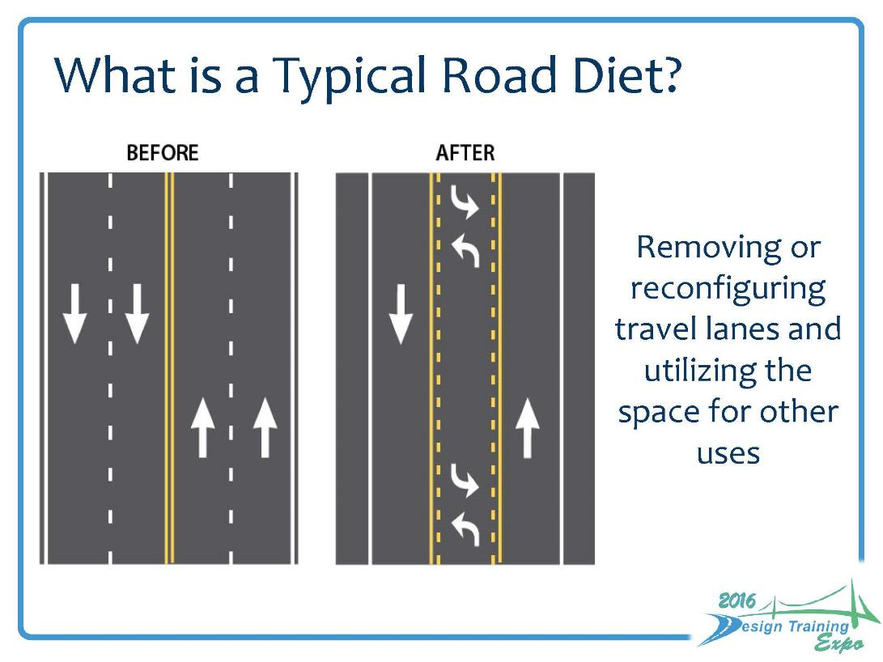

Slide 17
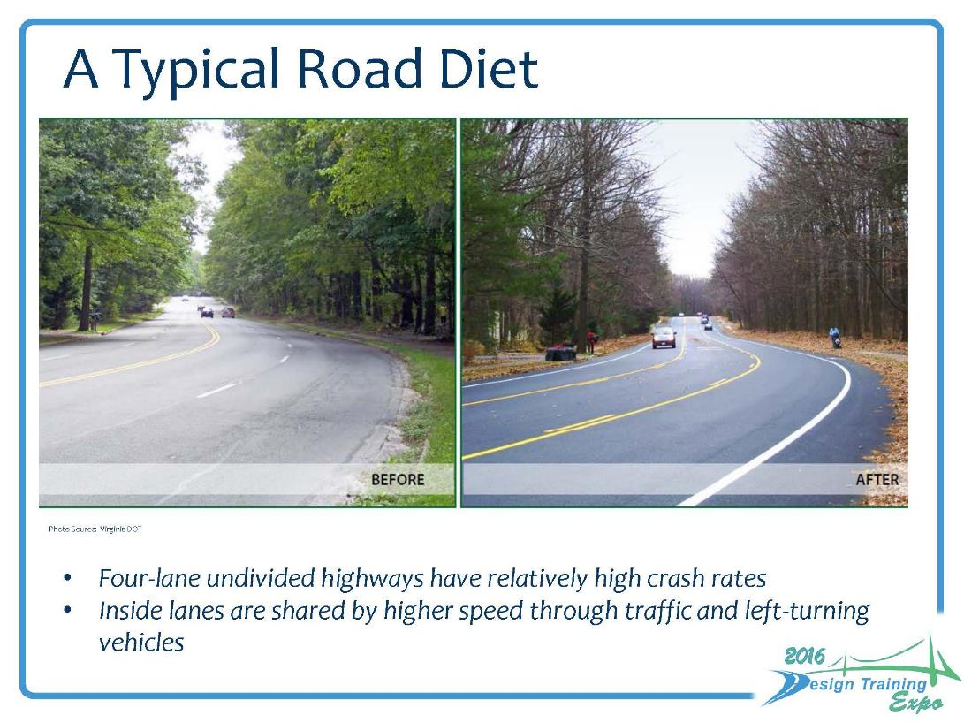

Slide 18
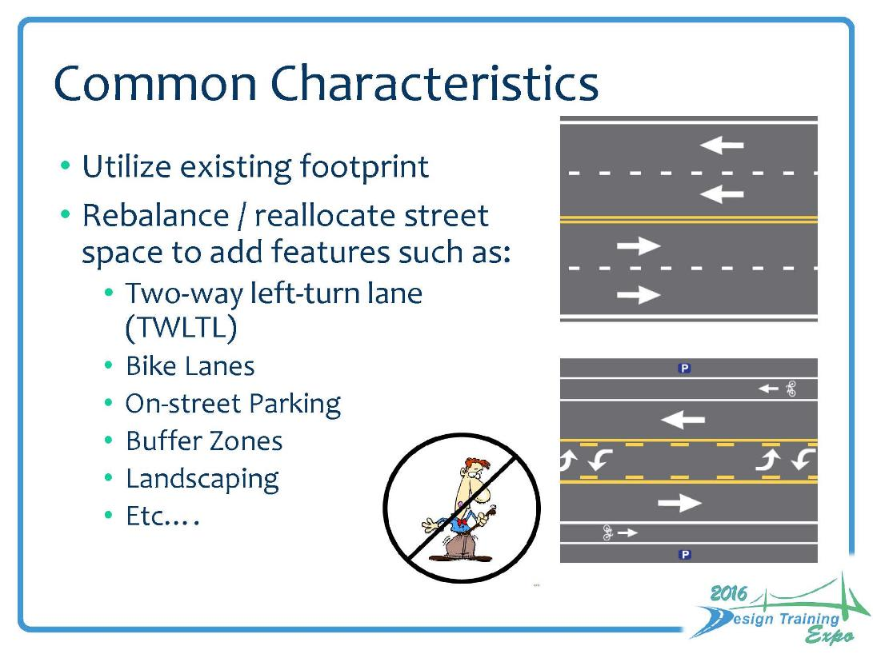

Slide 19
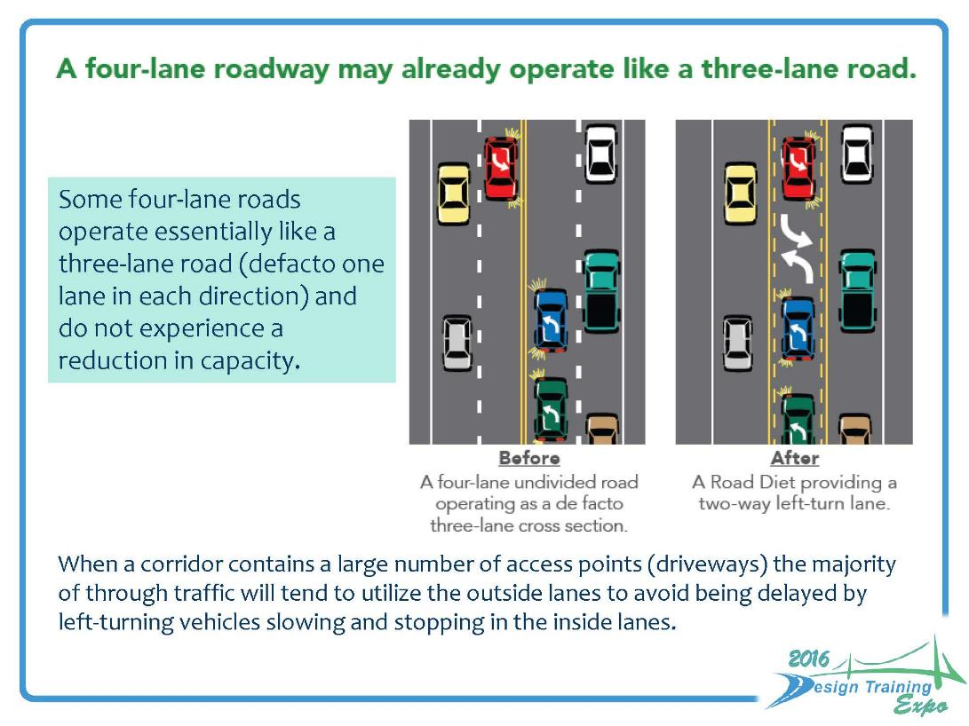

Slide 20
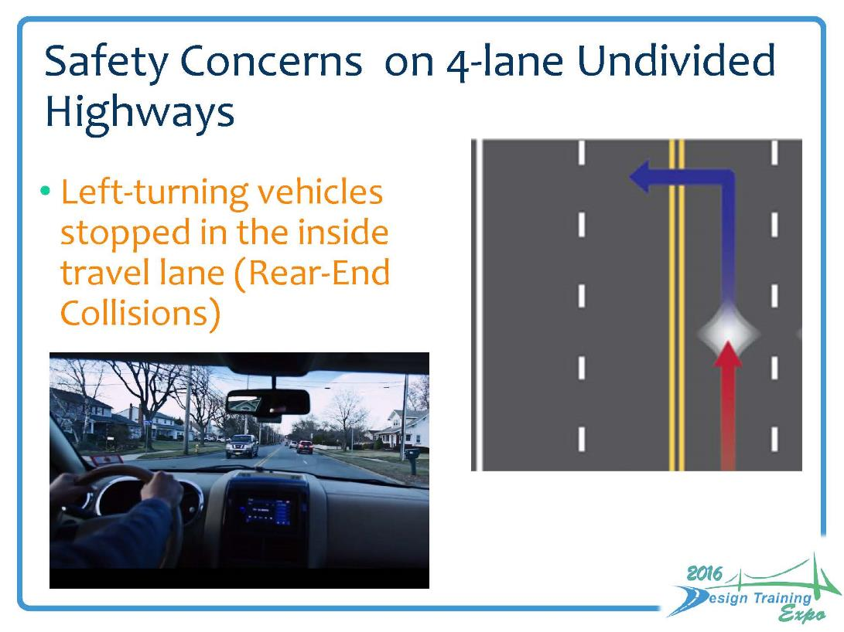

Slide 21
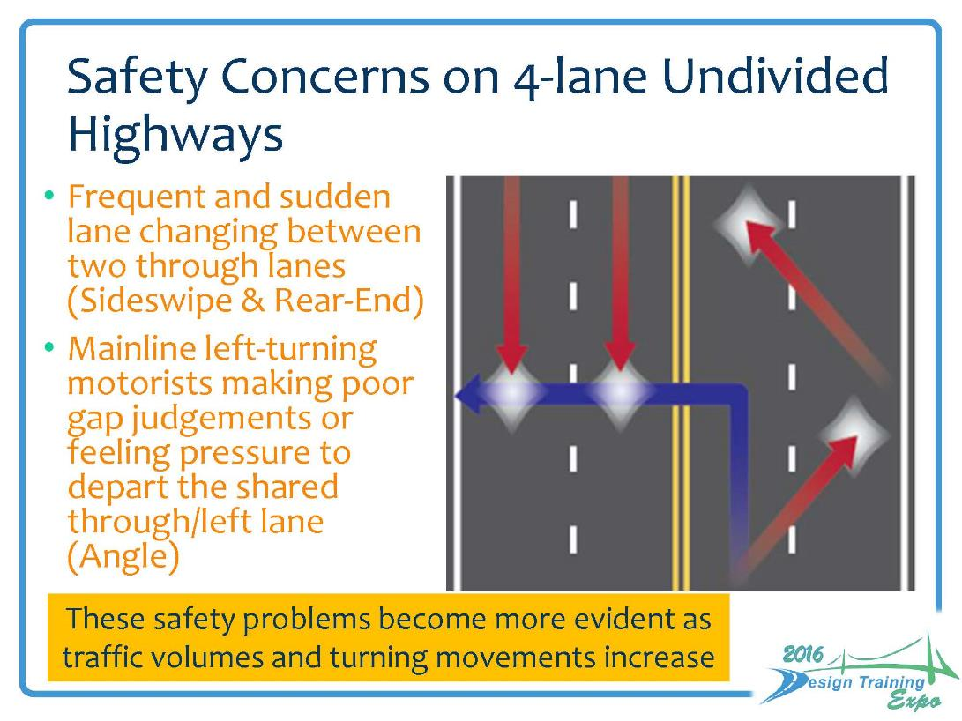

Slide 22
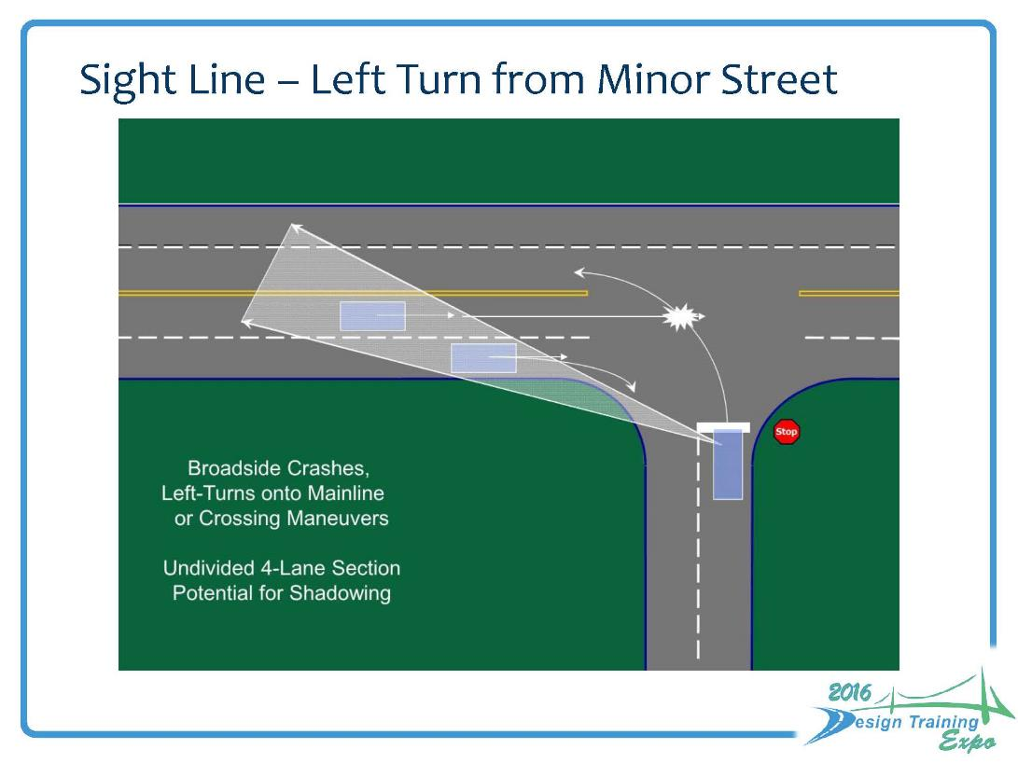

Slide 23
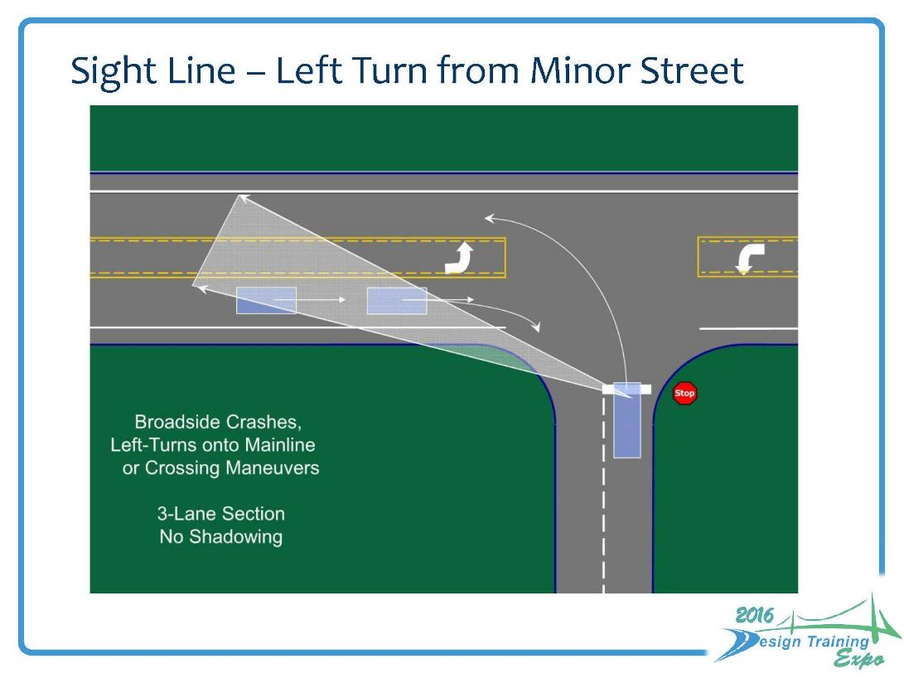

Slide 24
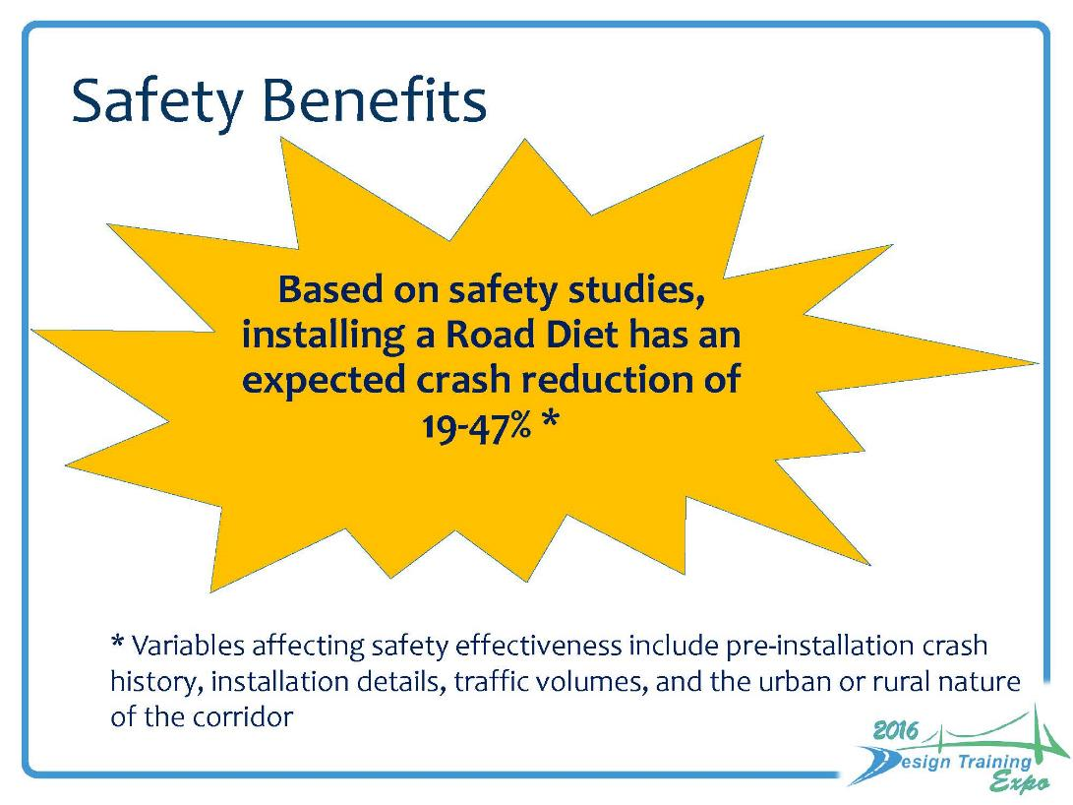

Slide 25
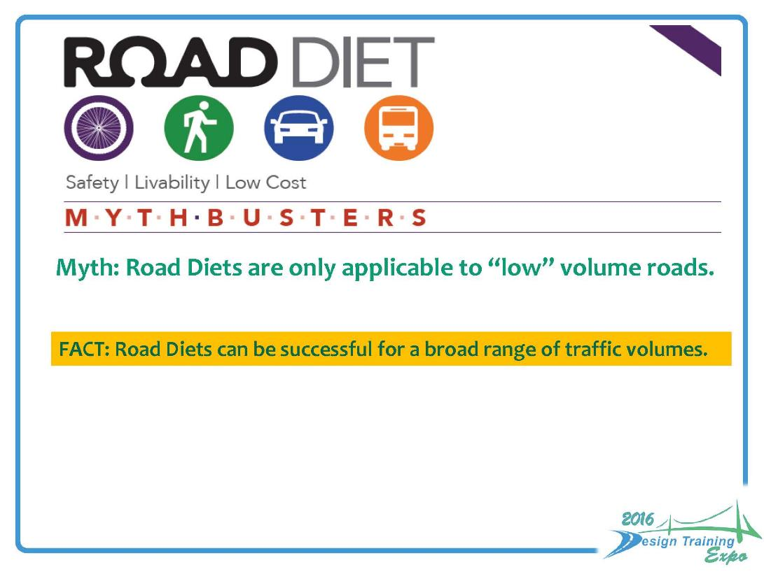

Slide 26
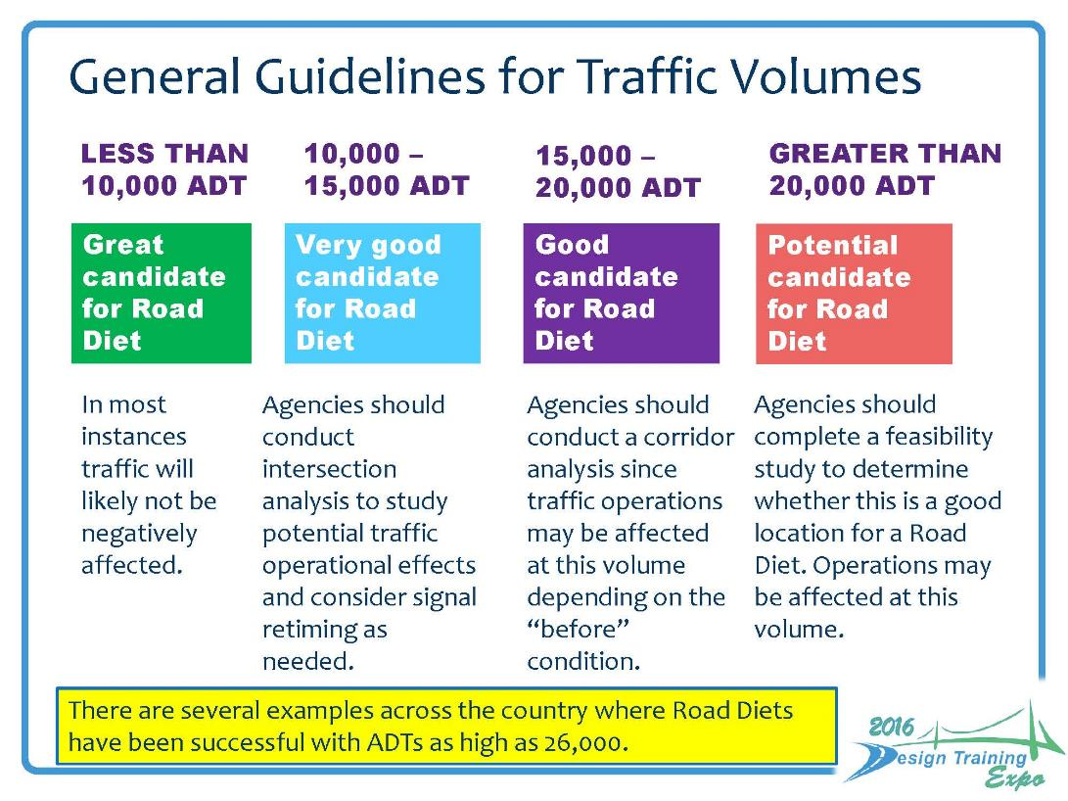

Slide 27
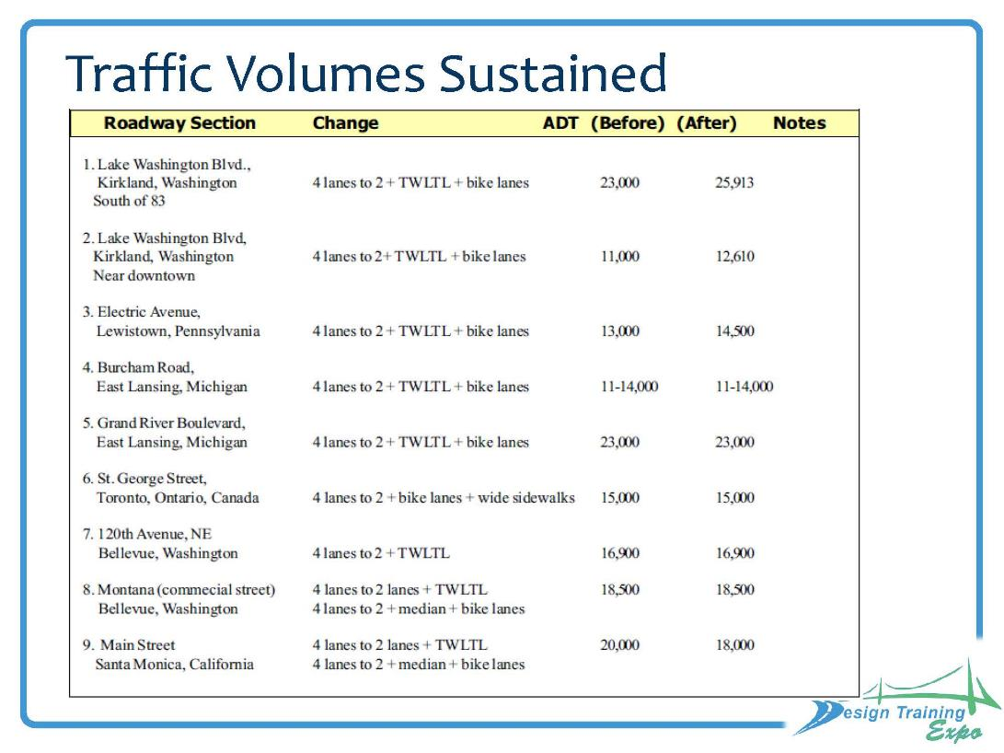

Slide 28
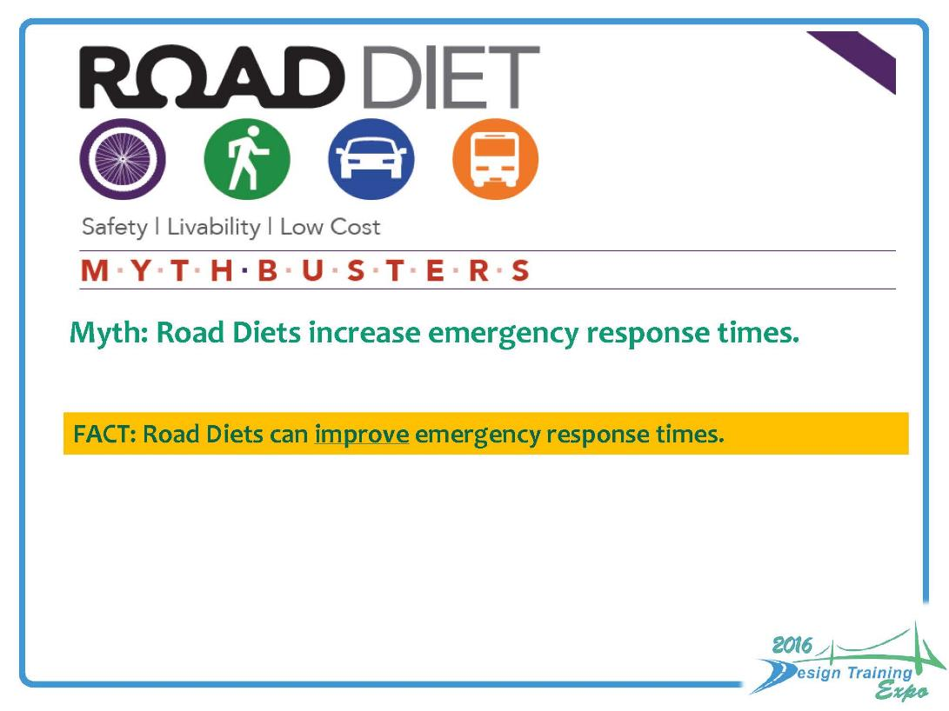

Slide 29
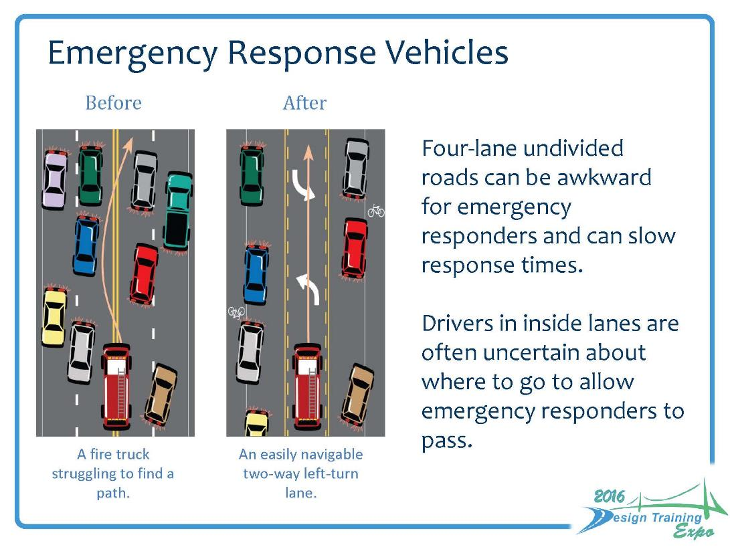

Slide 30
Existing Traffic Operations Analysis (2018)
Notes:
Jon

Slide 31
Forecast Traffic Operations Analysis (2040)
Notes:
Jon

Slide 32
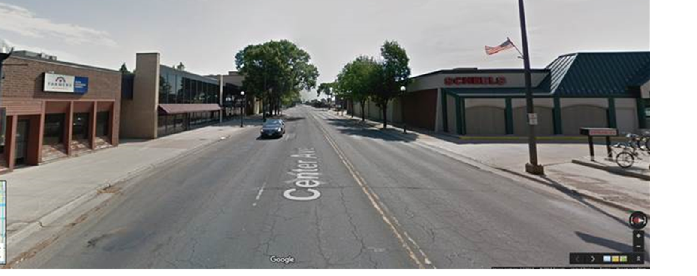
Landscape Opportunities
Notes:
Peggy

Slide 33
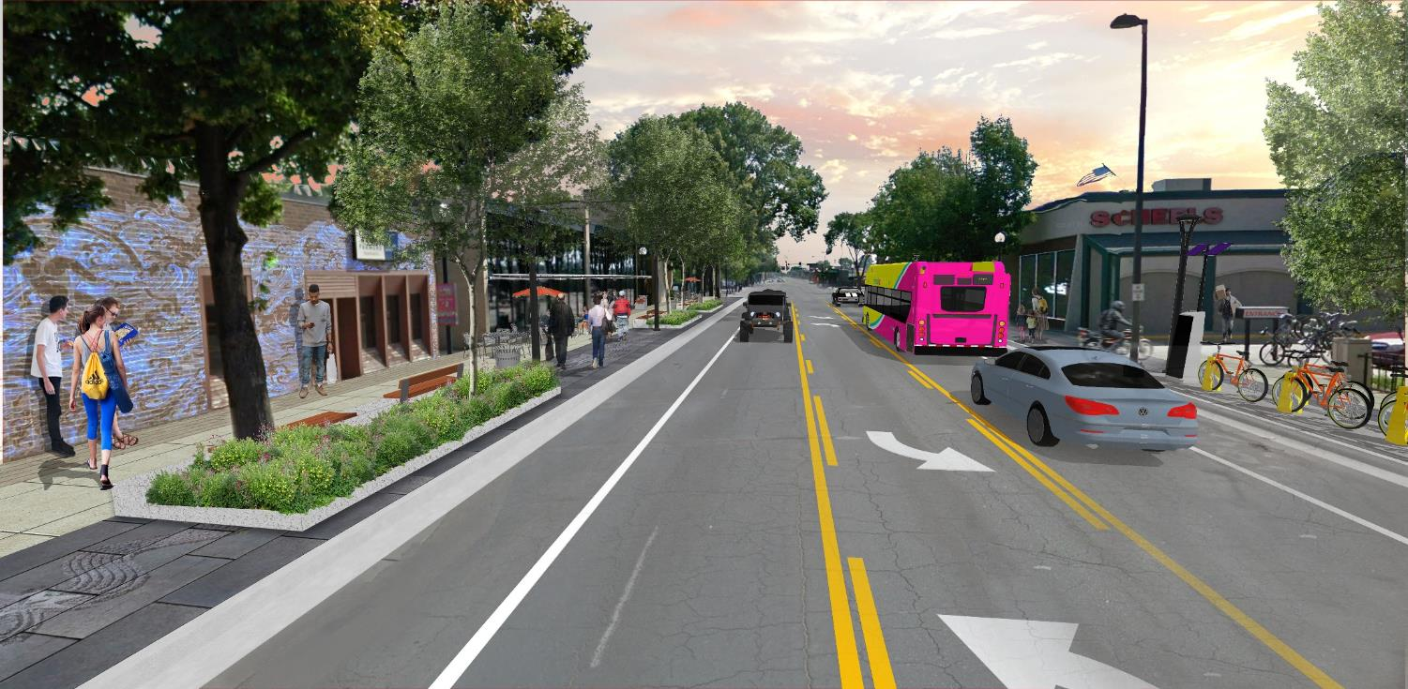
Landscape Opportunities
Notes:
Peggy

Slide 34
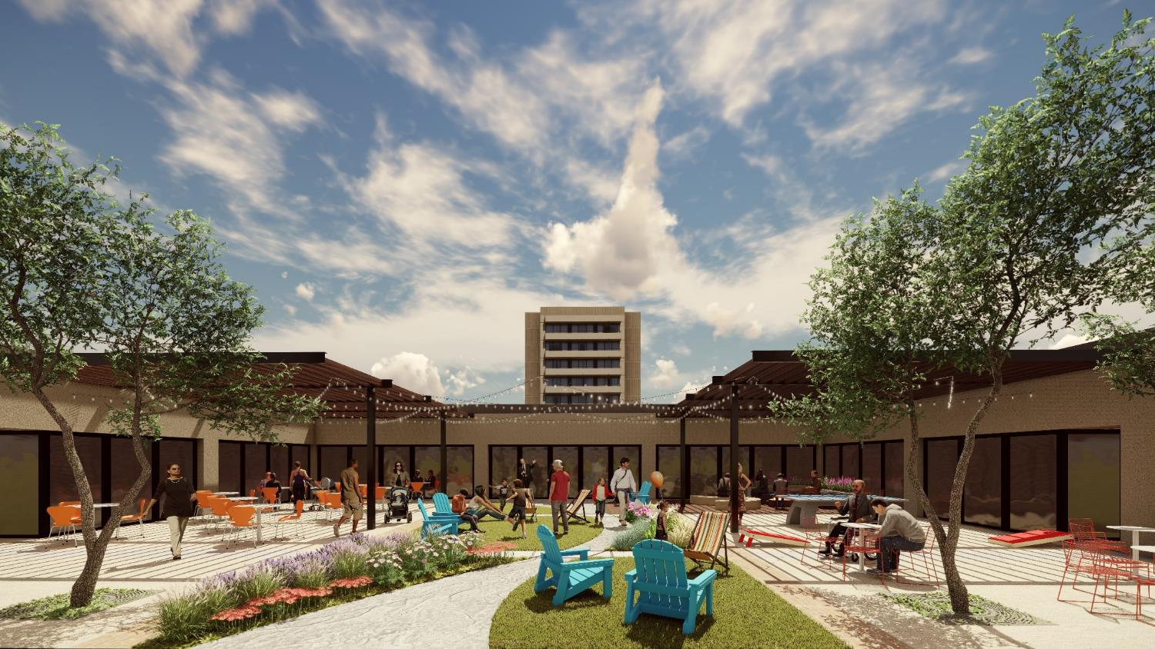
Landscape Opportunities
Notes:
Peggy

Slide 35
Options Chosen
Option D was the recommended option from staff.
  On street bike lanes favored by bicycle community and City staff.
  Existing surface parking didn’t show the need for on-street parking.
Option B was chosen by Council
  Wide outside lanes are a dedicated bicycle facility that also connect the proposed bike lanes across the bridge to 7th Street. Second favorite of bicycle community.
  Strong support from local business for on-street parking while still providing dedicated bicycle facilities.
  Local business wanted on street parking to allow for future development opportunities in existing surface lots. On-street parking promotes the “downtown feel.”
Notes:
Please word smith. Peggy & Jon

Slide 36
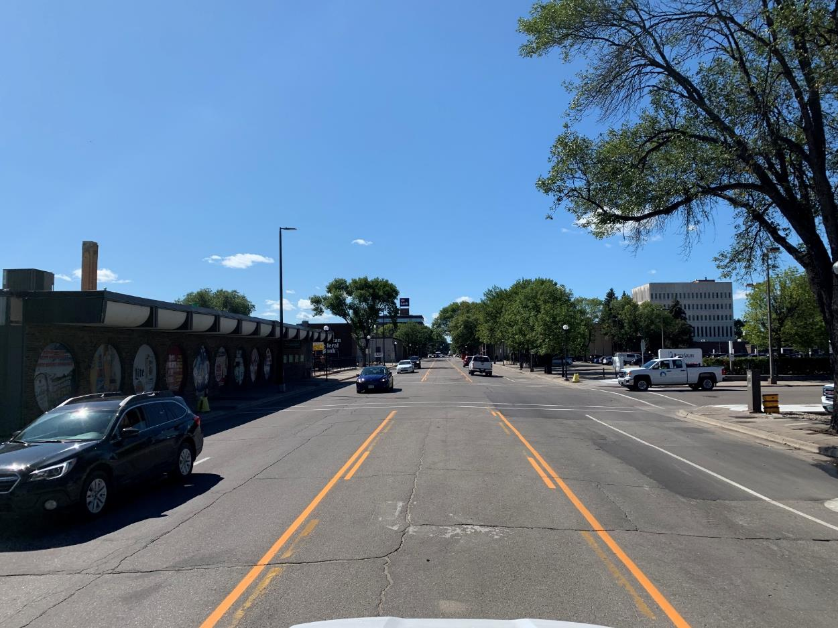
Questions or Comments?
Notes:
Add a background photo.

