Slide 1
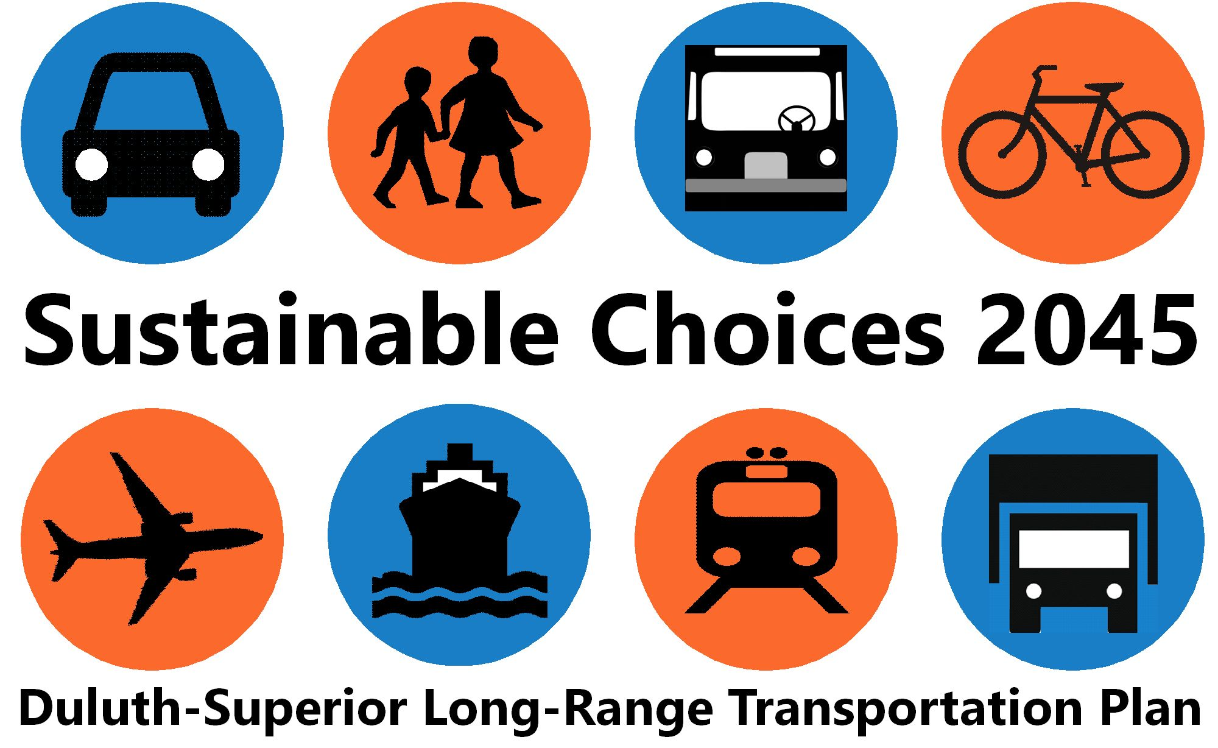

Minnesota MPO Conference
August 28, 2019

Slide 2
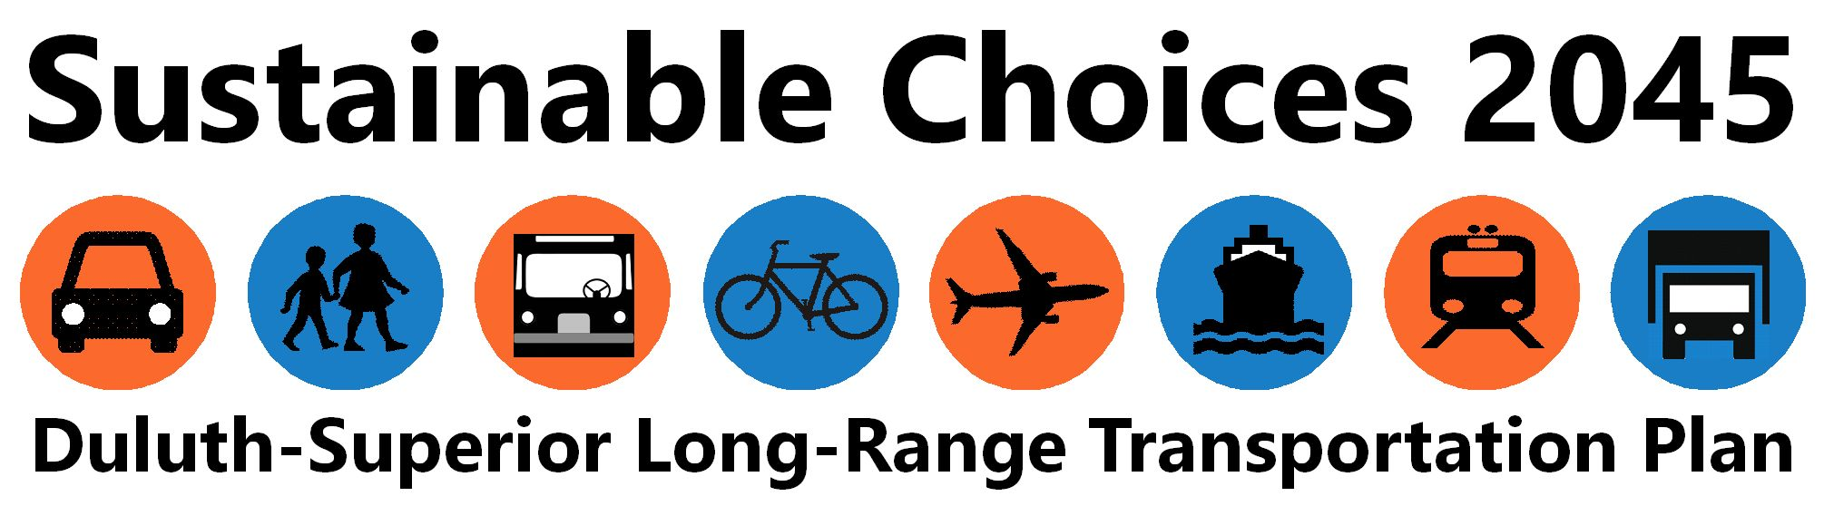
A New Framework for the MIC’s Long Range Transportation Plan
Minnesota MPO Conference
August 28, 2019

Slide 3
outline
Brief Background
Key Current Conditions
A New Direction
Moving Forward

Slide 4
Brief Background

Slide 5
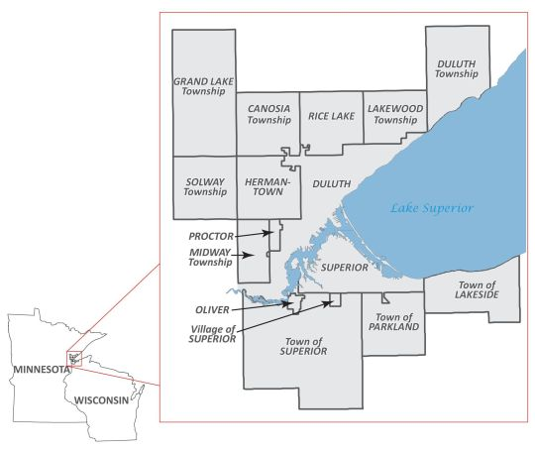
What is the MIC?
Metropolitan Interstate Council
Metropolitan Planning Organization (MPO) for the Duluth-Superior area
Federally designated
641 square mile area

Slide 6
Setting the Stage
Key Current conditions

Slide 7
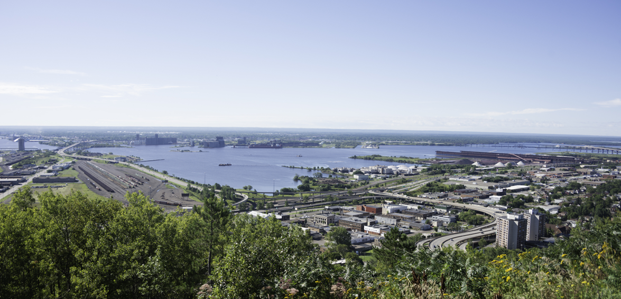
Our Many Transportation Assets
Bridge
Shipping Channel
Rail
Bridge
Interstate/Interchange
Roads
Transit Facilities
Sidewalks

Slide 8
Infrastructure Costs Continue to Rise
“… highway construction costs rose 66% between 2003 and 2016.” *
* = Long, Elliott. 2017. Soaring Construction Costs Threaten Infrastructure Push. Progressive Policy Institute, Washington DC. 13 pp
Notes:
The overall purpose of transportation planning is to improve the movement of people and goods to their destinations., therefore the MIC’s LRTP provides…

Slide 9
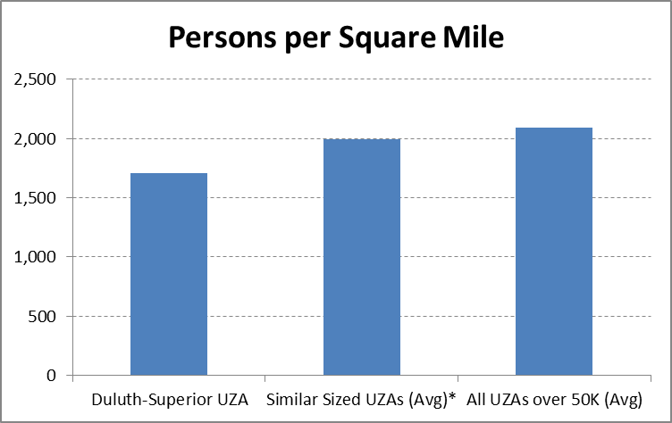
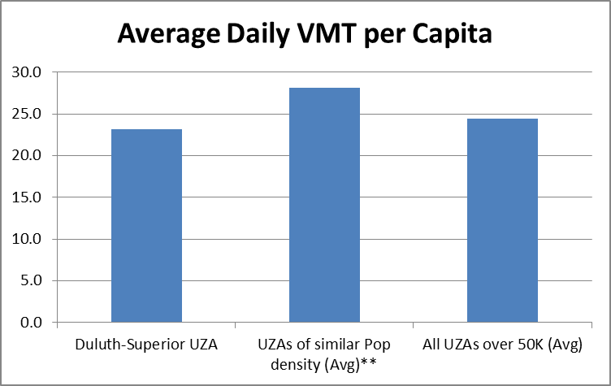
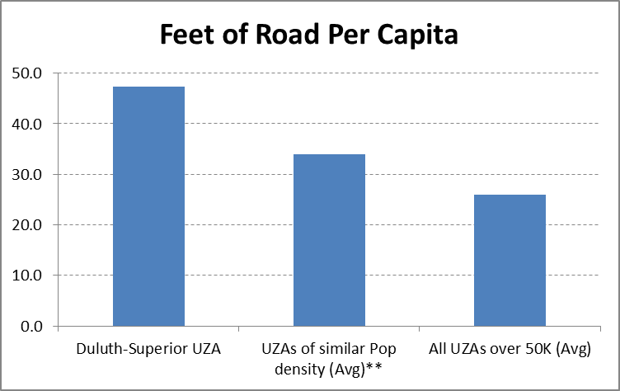
Compared to Similarly-Sized Cities We …
have fewer people,
drive less,
but have much more road.

Slide 10
We Have Limited Traffic Congestion
Majority of roads operate well below capacity
Congestion on a few corridors & intersections
Some congestion during peak hours & events
Notes:
The overall purpose of transportation planning is to improve the movement of people and goods to their destinations., therefore the MIC’s LRTP provides…

Slide 11
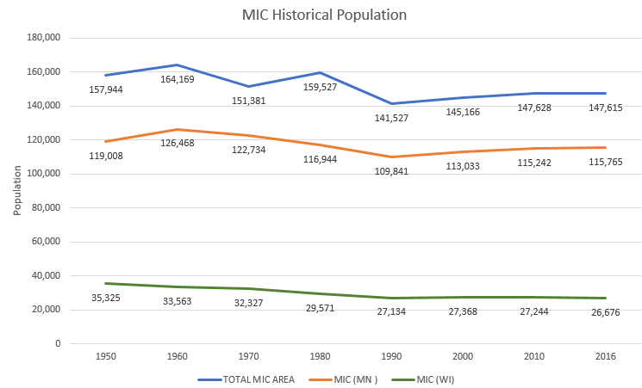
Population Not Growing
Notes:
Trend expected to continue

Slide 12
Aging Population
Notes:
Growing older
Decreasing number in the work force
Decreasing Tax Base

Slide 13
Poverty is a Real Issue & Concern
18% of the total MIC area population is below poverty

Slide 14
Summary – The Issues
Decreasing Tax Base
Sustainable Funding Problem
Likely Shift in Transportation Needs & Options

Slide 15
Bottom Line
There are many needs & wants, but limited resources.
We must make wise, sustainable choices.
Notes:
The overall purpose of transportation planning is to improve the movement of people and goods to their destinations., therefore the MIC’s LRTP provides…

Slide 16
A New Direction

Slide 17
Previous LRTP Framework
Largely framed by:
Mode
&
Federal Planning Factors (23 CFR 450.306(b))
Notes:
The overall purpose of transportation planning is to improve the movement of people and goods to their destinations., therefore the MIC’s LRTP provides…

Slide 18
New LRTP Framework
More Integrated, Holistic View
Big Picture
Notes:
The overall purpose of transportation planning is to improve the movement of people and goods to their destinations., therefore the MIC’s LRTP provides…

Slide 19
Bottom Line
There are many needs & wants, but limited resources.
We must make wise, sustainable choices.
Notes:
The overall purpose of transportation planning is to improve the movement of people and goods to their destinations., therefore the MIC’s LRTP provides…

Slide 20
Sustainable?
Financially
Socially
Environmentally

Slide 21
What does a sustainable transportation system look like?
Considers & Works for Everyone
Is Affordable
Has a Reliable Funding Source
Right Size – Not Overbuilt
Creates Wealth
Supports Economic Vitality
Safe
No Environmental Problems
Supports Livable Neighborhoods

Slide 22
Planning Perspectives
Moving People & Goods
Supporting Economic Vitality
Creating Livable & Equitable Communities
Protecting the Environment & Promoting Public Health
Improving Safety
Notes:
Our transportation system influences all of these, and should promote each of them for all people in or traveling through the Twin Ports area.

Slide 23
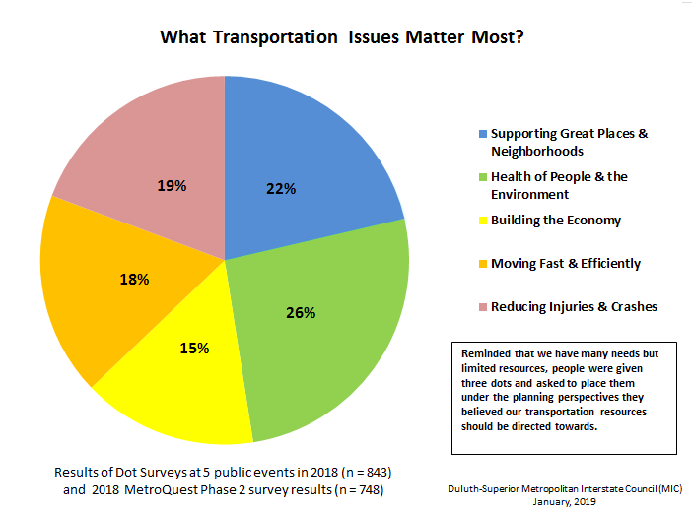
Balance Is Desired
Notes:
The overall purpose of transportation planning is to improve the movement of people and goods to their destinations., therefore the MIC’s LRTP provides…

Slide 24
Plan Goals
Based on 5 Planning Perspectives
Health of People & the Environment
Livable Communities & Equity
Safety
Moving People & Goods
Economic Vitality

Slide 25
Plan Goals
Goal 1
Promote public health and energy conservation, and protect and enhance the environment through responsible Duluth-Superior area transportation system policies and design
(3 Objectives)
Goal 2
Ensure the Duluth-Superior area transportation system supports the development and maintenance of a safe, healthy, and connected community that provides opportunities and choices for people of all ages, incomes, and abilities
(6 Objectives)
Goal 3
Ensure the safety and security of the Duluth-Superior area transportation system for all users and modes, including being prepared to handle emergencies and disasters
(6 Objectives)
Goal 4
Ensure the Duluth-Superior area transportation system is an integrated multimodal network that supports people and goods getting to where they need to go in an efficient manner
(6 Objectives)
Goal 5
Develop and maintain the Duluth-Superior area transportation system to support economic productivity and competitiveness, including tourism
(6 Objectives)

Slide 26
New LRTP Framework
Framed by:
5 Planning Perspectives/Goals (that meet the Federal Planning Factors)
&
A Continuous Implementation Strategy Approach
All Based on More Direct Public Input
Notes:
299 open comments from MQ Phase 1 page 3
909 markers and 623 comments on the MQ phase 1 interactive map
262 comments from stakeholder meetings and consultations
Nearly 1600 responses to the dot surveys
542 participants in MQ phase 1
275 participants in MQ phase 2
72 public engagements to date (committee and board meetings, consultations, stakeholder meetings, open houses, public events)

Slide 27
Increased Public Input & Involvement
72 public engagements to date (committee and board meetings, consultations, stakeholder meetings, open houses, public events)
262 comments from stakeholder meetings and consultations
Nearly 1600 responses to the dot surveys
542 participants in MetroQuest phase 1
275 participants in MetroQuest phase 2
299 open comments from MQ phase 1 page 3
909 markers and 623 comments on the MQ phase 1 interactive map

Slide 28
New LRTP Framework 1
Achieve a holistic balance of transportation-related planning factors beyond just safety and efficient movement of vehicles.

Slide 29
New LRTP Framework 2
Greater emphasis on sustainability in the development and maintenance of our transportation system – with the ultimate goal of a fully sustainable transportation system.

Slide 30
New LRTP Framework 3
Development of an ongoing, incremental implementation strategy – that includes an annual evaluation of progress towards meeting the plan’s goals & objectives.

Slide 31
New LRTP Framework 4
Adopted performance measures are incorporated.
Notes:
The overall purpose of transportation planning is to improve the movement of people and goods to their destinations., therefore the MIC’s LRTP provides…

Slide 32
Moving Forward

Slide 33
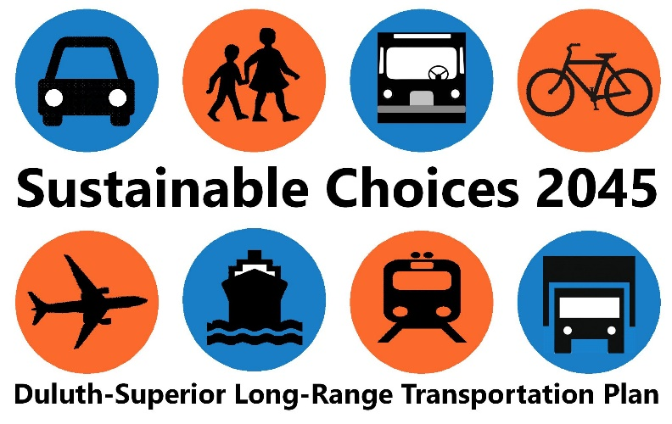
Comments? Questions?
Mike Wenholz mwenholz@ardc.org
Chris Belden cbelden@ardc.org
James Gittemeier jgittemeier@ardc.org
dsmic.org/planning/long-range

