Slide 1

CTPP Crash Course
Census Transportation Planning Products program
Penelope Z. Weinberger
CTPP Program Manager
AASHTO
8/28/2019
2019 National Regional Transportation Conference

Slide 2



Slide 3
CTPP
NHTS
Regional Household Travel Surveys
NPMRDS
LEHD
Probe Data
CAV Data…

Slide 4
What is the CTPP?
AASHTO sponsored Technical Services Program funded by member State Transportation agencies
Operates with support from FHWA, OST-R (BTS), FTA, Census Bureau, MPOs and TRB
The CTPP Program includes:
Data Products
Training and Technical Assistance
Research and Outreach
Designed for the
Transportation Community
by the
Transportation Community

Slide 5
But what does that mean?
Based on ACS
Ground truth
A resource of adequate sample size to compare, validate, calibrate, expand your data/survey/model
Workplace (daytime) data by demography
Flow from home to work by mode and demography
Has error

Slide 6
Guided by an AASHTO Oversight Board
MPOs
Arash Mirzaei, NCTCOG
Paul Agnello, FAMPOC
Shimon Israel, MTC
Ron Chicka, ARDC
John Sharp, ACOGOK
MaryAnn Waldinger, COMPASS
Benjamin Gruswitz, DVRPC
Chair: Jessie Jones, AR (Region IV)
Vice Chair: Guy Rousseau, ARC
AASHTO Liaison: Penelope Weinberger
16 voting members, 9 states and 8 MPOs
Liaisons
Charlynn Burd, Census Bureau
Ken Cervenka, FTA
Joseph Hausman, FHWA
Brian McKenzie, Census Bureau
Clara Reschovsky, OST-R, BTS
Association Adjuncts
Bill Keyrouze, AMPO
Tom Palmerlee, TRB
Erich Zimmermann, NARC
Technical Adjuncts
JJ (Jing Jing) Zang
Krishnan Viswanathan
Gabe (Jiangbo) Yu
Cambridge Systematics
AASHTO Staff
Penelope Weinberger
Caroline Kieltyka
Matt Hardy
Subject Matter Experts
States
Laine Heltebridle, PA (Region I)
Mark Grainer, NY (Region I)
Thomas Hill, FL (Region II)
Habte Kassa, GA (Region II)
Phillip Mescher, IA (Region III)
Jennifer Murray, WI (Region III)
Elizabeth Robbins, WA (Region IV) Nicholas Deal, CA (Region IV)

Slide 7
And it’s free, right?

Slide 9
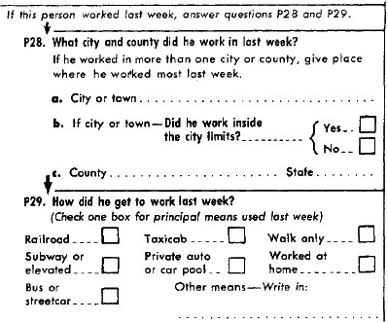

Slide 10
Transformation over time
 | Buyers/Users | Direct Cost | Tables
1960 | OMB | ??? | ???
1970 | 112 | $0.6 M | 43
1980 | 152 | $2.0 M | 82
1990 |  | $2.5 M | 120
2000 |  | $3.0 M | 203
2005 + | AASHTO Consolidated Purchase | $5.8 M | Multiple Products
2013 | Most States | $4.3 M | Robust
All States
and MPOs

Slide 11
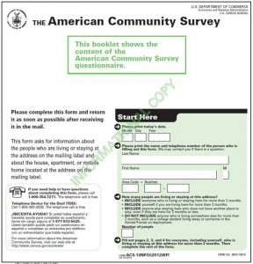

Slide 12
A brief history, Pop Quiz
When did the Journey to Work Question first appear on the Census Form?
1960
How often is the Census collected?
decennially
How about the American Community Survey (ACS)
Continuously!
Without data you’re just
Another person with an opinion
        W. Edwards Deming

Slide 13
CTPP Data Products
Derived from
US Census Bureau’s
American Community Survey (ACS)
CTPP Program includes:
Data Products
Training and Technical Assistance
Research and Outreach
ACS accumulates data over multiple months and years
Areas over 65,000 people Annual Data
Areas over 20,000 people Supplemental Estimates new in 2016
Tracts and Block Groups 5 Years of data

Slide 14

CTPP Data Concepts
Summarized data by
Place of Residence
Place of Work
Flows from Home to Work
Custom Geography (Local TAZs)
Unique Universes (e.g. workers in HHs)

Slide 15
5-year Geography and Flows
Asymmetrical Flows (in red)
Small Areas defined by MPOs in MPO areas and States Elsewhere
Tracts are Defaults for Small Areas
Default TADs defined by AASHTO
UZA tables for Part 1 ONLY
MCD Only States

Slide 16
Some Key Data Items Include
Data on Households
  Size, income, vehicles per household
Data on Workers
  Age and gender, occupations, earnings
Data on Journey to Work
  Usual mode to work, commuting time, work departure time
Data on Workplaces
  Work locations, times of arrival at work
Notes:
The Census Bureau used two different forms to collect Census 2000 data.
A short form with seven basic questions went to all households and a long form with these same questions and additional questions went to a sample of households.
The information that is tabulated from the questions asked of every person and housing unit is called the100-percent or short-form data.
The long-form questionnaire included the same seven population and housing questions plus additional inquiries. This is called either the sample data, or the long-form data.
DEFINITIONS:
100% Data - Population and housing information collected for all living quarters in the United States.
Census - A complete enumeration (count) of a population or the business and commercial establishments, farms, or governments in an area.
Long form - The decennial census questionnaire containing 100 percent and sample questions.
Sample data - Detailed social, economic, and housing information collected on the long form from a selected portion of all housing units and people living in group quarters. The 1990 census sampled approximately 15 percent of the nation's population and 16 percent of its housing units. See 100 percent data.
Short form - The decennial census questionnaire containing only the 100 percent questions.

Slide 17
CTPP Data Products
Commuting In America
1990 and 2000 Small Area Tables
Area Specific Data Profiles
CTPP 5-year Tables (2006 to 2010)
CTPP 5-year Tables (2012 to 2016)
Today’s Focus
https://ctpp.transportation.org/

Slide 18
Applications of CTPP Data Products
Comparative analysis
Long Range Planning/TIP
Performance measurement
Modal share analysis
FTA New Starts/Small Starts
Travel Demand Modeling and Forecasting
Policy Impact Analysis
Livability analysis
Corridor planning
Air quality modeling
Trend analysis
Descriptive statistics
Title VI
Environmental justice
Factoring/Adjusting surveys

Slide 19
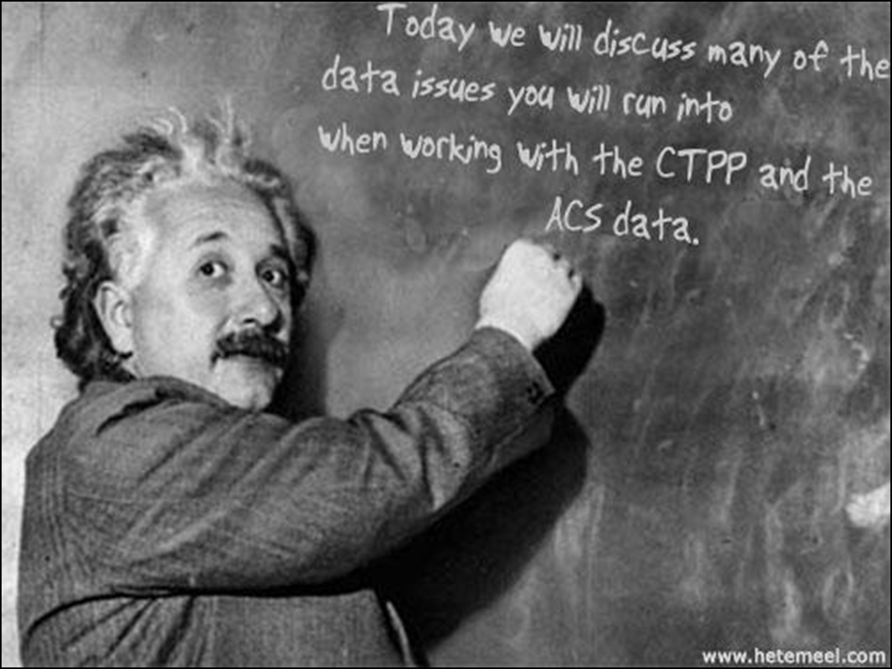
Working with the data - Things to Know
ACS Concepts
Joint ACS/CTPP Concerns
CTPP Specific

Slide 20
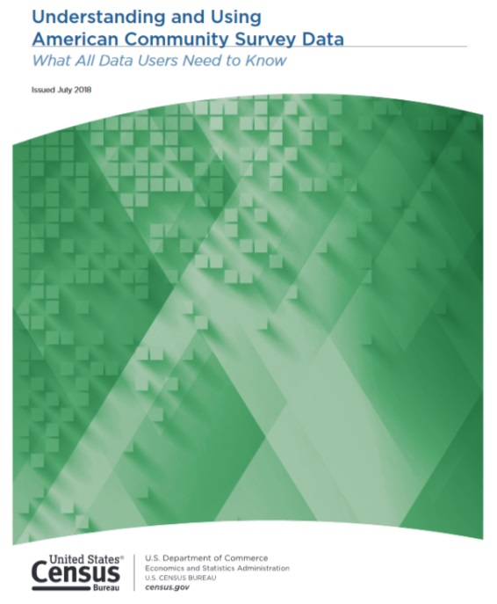
The American Community Survey
Handbooks for Data Users Series
Explains the Basics
Covers the Details
Includes “How to” Case Studies
Handbooks Targeted to Different Users
Links to ACS Resources
Contains Handy Tips
https://census.gov/programs-surveys/acs/guidance/handbooks.html

Slide 21

About ACS Data
I bet 80% of you, plus or minus 15% drove to class today
There are many topics to be aware of, these are but a few
Weighting the ACS
Period Estimates
Reliability/Currency
Trend Analysis
Dollar Values
ACS is a survey with Sampling Error expressed as a Margin of Error (MOE)
MOEs combined with the ACS estimate, give users a range of values within which the actual “real-world” value is likely to fall
Notes:
I bet 80% of you, plus or minus 15%, drove to class today.

Slide 22

Weighting the ACS
Statistical areas (Tracts, TAZs, TADs) have no control totals for pop and HU estimates
Weighted by
Age, Sex, Race, Hispanic Origin
Controlled by
Official Population, Housing Units
@ County level and since 2009, Incorporated Places

Slide 23
Period vs Point in Time Estimates
American Community Survey | Decennial Census and 2000 Decennial Census Long Form
Period Estimates | Point-in-Time Estimates
Estimates based on information collected over a period of time. For ACS the period is either 1 year or 5 years. ACS 3-year, for areas with 20K or more people was discontinued in 2013 | Estimates based on one point in time. The Decennial Census Long-Form data for the 2000 Census was based on information collected as of April 1, 2000
Did anything replace the ACS 3-year estimates?

Slide 24
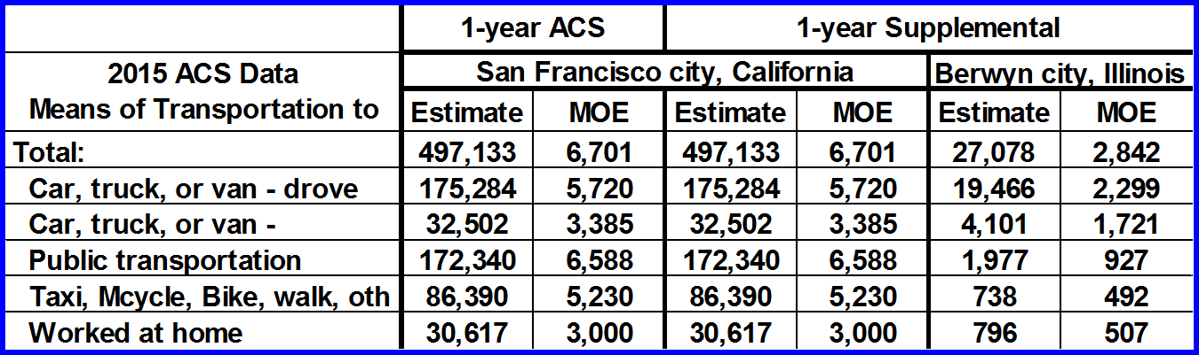
Yes, Supplemental Estimates
Now there is 1-year ACS Data for areas with >20K people
Sources: Adapted from ACS Standard 1-year Table B08301 and 1-year Supplemental Table K200801
Take note of the Margins of Error
Notes:
Note: ACS regular 1 year and supplemental are identical for areas over 65 K. There are fewer data items available for the supplemental tables.

Slide 25
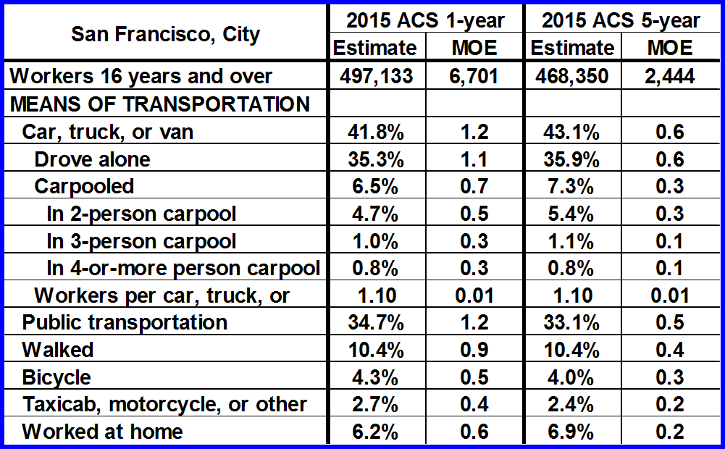
Reliability vs Currency
Which data is more reliable?
Which data is more current?
WHY?

Slide 26
When Doing Trend Analysis
Overlapping Years Syndrome
Try to avoid comparing successive period estimates with the overlapping years | Also, you should not compare a 1-year estimate with a 5-year estimate

Slide 27
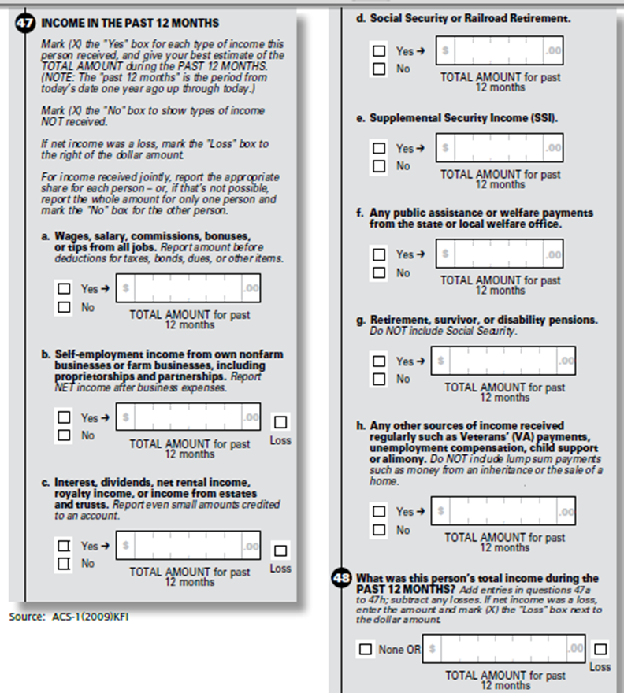
Dollar and Income Values
ACS asks What was your income during the last 12 months?
Single Year Estimates
-- 12 different periods
-- Each adjusted to single
period (Jan to Dec)
Multiyear Estimates
Each year adjusted to current year
Notes:
From Census Bureau staff on how annual and multiyear estimates are handled. “ACS income amounts are collected monthly and published annually. At the end of any given year, we have 12 different reference periods, one for each month of interview. For each month, we apply a different inflation-adjustment factor (CPI-U-RS from BLS) which adjusts the amounts to the publication year. This takes care of the monthly interviews. From those inflation-adjusted microdata, we calculate our publication statistics; income distributions, medians and means.
For the 5-year file, we do the same. But, of course, after the monthly adjustments we have five different dollar values for the five different years. Another inflation-adjustment for the older years brings these income amounts to the most recent year.
We don't inflation-adjust to an "end of year." The BLS factors inflate to simply 'a year' (2015 inflation-adjusted dollars, for example). There is no averaging of inflation factors.”

Slide 28

Bringing the ACS to CTPP Data
With ACS and CTPP I can speak with 90% confidence about what the data is saying
Lets shift to CTPP data and some ACS methodological by-products
Testing for Statistical Significance
Understanding MOEs
Collapsing

Slide 29
You must do Statistical Significance Tests
Sampling Error
To avoid false statements like…
All modes show gains especially Transit
“Based upon CTPP data, the total number workers who live in Santa Monica, CA increased as did the number of people who took transit to work. During the same time the number who Biked to work also increased.” The World Gazette

Slide 30
How do you do a Significance Test?
It is simpler than it looks, there are a lot of guides
1. Get the Margin of Error (MOE) from ACS
2. Calculate the Standard Error (SE) [SE = MOE / 1.645]
3. Solve for Z where A and B are the two estimates
4. If Z < -1.645 or Z > 1.645
Difference is Significant at 90% confidence

Slide 31
Some things to keep in mind
Obtaining Standard Errors is the Key
    SE = MOE / 1.645
Formulas vary depending on comparisons
    Sum or Difference of Estimates
    Proportions and Percentages
    Means and Other Ratios
Working with 2000 data will be a little more involved
There are resources to help

Slide 32
Statistical Significance Resources
The CTPP “free” online data retrieval software will do this for you
Plenty of Help Available
The Census Bureau
New York State Data Center Calculator
University Center for Transit Research (CUTR) South Florida
NCHRP Guidebook

Slide 33

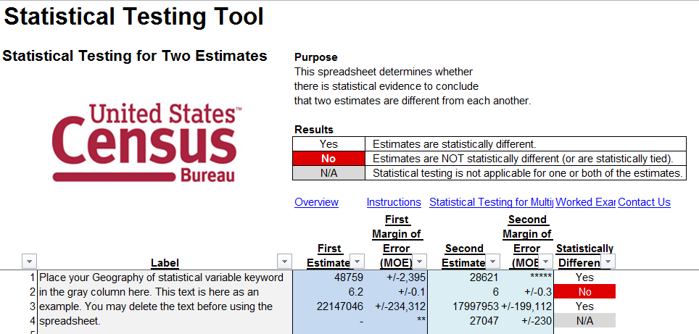
Census Bureau Aids
Handbooks and Tool
https://census.gov/programs-surveys/acs/guidance/statistical-testing-tool.html
https://census.gov/programs-surveys/acs/guidance/handbooks.html

Slide 34
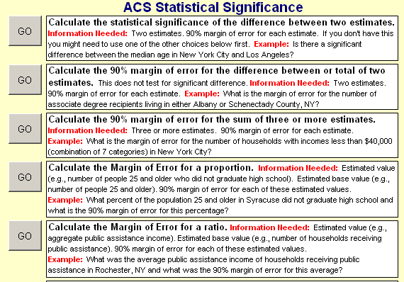
NY State Data Center Calculator
http://sdcclearinghouse.wordpress.com/2009/03/03/spreadsheet-to-calculate-acs-margins-of-error-and-statistical-significance-for-sums-proportions-and-ratios/

Slide 35
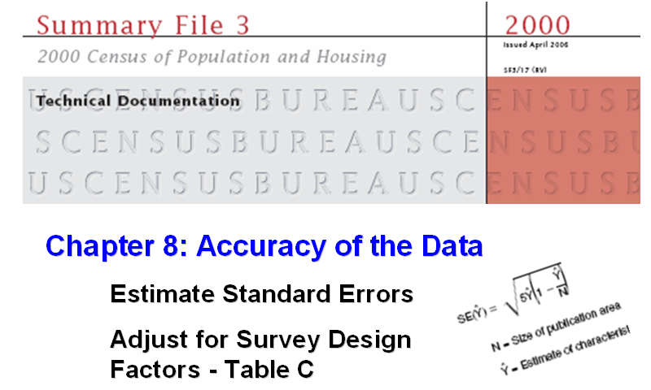
What if I am using 2000 Census Data?
You will need to Estimate the MOE using the Survey Design Factor
https://www.census.gov/prod/cen2000/doc/sf3.pdf

Slide 36
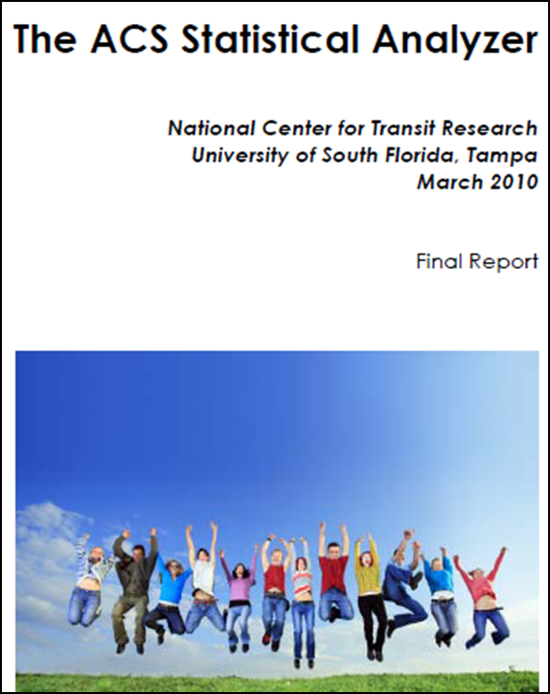
The CUTR Guide has you covered
There’s a Report
http://www.nctr.usf.edu/pdf/77802.pdf
and Spreadsheet Calculator
http://www.nctr.usf.edu/spreadsheet/77802.xls
…with built in Survey Design Factors
http://www.nctr.usf.edu/abstracts/abs77802.htm

Slide 37
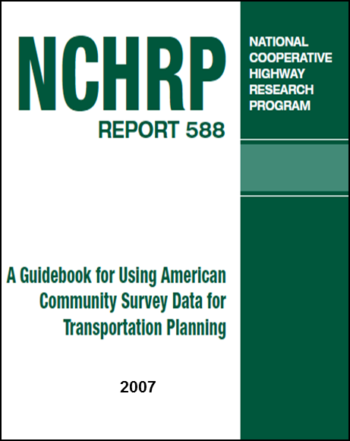
One Last Resource
A Guidebook for Using American Community Survey Data for Transportation Planning
http://onlinepubs.trb.org/onlinepubs/nchrp/nchrp_rpt_588.pdf
Census Transportation Data Use and Application Field Guide (Coming soon)
NCHRP Project 8-123, under contract June 2019

Slide 38
Understanding the MOE
We know the number of workers has changed. But when considering the MOEs what is the range of that change?
A. 4,975 C. 3,234 to 6,716
B. 5,122 to 4,828 D. 3,482

Slide 39
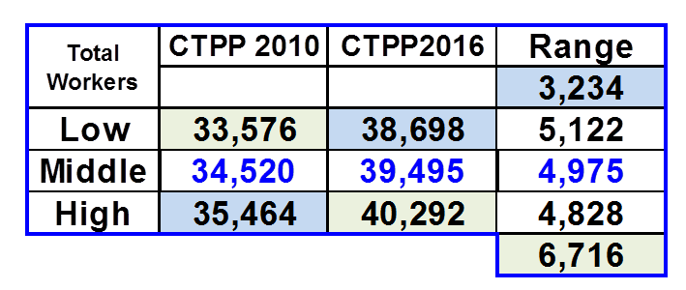
A Different View of Undertanding MOEs

Slide 40
More Fun With MOEs
Between the reference period what has the number of people who took a Bike to Work in Ashland done?
A. Gone Up?
B. Gone Down?
C. No significant Change
Which Table would you use and why?
Part 1 Resident data
Part 2 Workplace data

Slide 41

Moving from ACS to CTPP
Did you know mode of transportation to work was first asked in 1960?
Data issues with ACS that spill into CTPP
Collapsing
Light Rail Conundrum
Questionnaire Content Program
Population Totals
P29--How did he get to work last week?
Railroad
Subway or elevated train
Bus or streetcar
Taxicab
Private auto or carpool
Walk only
Worked at home
Other (write in)

Slide 42
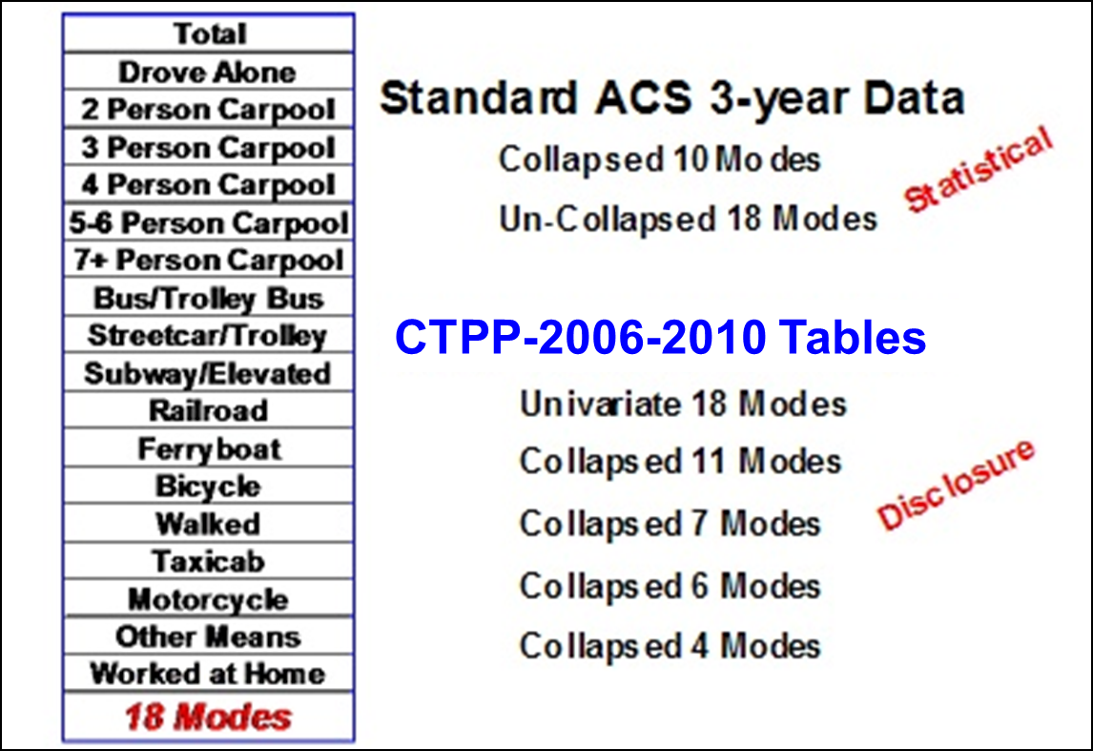
Collapsing, Where It All Began
ACS introduced collapsing for statistical quality
CTPP introduced collapsing for disclosure proofing reasons
http://www2.census.gov/programs-surveys/acs/tech_docs/data_suppression/ACSO_Data_Suppression.pdf

Slide 43
Collapses for 2012 to 2016 CTPP
Other Collapsed Variables
Age
HH Income
Industry
Time Leaving
Time Arriving
Units in Structure
Vehicles Available
# Workers in HH
You can also collapse geography

Slide 44
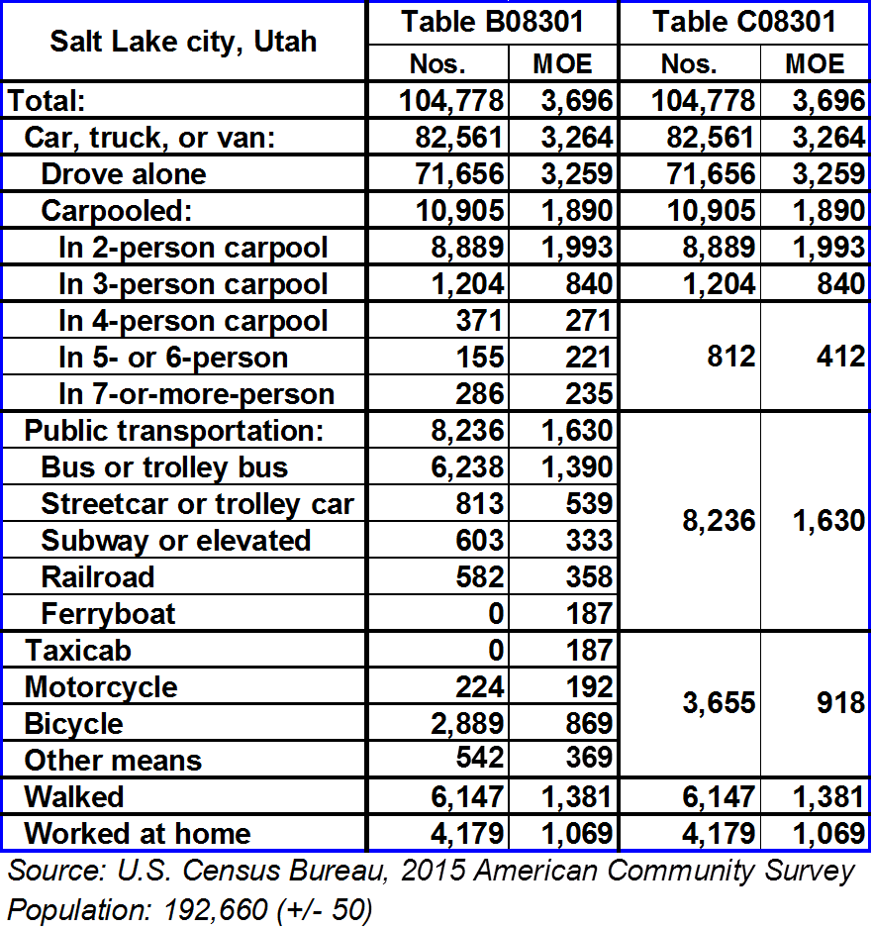
Collapsed Example
What do you notice about the Table?
You can collapse variables or geography to improve the quality and reliability of your data
Notes:
40% workers.

Slide 45
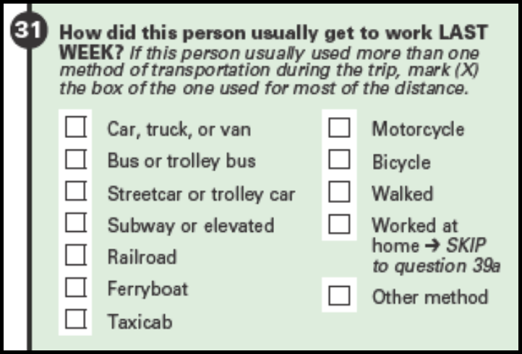
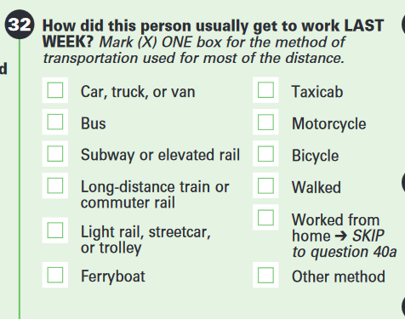
Old & New (beginning 2019) MOT Questions
Mode | = | Means of Transportation (MOT) in census speak
https://www.census.gov/programs-surveys/acs/methodology/questionnaire-archive.html

Slide 46
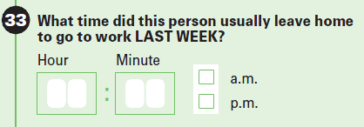
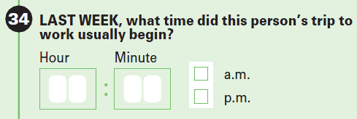
Question Changes and Content Tests
2005-2019
2019
Next Content Test 2021, Changes 2024
Taxi, limo, or ride hailing services
Taxi, ride hailing services
https://www.census.gov/programs-surveys/acs/methodology/content-test.html

Slide 47

Zeroing in on the CTPP
The first CTPP data tables were produced with the 1970 census using Long Form data
Some CTPP Specific Data Issues
Disclosure Proofing
Rounding
More on Collapsing
Data for Large Areas Only
Extended Allocation / Worker Totals

Slide 48
Disclosure Proofing - Protecting Privacy
Some ACS safeguards
Federal Law Protects Your Information
Titles 13 and 26 USC
No Census employee may disclose or publish any census or survey information that identifies an individual or business

Slide 49
Disclosure Avoidance - Extra Layer
Custom Table Requests
Staff will contact you within 3-5 business days after you submit your request to discuss work
Minimum cost is $3000 (and often more)
Minimum timeframe is 8 weeks (and often longer)
DRB must review and approve all requests started
Starting in February 2018 Census Bureau is no longer approving requests for Special Tabulations involving substate geographies unless the data are protected using strengthened disclosure avoidance methods
https://www.census.gov/programs-surveys/acs/data/custom-tables.html

Slide 50
Disclosure Proofing – CTPP Specific
Perturbation
Rounding
Cross Tab Limits
CTPP has two types of tables
Tables that passed Census Rules (A Tables)
Privacy protected (perturbated) tables (B Tables)
http://onlinepubs.trb.org/onlinepubs/nchrp/nchrp_w180.pdf

Slide 51
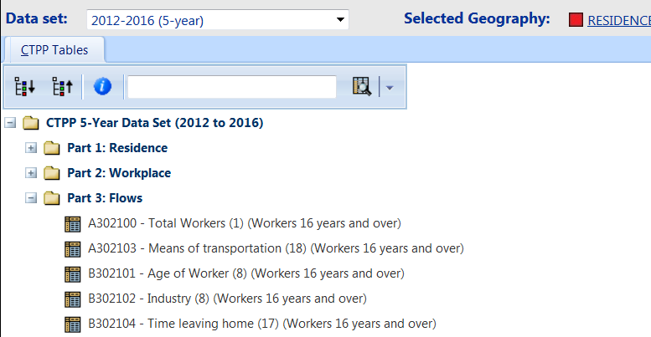
What Do the “A”s and “B”s look like?
Notes:
51

Slide 52
Rounding
All CTPP tables are rounded
1. 0=0, 1-7=4, 8 or > = nearest multiple of 5
Any number that ends in 5 or 0 stays as is
Totals Rounded independently of cells
Aggregate dollar values rounded to nearest 100
Medians or quintiles not subject to rounding
Percentages and rates calculated after rounding
http://www.census.gov/population/www/cen2010/spec-tab/stp_DRBrules.html

Slide 53
Suppression Continued
For (A) Tables Only
Cell Suppression: Must have a “0” or at least 3 records
A101106 (unweighted sample count)
A101107 (percent of population in sample)
A110101 (total housing units sampled)
A110103 (percent of housing units sampled)
Table Suppression: Aggregates and Means must have at least 3 unweighted cases to be shown. The policy of the ACS program is that if any one cell in a table is suppressed, the whole table is suppressed

Slide 54
Disclosure Proofing and Collapsing
What we wanted
By

Slide 55
What we Got
By
Part 1: Modes 18 & 11
Part 2: Modes 18, 11, 7(B202222)
Part 3: Modes 18 & 7
11

Slide 56
Data for Large Areas Only
Puerto Rico not included in TAZs

Slide 57
Place of Work Worker Counts Do Not Add Up
Using Part 2 data the sum of workers for my tracts does not equal the number of workers at the Place or County levels
Why don’t my tract totals add up to my county total? Rounding?
Census cannot geocode all place of work locations to the Block level

Slide 58
Example
Previous CTPP Products had Extended Allocation applied to them
So 1,180 workers (11%) work somewhere in Berwyn but could not be coded to a Berwyn Tract

Slide 59
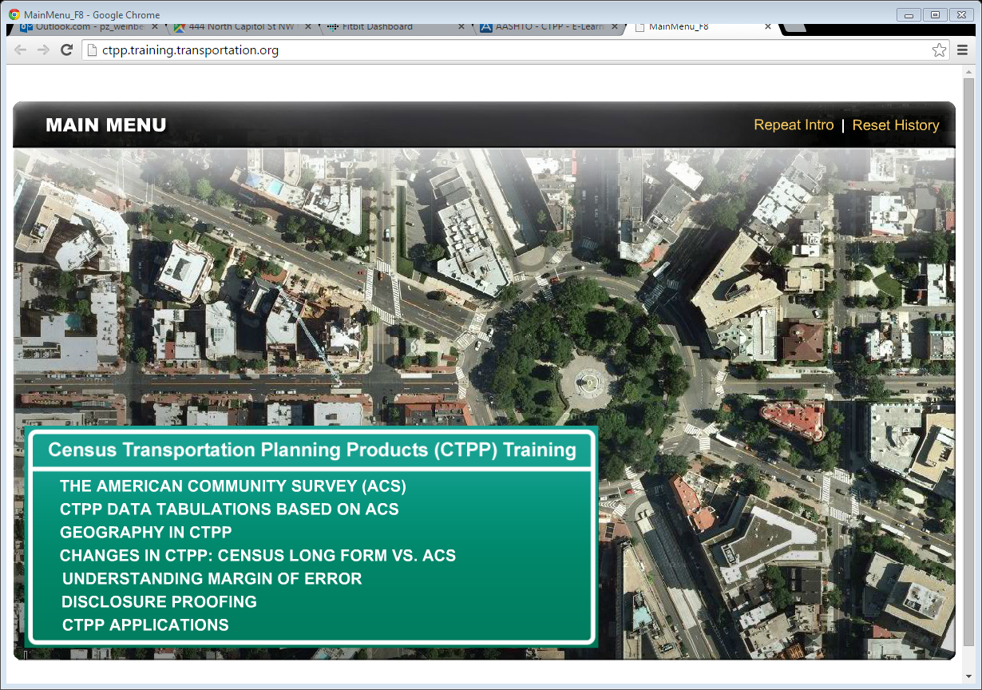
CTPP’s E-Learning Modules

Slide 60

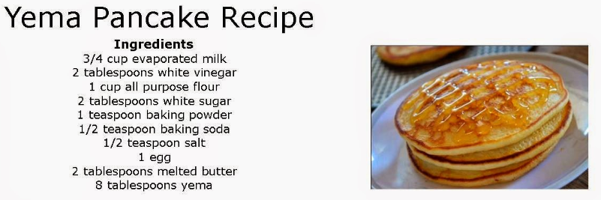
Applications Module
Two scenarios when applying CTPP (or any) data:
  Pantry: What can I do with this data? (What can I cook with the ingredients at hand?)
  Recipe: Do I have what I need to solve this problem? (Do I have sufficient ingredients for cooking with this recipe?)
vs.
Because CTPP has common and well documented uses such as calibrating and validating travel demand models, we will show some examples of less common applications that hopefully inspire you to come up with your own.

Slide 61
How do I know if my application can be analyzed with CTPP?
How do I know if CTPP has the data I need for my application?
What data elements are required?
What population am I assessing,
What timeframe is relevant to my analysis,
What variables do I need to incorporate?
What geography am I looking at – is the data tabulated at a geography I can use?
What question am I trying to answer
Who is my audience
  CTPP is a rich resource of demographic data for people, workers, and households,
  Households
        Size, income, vehicles per household
  Workers
      Age and gender, occupations, earnings
  Journey to Work
      Usual mode to work, commuting time, work departure time
  Workplaces
      Work locations, times of arrival at work

Slide 62
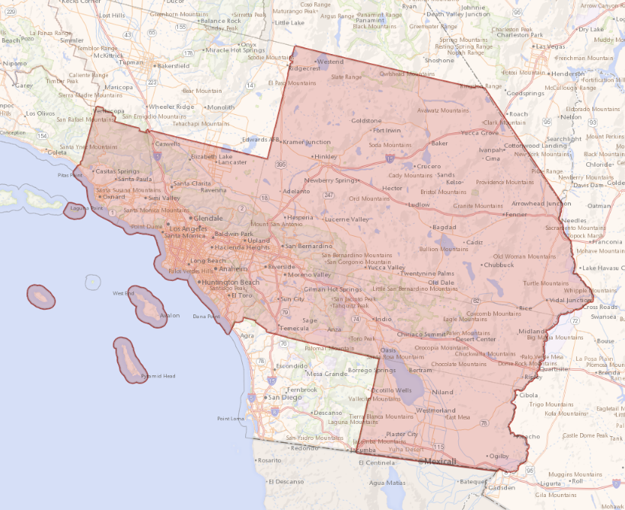
Example 1: Visualize Commuter Flows of SCAG
Suppose SCAG plans to visualize the commuter flow data by means of transportation aka mode (Table A302103)

Slide 63
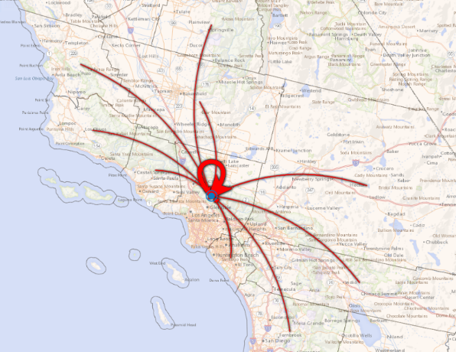
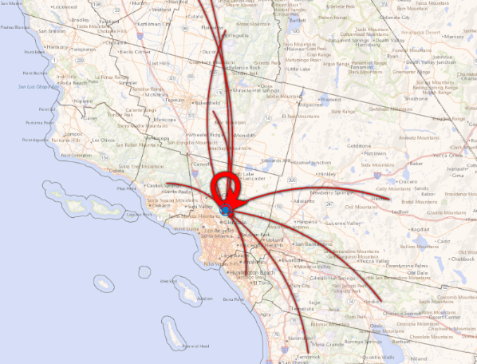
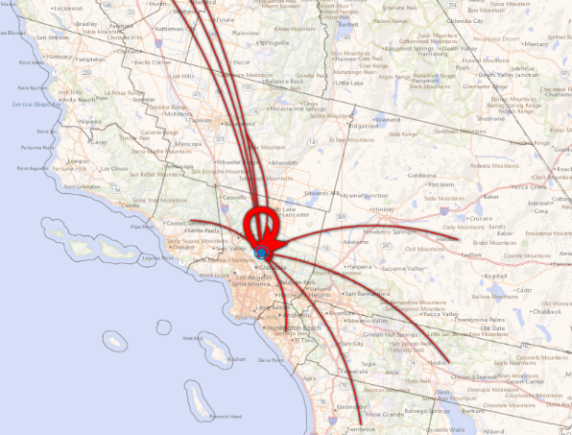
Example 1: Visualize Commuter Flows of SCAG
We can compare commuter flows by means of transportation at different geo levels (here we use the county level)
Drive-Alone
Carpool
Transit or Commuter Rail
From the figures above, planners can, for example, consider the policy (e.g., HOT pricing) and investment that encourages counties with low share of environmentally-friendly means of transportation.

Slide 64
Example 1: Visualize Commuter Flows of SCAG
By presenting commuter flows in a visual way, SCAG’s stakeholders can gain more understanding of the impact of transportation planning and how to collaborate with one another.

Slide 65
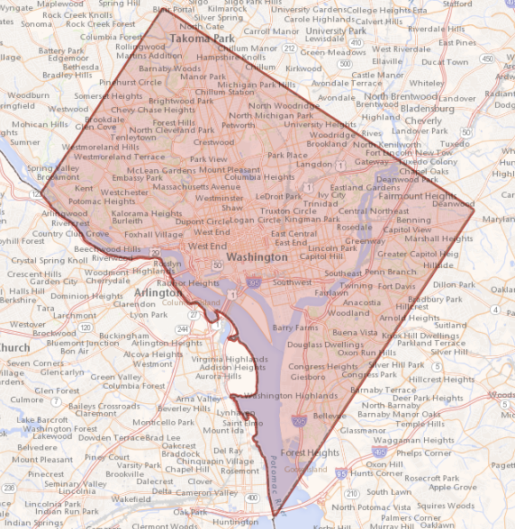
Example 2: EJ Analysis on Income (DC)
Suppose DC studies travel time by income level (Table A102204 at PUMA Level with customized groups)

Slide 66
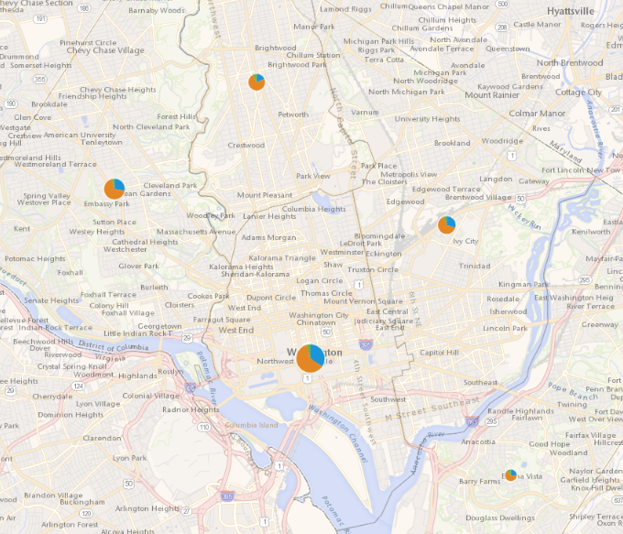
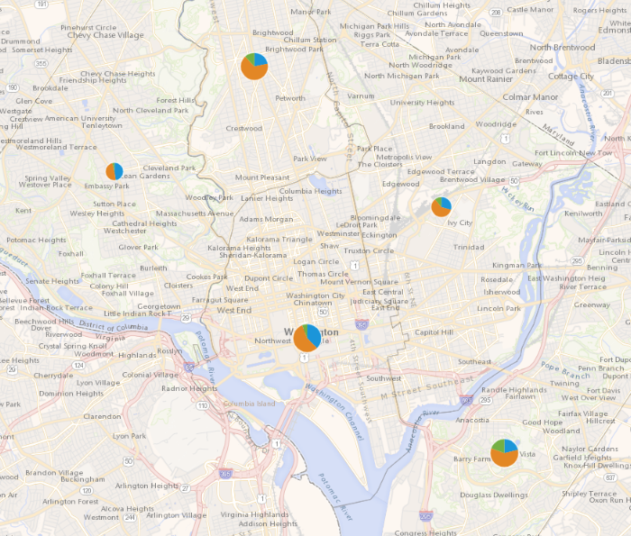
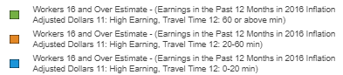
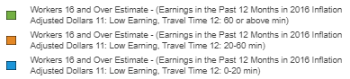
Example 2: EJ Analysis on Income (DC)
High Income
Low Income
We can see that the high-income workers in the Northwest DC area tend to have longer travel time than low-income workers do. Analysts can further investigate the commuter flow data for possible reasons.
Notes:
0-50,000 vs 50,000+

Slide 67
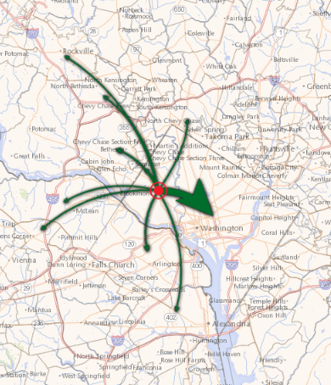
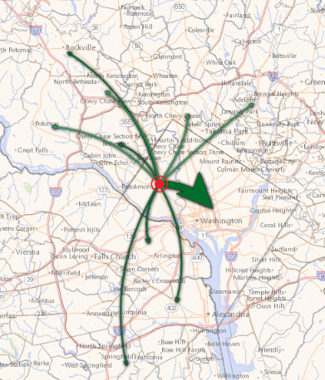
Example 2: EJ Analysis on Income (DC Northwest Area)
B303100 (Commuter Flow by Household Income) PUMA to PLACE
High Income
Low Income
As one can see, workers from different income levels share similarity in their work place distribution. However, the high-income workers also tend to work at the locations where no convenient transit is available (or since they can drive, historically there has been low demand on transit services to those areas.) On the other hand, this might cause workers who do not have available cars to miss the opportunities in areas where no transit options are available.
Notes:
0-50,000 vs 50,000+

Slide 68
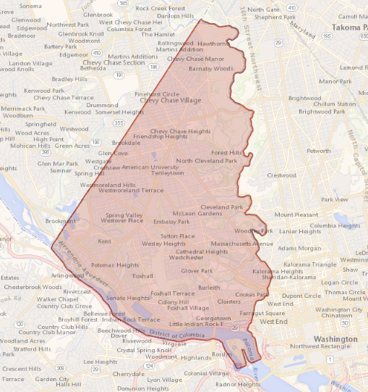
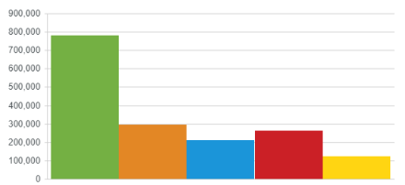
Example 2: EJ Analysis on Income (DC Northwest Area)
We can then plot B103202 (median household income by means of transportation) using customized groups.
Income
Auto
Active
Work at Home
Rail
Bus
This strengthens our hypothesis that high-income workers tend to drive and drive longer (partially due to lack of transit options), while low-income worker tend to take transit, bike, or walk and work nearby.

Slide 69
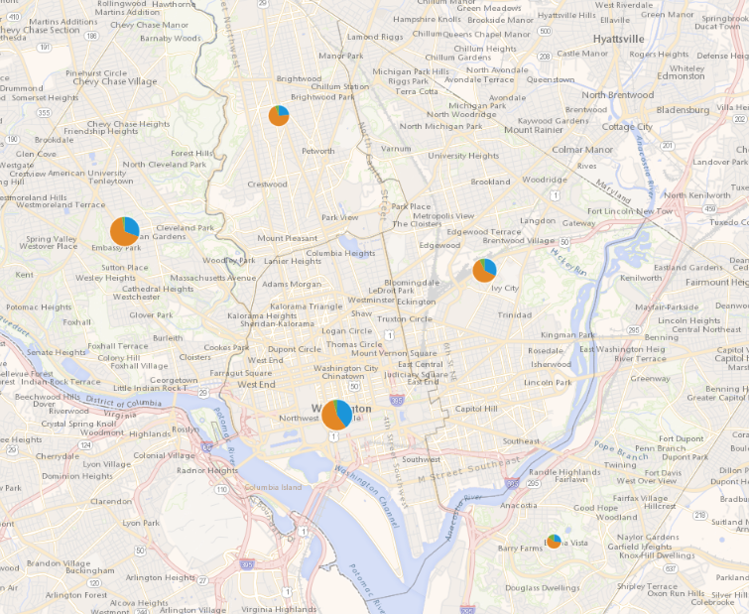
Example 2: EJ Analysis on Income (DC Northwest Area)
We can further compare the 2012-2016 CTPP with the historical CTPP (e.g., 2006-2010) to understand if the equity has improved or worsened.
High Income 2006-12
High Income 2012-16
It seems the south area has a decreased portion in high-income workers whose travel times are lower than 20 min.

Slide 70
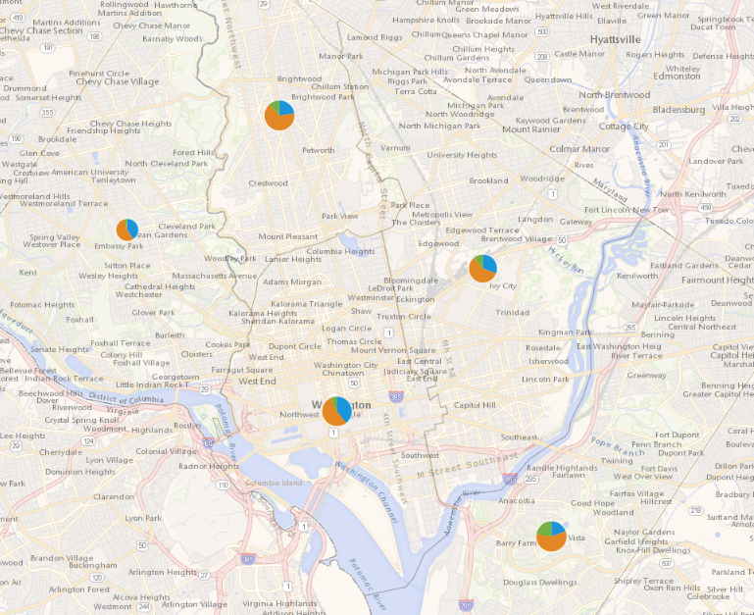
Example 2: EJ Analysis on Income (DC Northwest Area)
Low Income 2006-12
Low Income 2012-16
In the west area, it seems that the portion of the low-income workers whose travel times are within 20 min became higher compared with 2006-12.

Slide 71
Today’s CTPP Data Product
Five year Tables (2012 to 2016)
Same Structure as 2006 to 2010 CTPP
Same Software with Enhancements
No TAZ changes
Hit the streets March 31, 2019*
Some Table Changes (adds and subtractions)

Slide 72
What’s not in the New Data
Items Removed
All collapsed Tables
A few “never” used tables
A Handful of tables that will be created by our software
All tables for Urbanized Areas
Also: all crosstabs with means of transportation will use 11 modes

Slide 73
What is in the New Data
The New and Improved Stuff
Added Flows from Places to Counties
Added Several Tables
Average HH Size (p1)
Poverty by Mode (p1, p2)
Class of Worker
  by [Industry, Time Arriving, Mean TT, Mode] (p2)
Vehicles available by number of Workers in HH (p3)

Slide 74
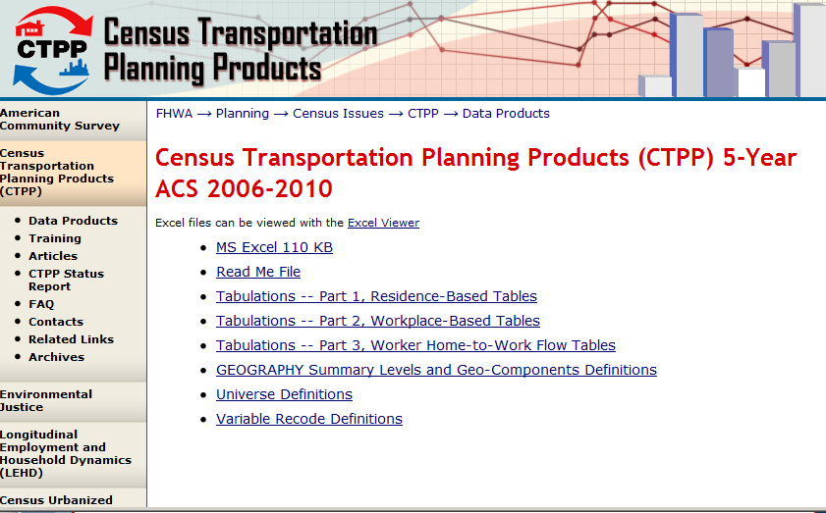
FHWA website
http://www.fhwa.dot.gov/planning/census_issues/ctpp/

Slide 75
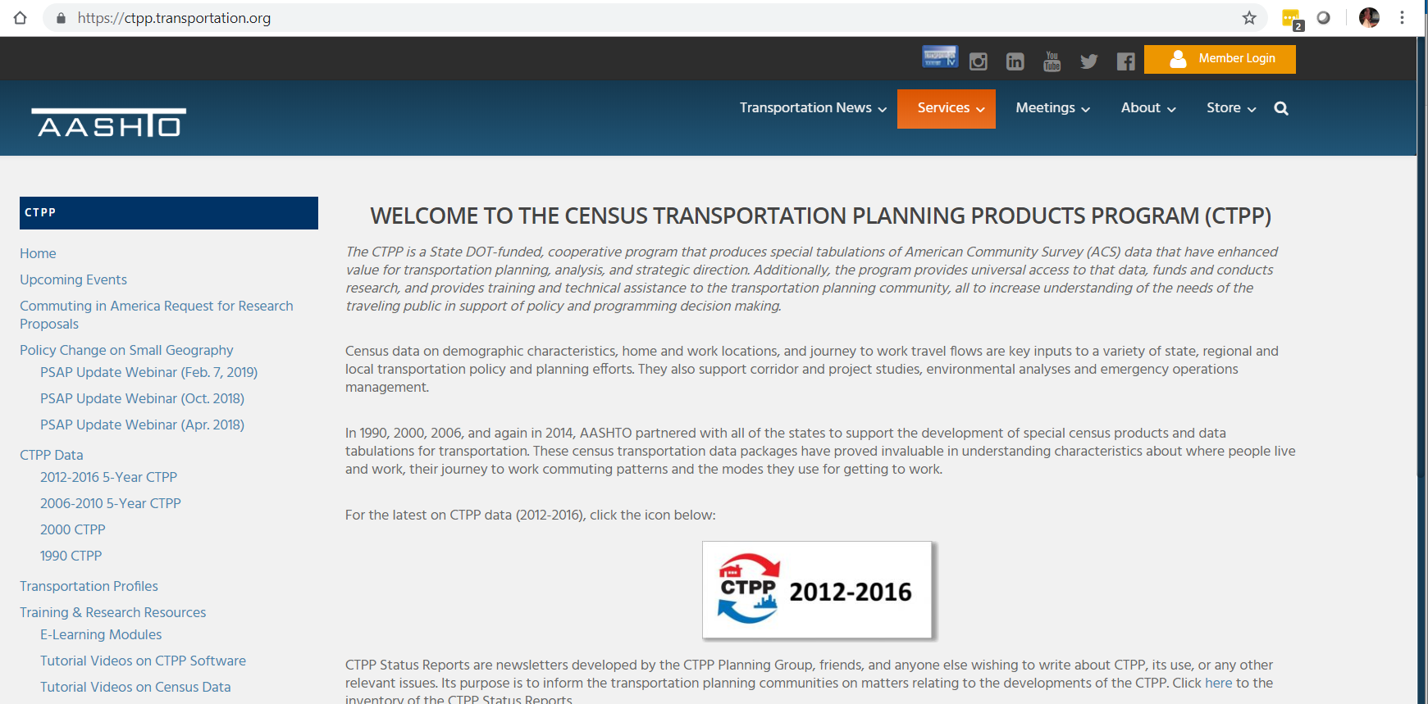
AASHTO website
http://ctpp.transportation.org/

Slide 76
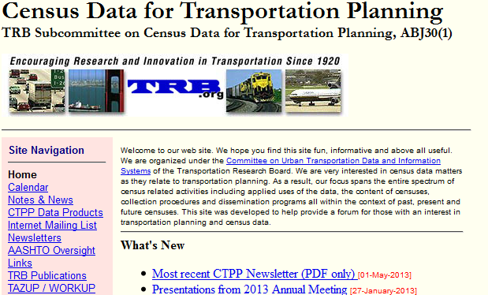
CTPP List Serve
http://trbcensus.com

Slide 77
Training Materials
AASHTO CTPP Website
http://ctpp.transportation.org/Pages/trainingresources.aspx
E-Learning
http://ctpp.transportation.org/Pages/elearningmodules.aspx
Recorded Webinars
http://ctpp.transportation.org/Pages/webinardirectory.aspx

Slide 78


CTPP websites
http://www.fhwa.dot.gov/planning/census_issues/ctpp/
http://www.TRBcensus.com
http://ctpp.transportation.org

Slide 79
Special Staff and Contacts
Penelope Weinberger
CTPP Program Manager, AASHTO
444 North Capitol Street NW Suite 249
Washington, DC 20001
202-624-3556
pweinberger@aashto.org
https://ctpp.transportation.org
CTPP Technical Support
JJ (JingJing) Zang
jzang@camsys.com
Gabe (Jiangbo) Yu
jyu@camsys.com
Charlynn Burd
CTPP Program BFF
Census Bureau
charlynn.burd@census.gov

