Slide 1
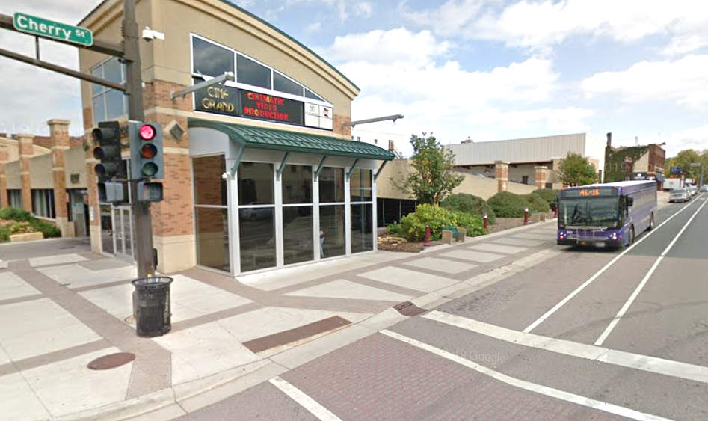
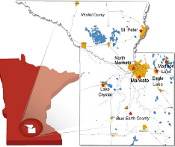
Mankato/North Mankato Area Planning Organization (MAPO)
Technical assistance to partner agencies

Slide 2

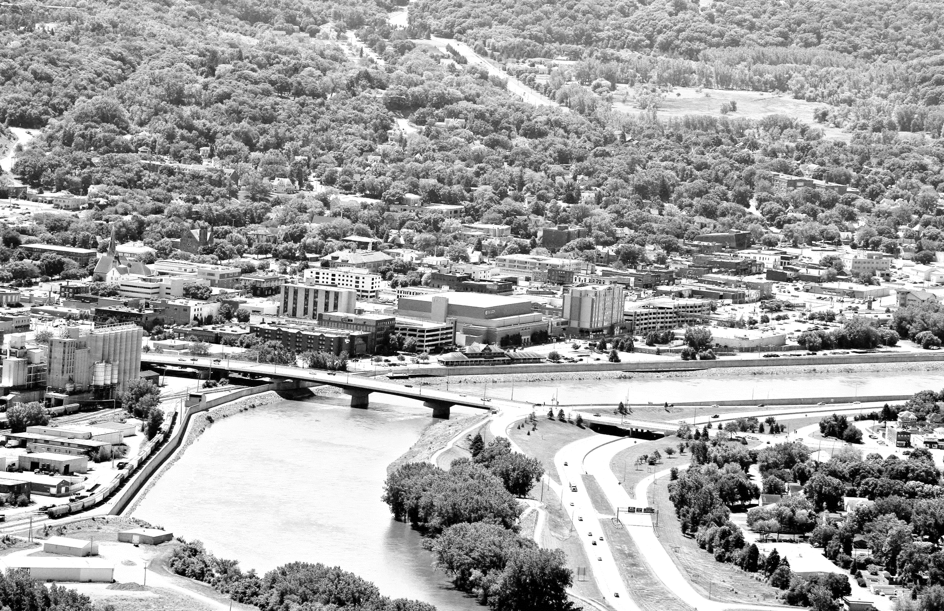
Contents
MAPO refresher
Partner agency Strategic Plan
MAPO role
Initiatives
Next steps

Slide 3
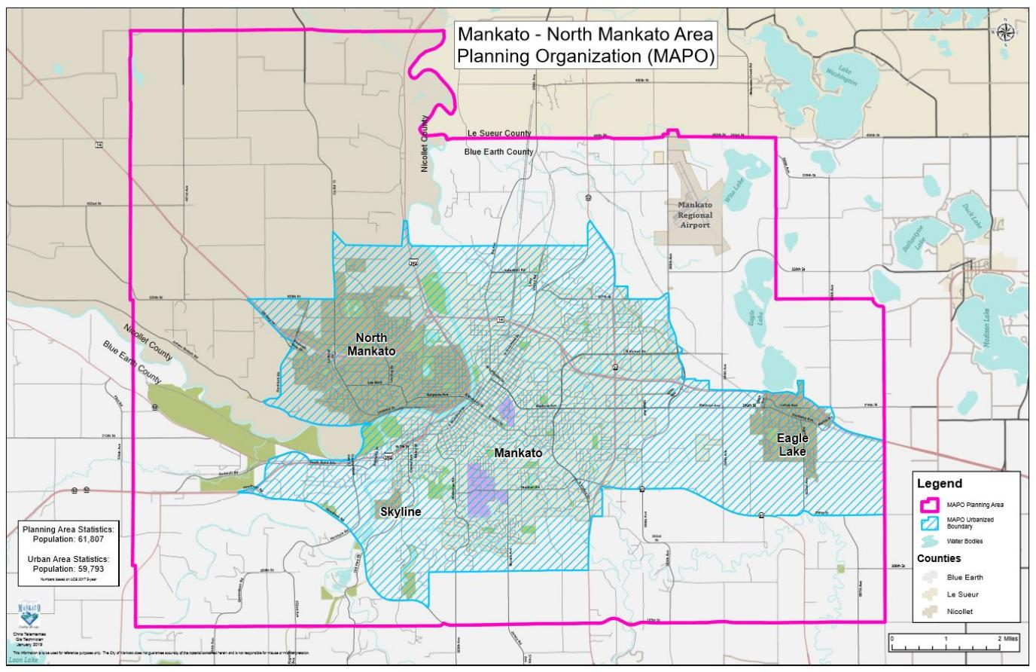
Cities: Eagle Lake,
Mankato, North Mankato,
Skyline
Counties: Blue Earth,
Nicollet
Townships: Belgrade,
LeRay, Lime, Mankato,
South Bend
Planning Area Pop:
61,807
Urbanized Area Pop:
59,793
Notes:
Planning Area Population 61,698
Urbanized Area 58,265
Total Square Miles: 131sq Miles
Approved planning and Urbanized Area Dec 2013

Slide 4
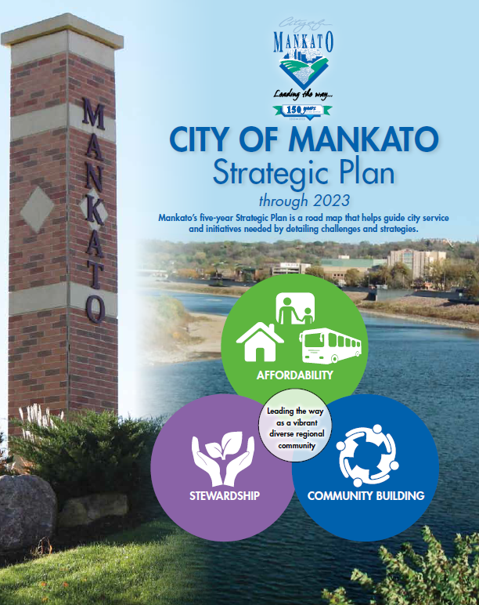
City of Mankato Strategic Plan
“…regional community…”
The “sheds:” housing, transportation, employment, medical, etc.
Road map to guide service & initiatives
Outlines challenges & strategies
Cross-departmental teams
Transportation Options & Access element

Slide 5
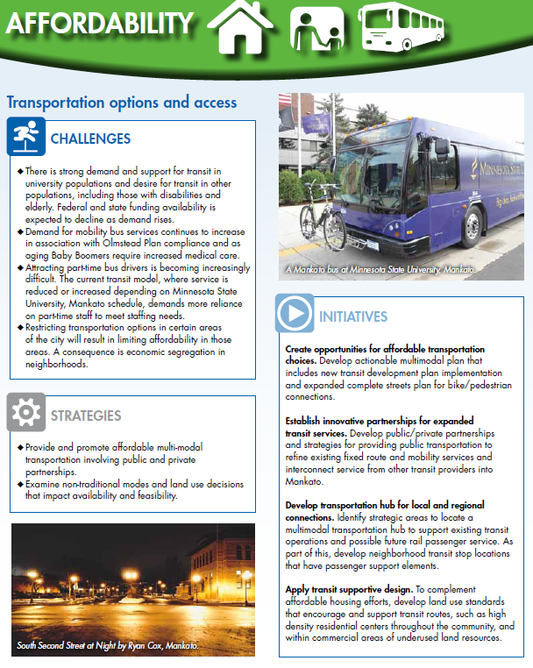
Transportation Options & Access
Initiatives
Regional emphasis
1. Create opportunities for affordable transportation choices
2. Evaluate innovative partnerships for expanded transit services (current fixed routes in Eagle Lake, Mankato, North Mankato)
  Low-density areas including townships
3. Develop transportation hub for local & regional connections
4. Apply transit supportive design

Slide 6
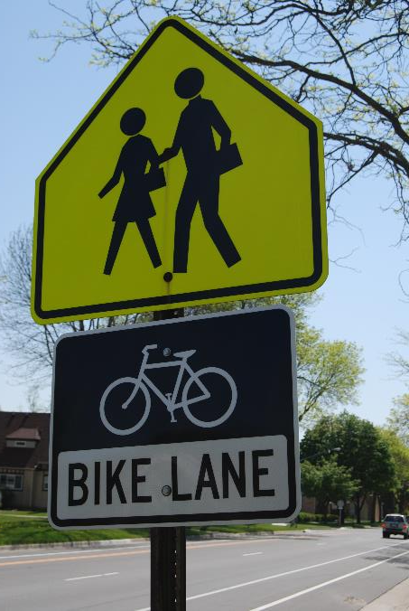
MAPO role
Provide technical assistance to partner agencies re: regional transportation issues
Bridge for regional, intergovernmental, multiple stakeholder planning
Identify issues & opportunities
Guidance re: scoping, management, & execution
Provide resources/information

Slide 7
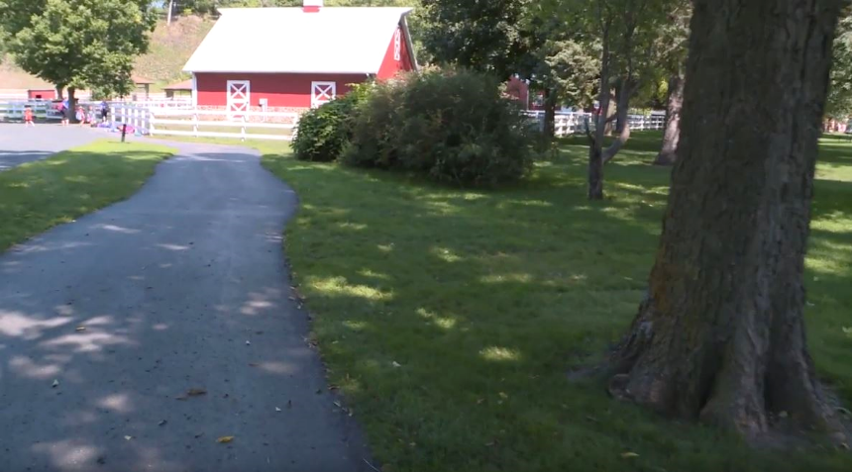
Initiative: Create opportunities for affordable transportation choices
Strategic Goals
Emphasis on multimodalism
  Pedestrian/bicyclist connections
  Integrate with transit
  Identify gaps in network
  Affordability & Accessibility
  Actionable solutions
Early talks regarding Multimodal Plan
Sibley Park, Mankato

Slide 8
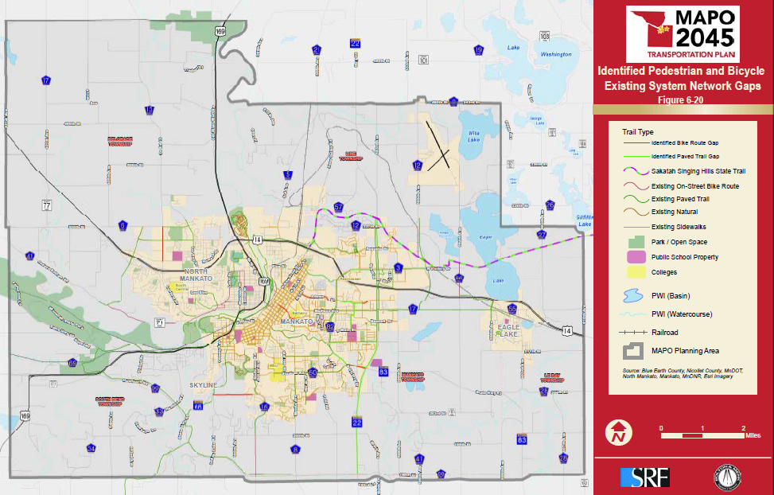
Initiative: Create opportunities for affordable transportation choices
MAPO role
Discuss LRTP Update process
  Multimodal emphasis
Invite work group stakeholder participation
Report back to work group throughout process
Partner on public outreach for LRTP
Opportunity to identify/prioritize projects
Ped/bike network gaps, MAPO LRTP

Slide 9
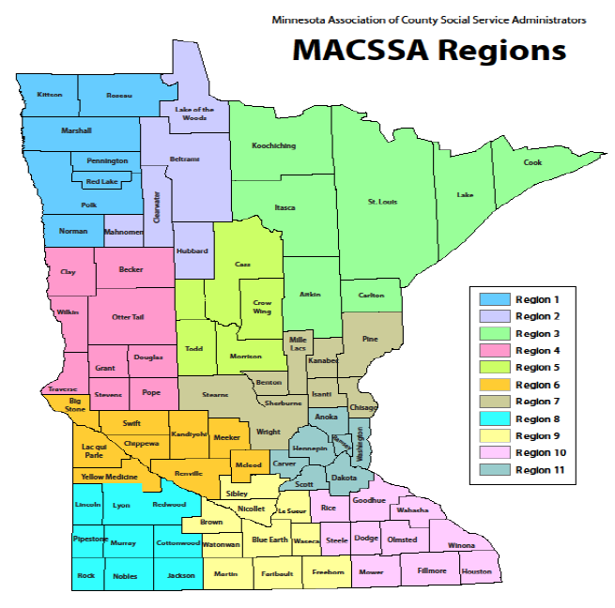
Initiative: Establish innovative partnerships: Regional Transportation Coordinating Council
Strategic Goals
Exploration of opportunities for regional partnerships, coordination, & collaboration through RTCC
Facilitate coordination between transportation providers & customers
Streamline access
Provide individuals more options of where / when to travel

Slide 10

Initiative: Establish innovative partnerships: Regional Transportation Coordinating Council
MAPO role
Apply for/receive MnDOT’s RTCC Phase 1 – Planning program
Coordinate with partners
  stakeholder outreach
  issues identification
  facilitate coordination
  develop strategies
Produce regional Operational Implementation Plan

Slide 11
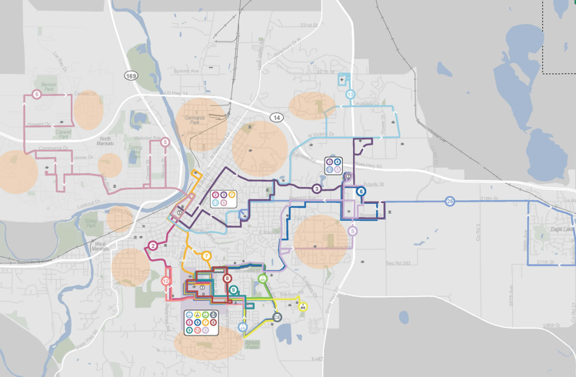
Initiative: Establish innovative partnerships: Transportation Networking Companies
Strategic Goals
Evaluate feasibility of Mankato Transit partnership(s) with other providers
Evaluate service to low-density areas (townships, etc.)
Evening service
Research planning for achievable partnership(s)
Identify opportunities for service to areas with limited access to transit
Flex zones identified in Mankato Transit Development Plan

Slide 12
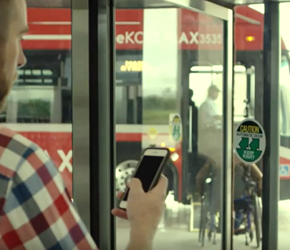
Initiative: Establish innovative partnerships: Transportation Networking Companies
MAPO role
Provide informational resources (peer examples/case studies)
Provide notice of grant opportunities
Provide input throughout grant application process
  Evening service expansion (all operating, no new capital)
  Mobility Bus expansion (operating and capital)
Provide further input as needed

Slide 13
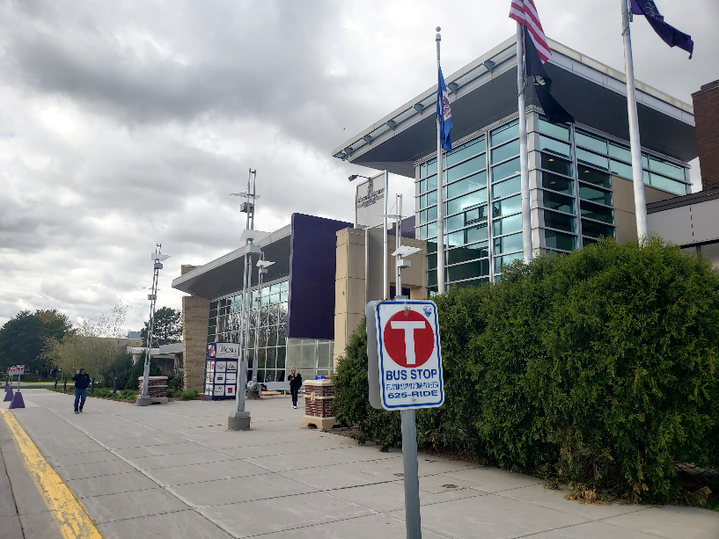
Initiative: Develop transportation hub(s) for local & regional connections
Strategic Goals
Identification of potential regional transportation hub(s) with site assessment
Assessment of site readiness
  Location (Mankato/North Mankato)
  Site/adjacent conditions
  Local/regional context
Emphasis on Location & Amenity
Centennial Student Union, MSU

Slide 14
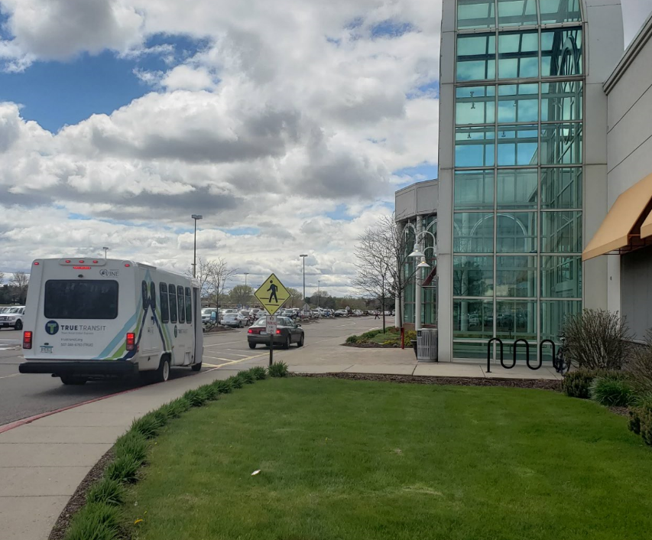
Initiative: Develop transportation hub(s) for local & regional connections
MAPO role
Provide input re: scope, criteria, & options for sites to be assessed
Participate in site assessments
Draft language
Identify opportunities
Facilitate communication between city & regional transportation providers
River Hills Mall, Mankato

Slide 15
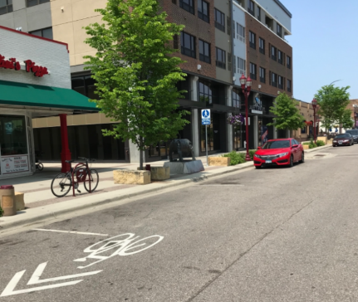
Initiative: Apply transit supportive design
Strategic Goals
Initiate efforts to create more transit supportive conditions
Cross-departmental collaboration including transit, planning/zoning, housing, economic development, engineering, etc.
Increase access to transit services
Identify opportunities for ordinance adjustments to encourage transit supportive design
South Front Street, Mankato

Slide 16
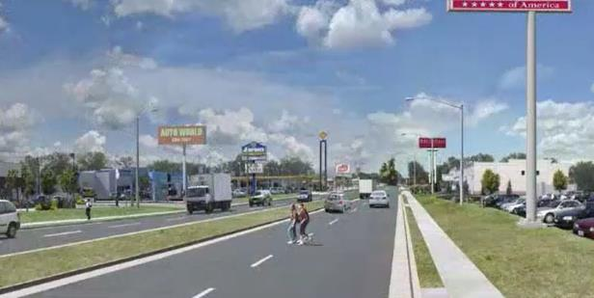
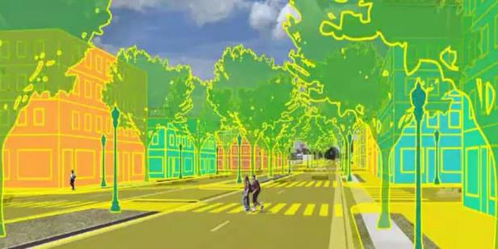
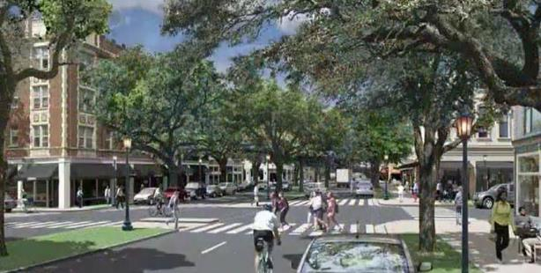
Initiative: Apply transit supportive design
MAPO role
Provide input on initiative scope, mgmt., & goals
Draft informational materials
Assist in defining stakeholders
Make resources available
Identify opportunities
  NTI TOD training course, April 2019
  Potential funding opportunities (FTA, MnDOT, DHS)

Slide 17

Next Steps
Continue to provide technical / project mgmt. input, resources, draft language, etc.
Continue to collaborate on LRTP development
Develop RTCC OIP
Assist Mankato Transit research re: partnerships w/other providers
Provide assistance to hub site assessment
Participate in TOD planning as opportunities arise

Slide 18

Questions & Contact
Paul Vogel
Executive Director
Charles Androsky
Transportation Planner
pvogel@mankatomn.gov
(507) 340-3733
candrosky@mankatomn.gov
(507) 387-8389
Mankato/North Mankato Area Planning Organization (MAPO)
10 Civic Center Plaza | Mankato, MN | 56001

