Slide 1
Supporting Transportation Planning in Small Metropolitan Planning Organizations through Partnerships and Innovative Methods
Diomo Motuba, PhD
Kshitij Sharma
Advanced Traffic Analysis Center
Upper Great Plains Transportation Institute
North Dakota State University
Fargo, North Dakota 58102
08/29/2019

Slide 2
Outline
ATAC-UGPTI-NDSU
ATAC/MPO/NDDOT/FHWA Partnership
Some Kinda Cool stuff
  Accessibility
  NPMRDS
  DTA
Traffic Analysis Tool

Slide 3
UGPTI/ATAC/NDSU
ATAC- Advanced Traffic Analysis Center
  One of 9 centers in Upper Great Plains Transportation Institute
    SMARTSe; DOTSC; MPC; NDLTAP; RTSSC; SURTC; TLN; Agriculture, Energy, and Industrial Freight Center

Slide 4
ATAC Partners
Main Partners
  NDDOT, FHWA, FM Metro COG, Grand Forks-East Grand Forks (The Forks MPO), Bis-Man BPO
Other Partners
  City and traffic engineering departments (Fargo-Moorhead, Grand Forks-East Grand Forks, Bismarck-Mandan)
  MNDOT, SDDOT, MDT and consultants

Slide 5
ATAC and Main Partners: How it Started
UGPTI Identified Small MPOs in ND with distinctive issues
    Resources – hiring full time staff for modeling activities, funding for data, few modelers
    Limited data availability – common for all MPOs but even more so for smaller MPOS
    Growth potential
    Institutional complexity (inter jurisdictional and interagency issues) – Dealing with other agencies

Slide 6
Institutional Arrangements
Master agreement
  Ratified by partners
  Runs for 3 years
  Specifies legal provisions, annual contributions, types of activities, mechanism for conducting requested activities

Slide 7
Organizational Plan
Steering committee
  Representatives from participating agencies
  Provide guidance to program priorities
  Annual work plans to serve agency needs
ATAC Director, NDDOT Local Government, MPO directors or representative

Slide 8
ATAC Staffing for Program
Director
Travel Demand Modeler
ITS Specialist
Traffic Operations Engineer
IT Administrator
Undergraduate/Graduate Research Assistant(s)
Administrative Assistant

Slide 9
Core Program Goals and Objectives
Support MPO transportation planning and model improvements
Explore potential applications of new modeling tools or systems
Facilitate greater institutional cooperation- neutrality between partners
Training opportunities for MPOs
Increase # of qualified civil engineering students in planning
ITS support
Software evaluation
MPO modeling, ITS and traffic OPS meetings
Traffic web data
Research from NDDOT – performance measures, transit planning support and others determined by steering committee

Slide 10
Cool Stuff - Accessibility
Accessibility Definition – many definitions
  Mobility + Proximity + Activity Patterns
  Measure Interaction of one place or person to all other places or persons
  Potential of opportunities for interaction (Hansen,1959)

Slide 11
Components of Accessibility

Slide 12
So What is ATAC Doing?
Accessibility measures for the state of ND and for MPOs research
Research Model
  Accessibility of K-12 Schools to ambulatory services and Trauma Centers
Sugar Access
  Arc-GIS Add in used to score community accessibilities for different purposes
    Access score work
    Access score-non work
    Open access score
    POI summary
    Scenario analyzer
  Black box

Slide 13
Cube Sugar Access Accessibility Metrics
Travel time
  Minimum travel time to a particular destination or POI
  Every zone in analysis area used

Slide 14
Destination Summation
  Cumulative access to a destination for particular type
  For each zone, number of destinations accessible within travel time threshold

Slide 15
Access Score
  Cumulative access to destinations
  Implements a decay cost function allowing for multiple destination in one matrix
  User defined target for POIs
  Portion of total score on 100 for each POI
  Each destination weighted differently based on willingness to travel
    Proximity to origin and using NHTS data
  Gravity based funtion

Slide 17
City-Wide Accessibility Metrics
  Average of zonal accessibility metrics across cities or regions
  For any of the three defined above
  Weighted for population group

Slide 18
Data
Sociodata
  Households
    ACS data- Census track level data
    PUMS
    CTPP data
    Local TAZ Data
    InfoUSA Data
  Jobs Data
    LEHD – Longitudinal Employer-Household Dynamics
    Local TAZ data
    InfoUSA Data
  Points of Interest Data
    Local destinations from
    InfoUSA Data
    Combined with HERE data

Slide 19
Data
Network
  State highway
    Here Data Obtained by UGPTI
    Lots of Cleaning to do
  MPO Highway
    MPO TDM output network
  Transit Data
    General Transit Feed Specification Data (GTFS)
    Stops, routes, trips other schedule data
    Stops linked to roadway network
  Bike and Pedestrian Data
    From MPOs
Geographies
  State – Census Block group
  MPO – Local MPO TAZs

Slide 20
Challenges so far
  Black box
    It doesn’t always work – we cannot see why we have errors
    Sometimes results don’t make sense
    Transit access for example for the Forks MPO
  Data Intensive
    Start was tough, for additional $$$ we could have gotten Citilabs to get us data
    Once code written, easy to implement

Slide 21
Demo

Slide 22
NPMRDS Data
NPMRDS and RITIS
  Developed excellent tool for performance matrices
  It is expensive
Data is available online
  Needs lots of processing

Slide 23
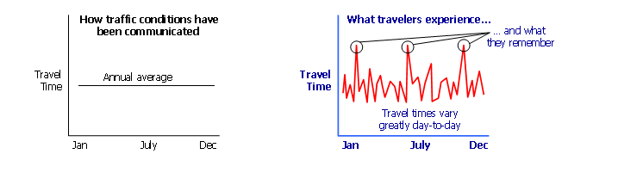
Averages Don’t Tell the Full Story

Slide 24
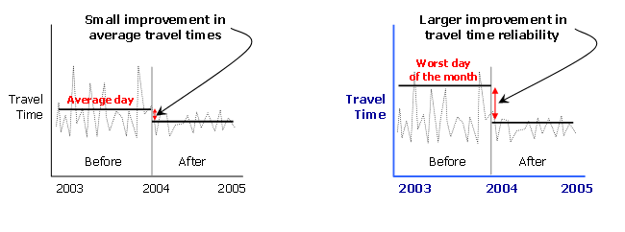
Reliability Measures Capture Traffic Management

Slide 25
Travel Time Reliability Indexes
Buffer Index
  Extra time added to average travel time when planning trips to ensure on-time arrival
Planning Time Index
  How much total time traveler allows to ensure on-time arrival
Travel time index: ratio of travel time in peak period to travel time in free flow conditions

Slide 26
Demo

Slide 27
Dynamic Traffic Assignment
Currently looking at developing models
Using DTA – lite software
Developed but not calibrated initial model for two MPOs
TDM model used as input
Calibration probably next year
  GF has good data from traffic analysis tool
  FM data collection hopefully next year
  Before, during and after construction data

Slide 28
Demo

