Slide 1
Autoscope Data Collection & Analysis
2019 Minnesota MPO Summer Workshop, Fargo, ND
Kshitij Sharma
Associate Research Fellow – Traffic Operations
Advanced Traffic Analysis Center
Bradley Wentz, PE
Program Director
Advanced Traffic Analysis Center & Dept. of Transportation Support Center
08.29.19

Slide 2
Stakeholders
MPO
State
UGPTI
TCC
Econolite ISS
City
Notes:
MPO being the central agency bringing everybody together

Slide 3
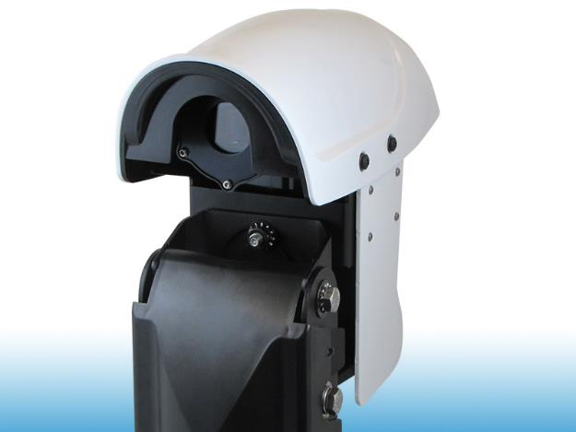
City of Grand Forks, ND
~ 54 intersections
  Encore (~160)
  Terra (~45)
  Duo (4)
  Suite of programs
    Browser
    Data Collector etc.
Older
Source: Econolite
Notes:
Fiber network includes loops

Slide 4
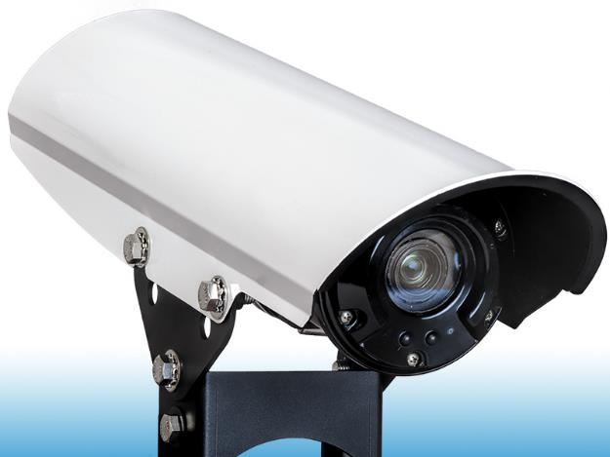
City of Grand Forks, ND
9 intersections
  VISION cameras
  ISS Supervisor
    Data collection
Source: Econolite
Notes:
Project along Demers Ave

Slide 5
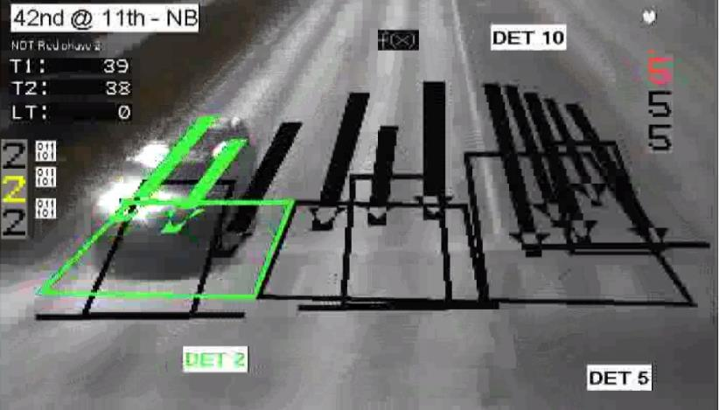
Camera Comparison

Slide 6


Slide 7
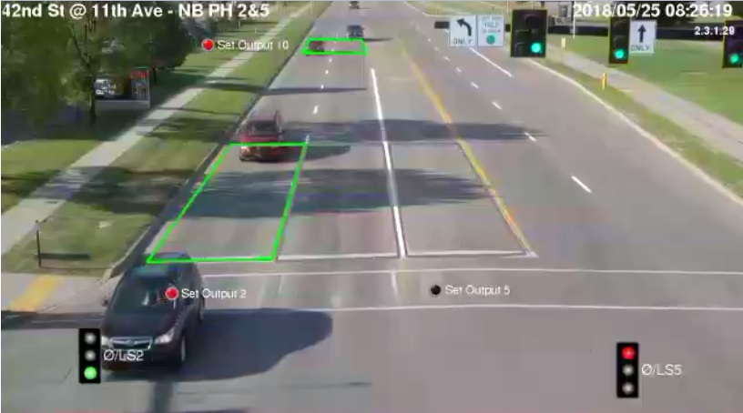
Camera Comparison

Slide 9
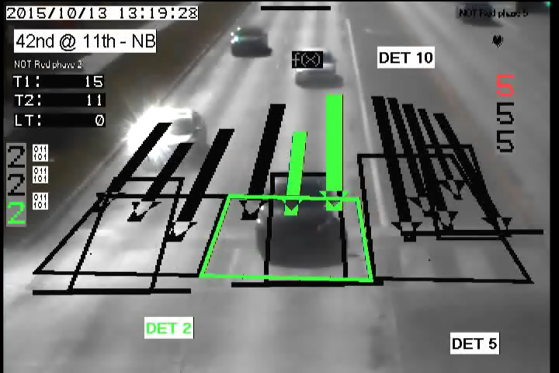
Camera Comparison

Slide 10
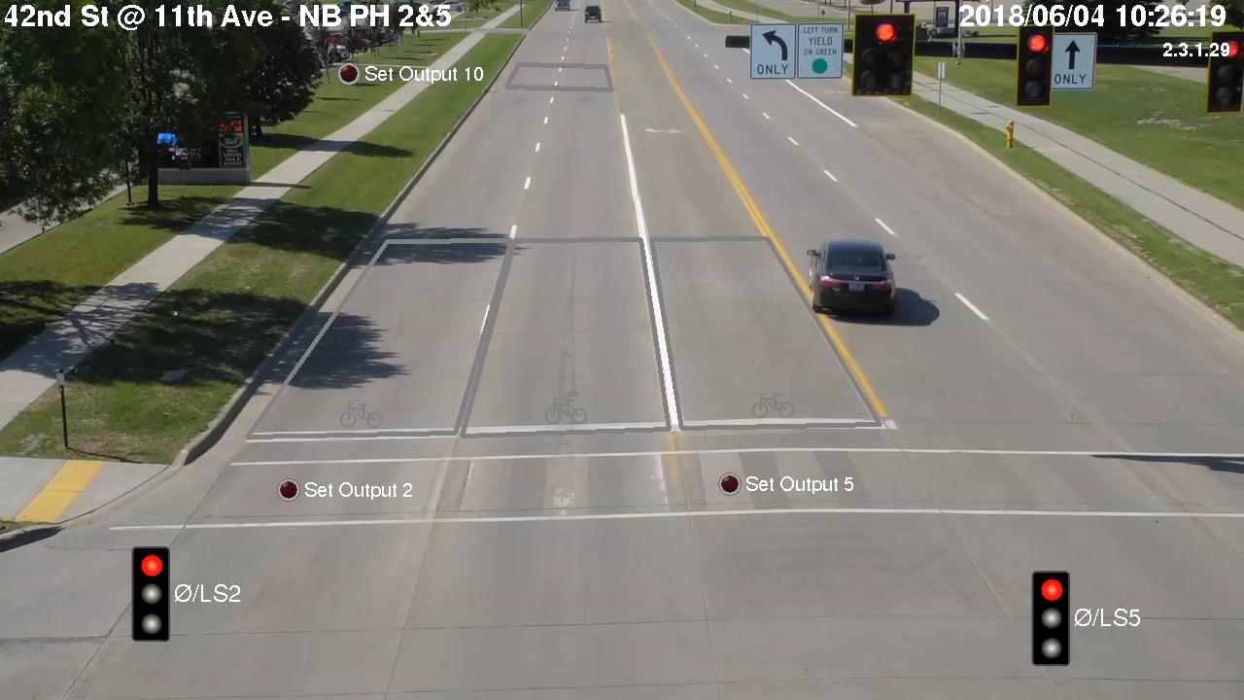
Camera Comparison

Slide 11
Process
Autoscope Cameras
MPO Server
UGPTI Server
Traffic Analysis

Slide 12
Autoscope Camera Data Collection
Encore
Terra
Duo
Vision
UGPTI
TCC

Slide 13
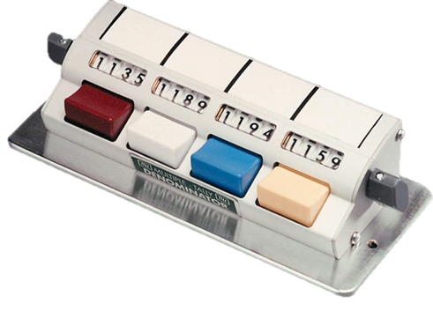
Data Accuracy Checks
One hour checks per approach
  Manual vs Autoscope
  Compared using GEH

Slide 14
Data Accuracy Checks
Notes:
GEH
Older cameras
Fail scenario

Slide 15
Data Accuracy Checks
Notes:
Older cameras still
Pass scenario

Slide 16
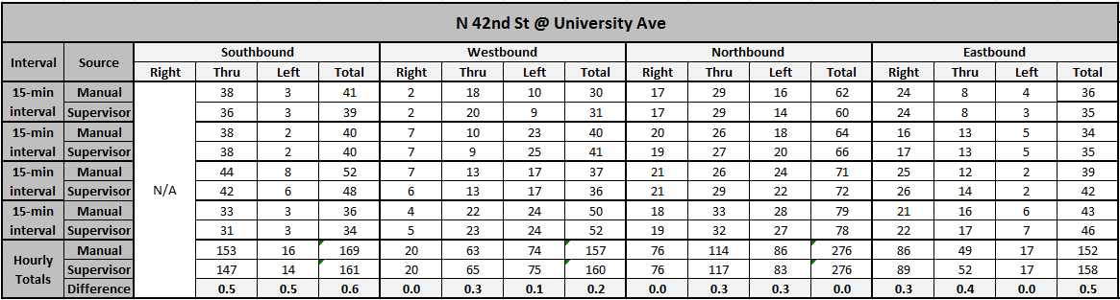
Data Accuracy Checks
Notes:
Newer cameras
Pass (not windy)

Slide 17
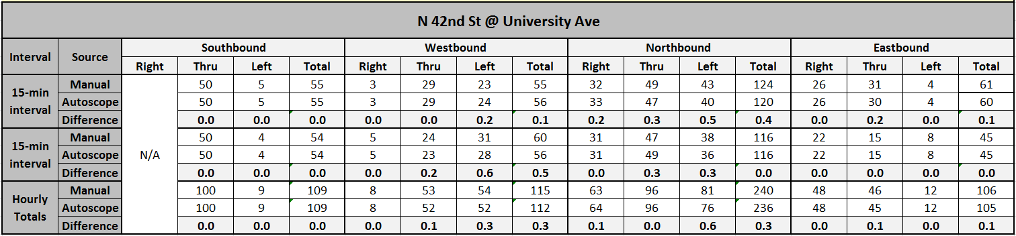
Data Accuracy Checks
Notes:
~20 mph sustained winds
~30 mph gusts

Slide 18
Factors Affecting Data Quality
Intersection configuration + Camera view
Weather
  High sustained winds
  High wind gusts
  Other
Lens condition

Slide 19
Data Transfer
MPO Server
  Hosted by City
Script transfers data (<100KB/camera)
  To UGPTI Server
  Via FTP
  VPN

Slide 20
Traffic Analysis Tool
SQL database
Web based application
Notes:
GUI changes based on which report you want to run

Slide 21
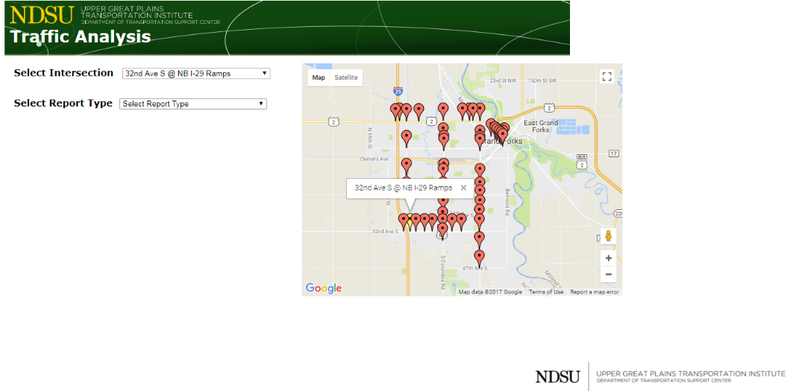
Traffic Analysis Tool
Notes:
http://dotsc.ugpti.ndsu.nodak.edu/TrafficAnalysis/
Username: gfegf
Password: GF@t@c14

Slide 22
Traffic Analysis Tool
Data Exclusion/Flagging
  Current ADT vs past average
    For same day of the week
    Compared using GEH
  Flagged if suspicious
  Excluded if deemed bad

Slide 23
Traffic Analysis Tool
Data Exclusion/Flagging
  Accounts for seasonal fluctuations
  Accounts for closures, construction etc.

Slide 24
Traffic Analysis Tool
Reports
  Graphs
  Turning Movement Counts

Slide 25
Traffic Analysis Tool
Volume profile
Monthly seasonal factors
Day of the week seasonal factors
Peak hour volume/factor
AADT
MADT
ADT
Graphs
Turning Movement Counts

Slide 26
Volume Profile
24 hour average traffic volumes
  3 graphs
    All legs
    East-West
    North-South
  PDF Report & Excel data export

Slide 27
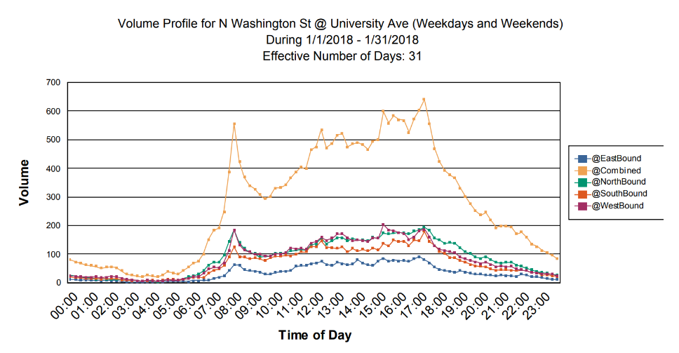
Volume Profile

Slide 28
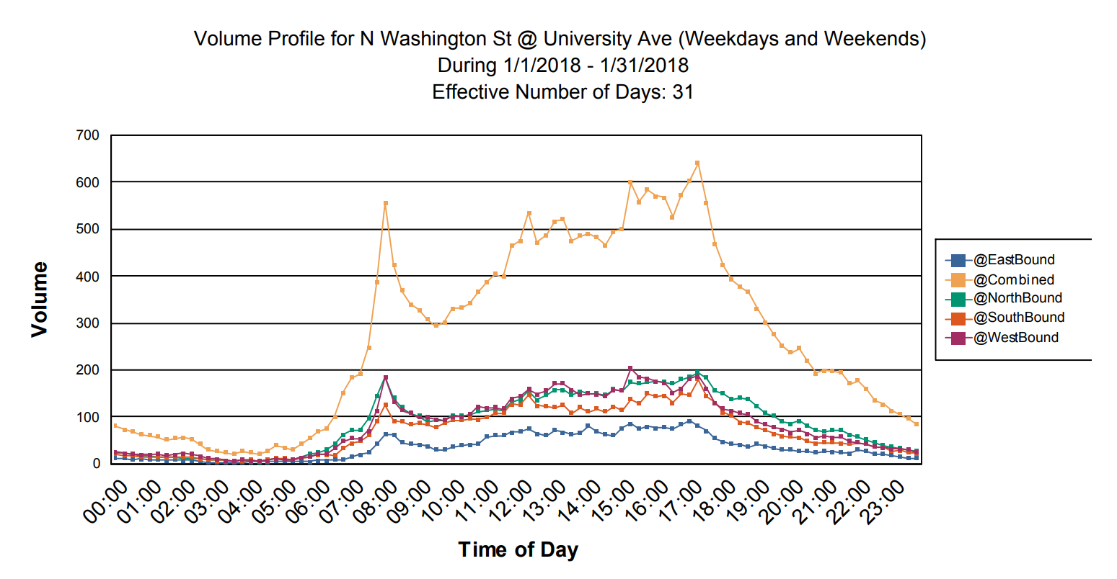

Slide 29
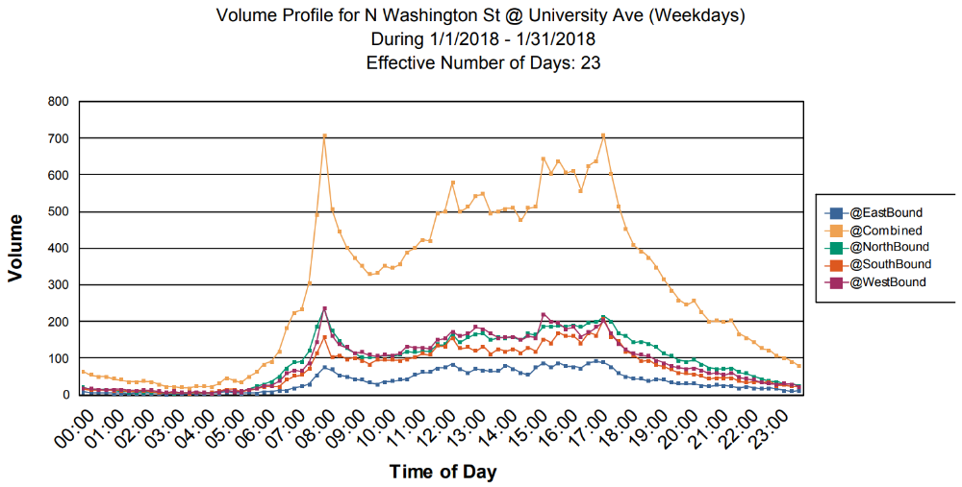
Volume Profile

Slide 30


Slide 31
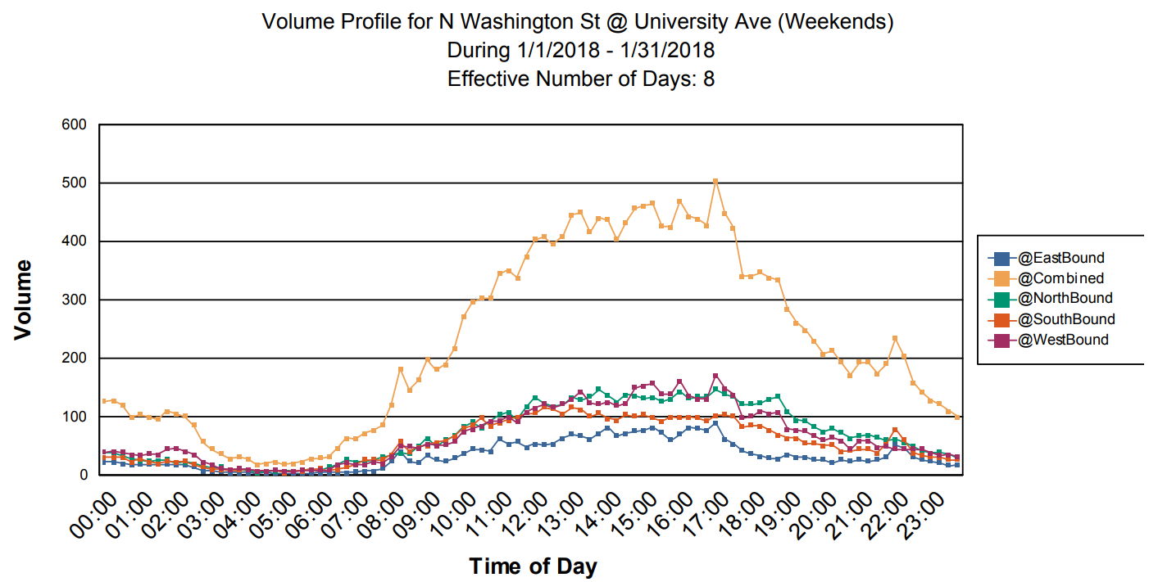
Volume Profile

Slide 33
Monthly Seasonal Factors
Monthly ADT and Factors
  As compared to AADT
2 Graphs
  Intersection totals
  Bidirectional approach totals
PDF Report

Slide 34
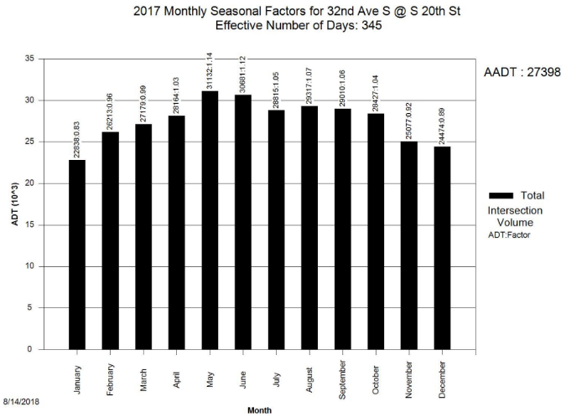
Monthly Seasonal Factors

Slide 35
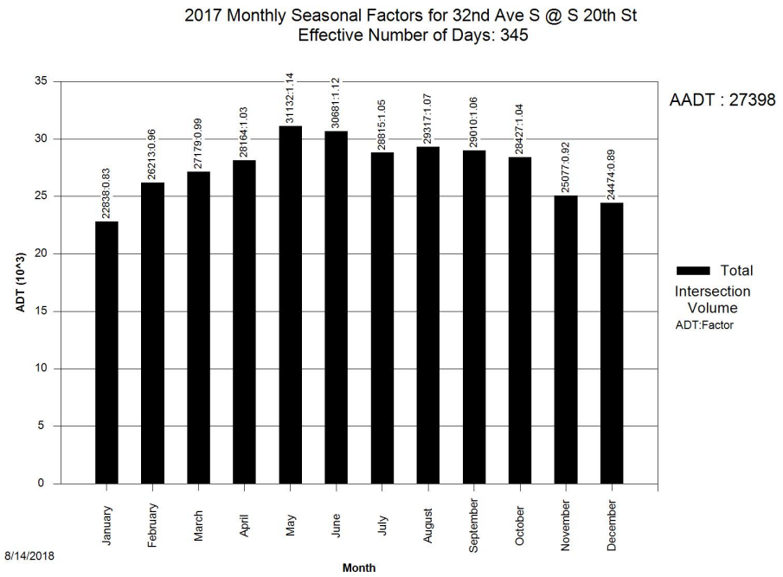

Slide 36
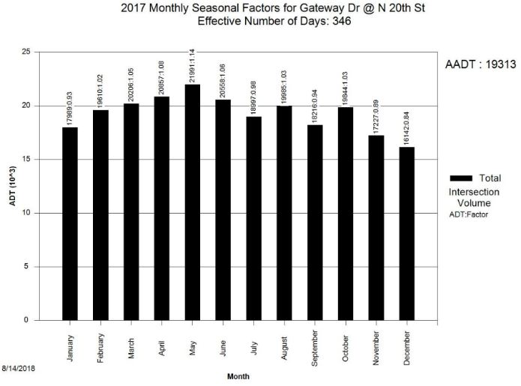
Monthly Seasonal Factors

Slide 37
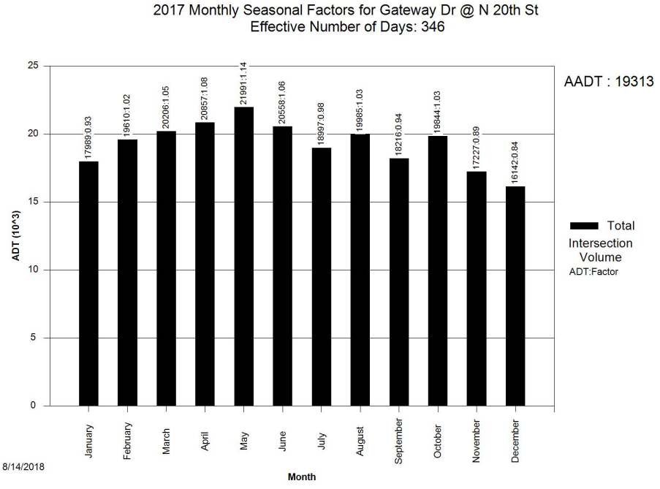

Slide 38
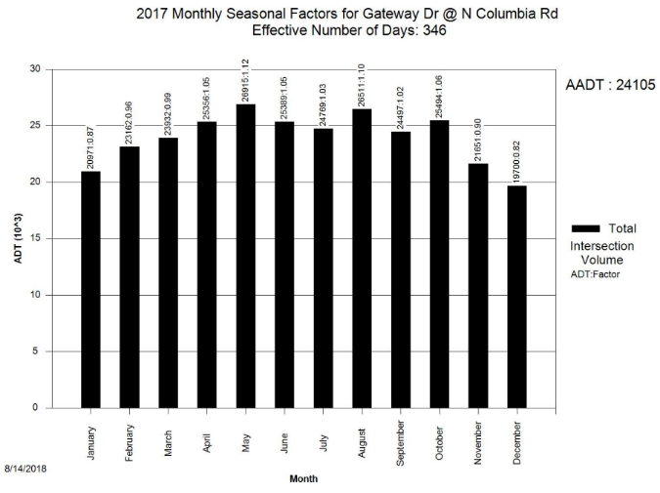
Monthly Seasonal Factors

Slide 39
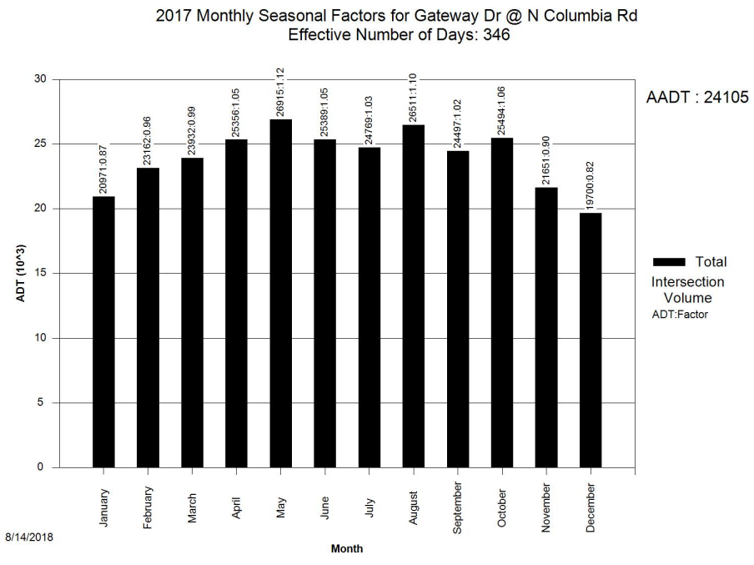

Slide 40
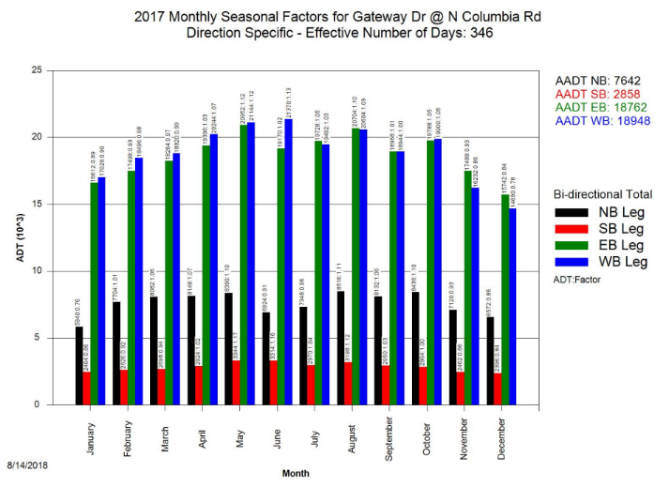
Monthly Seasonal Factors

Slide 41
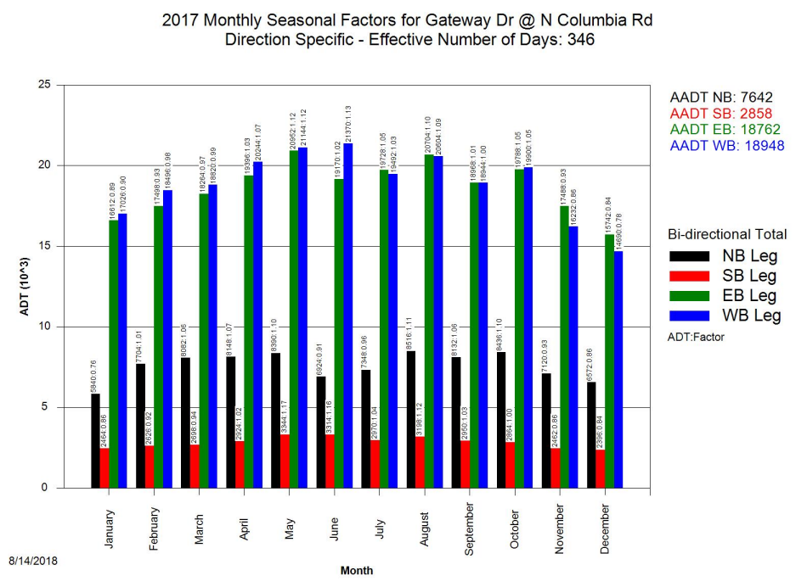

Slide 42
DOTW Seasonal Factors
DOTW seasonal factors
  For a month
2 Charts
  Intersection totals
  Bidirectional approach totals
PDF Report

Slide 43
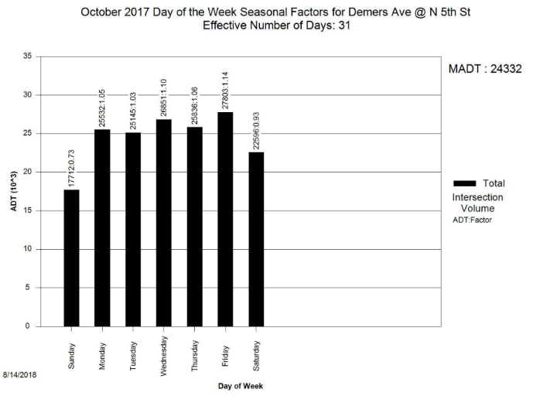
DOTW Seasonal Factors

Slide 44


Slide 45
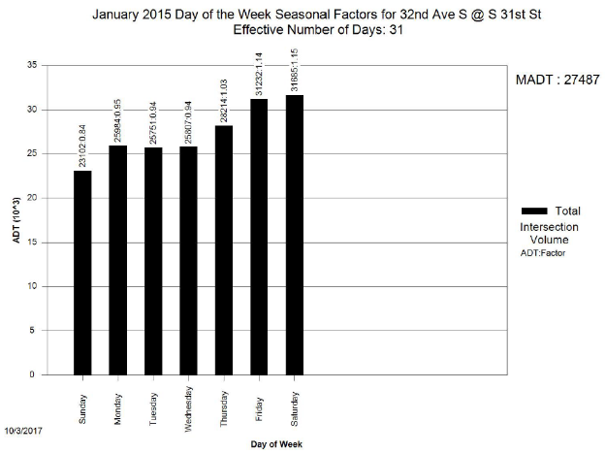
DOTW Seasonal Factors

Slide 46
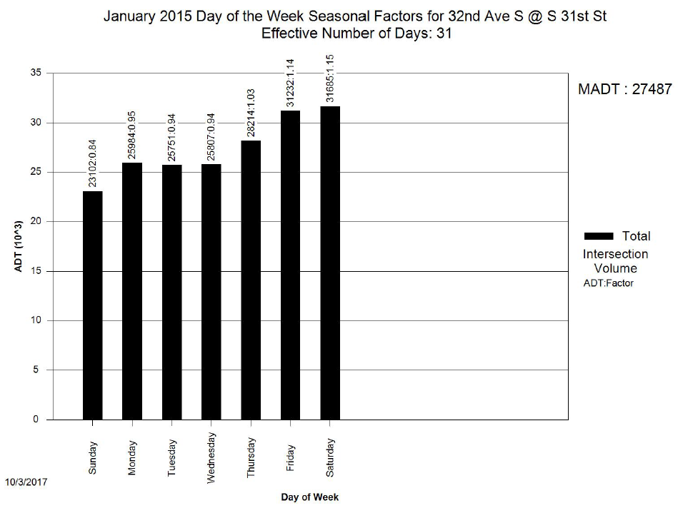

Slide 47
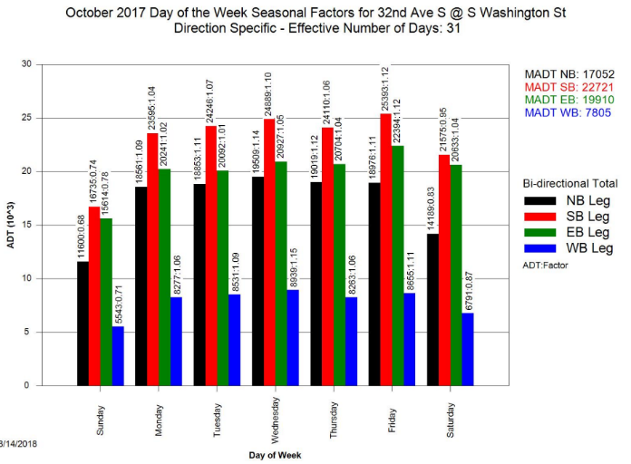
DOTW Seasonal Factors

Slide 48


Slide 49
Peak Hour Volumes/Factors
Turning movement count
1 TMC type diagram per peak period
  AM (6 – 10)
  Midday (10 – 2)
  PM (3 – 7)
PDF Report & Data Export

Slide 50
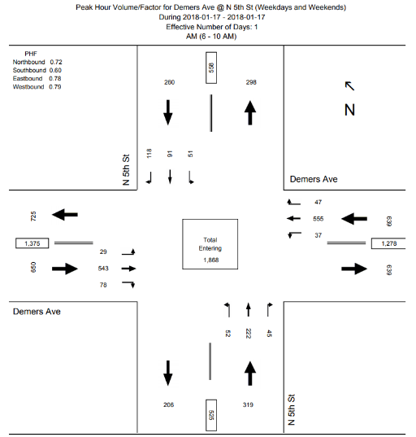
Peak Hour Volumes/Factors

Slide 51
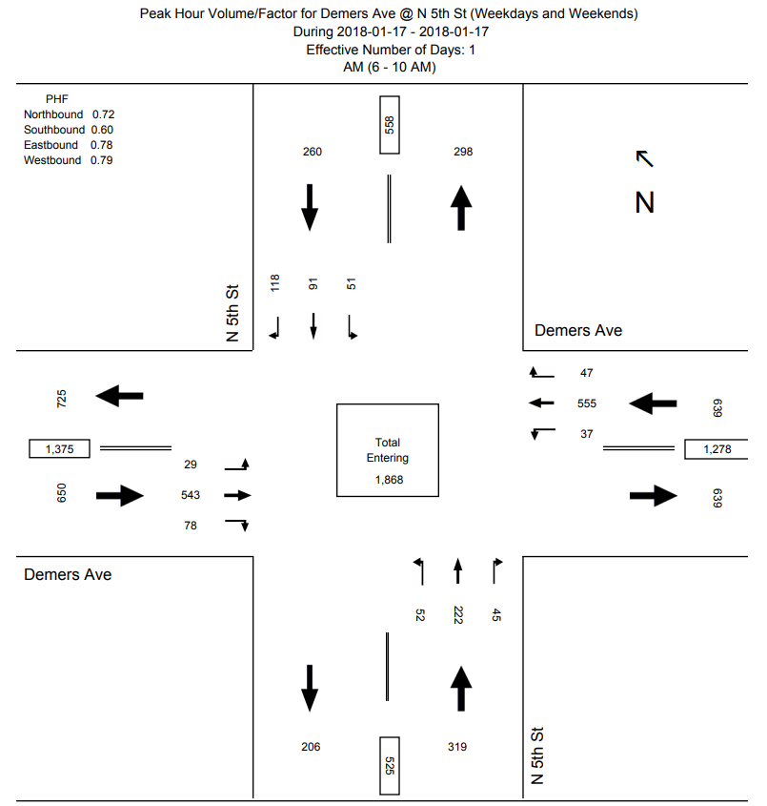

Slide 52
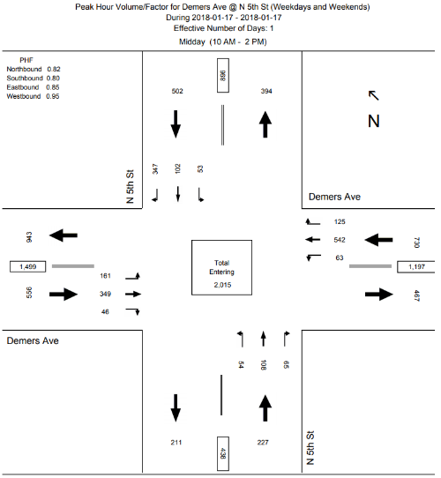
Peak Hour Volumes/Factors

Slide 53


Slide 54

Peak Hour Volumes/Factors

Slide 55
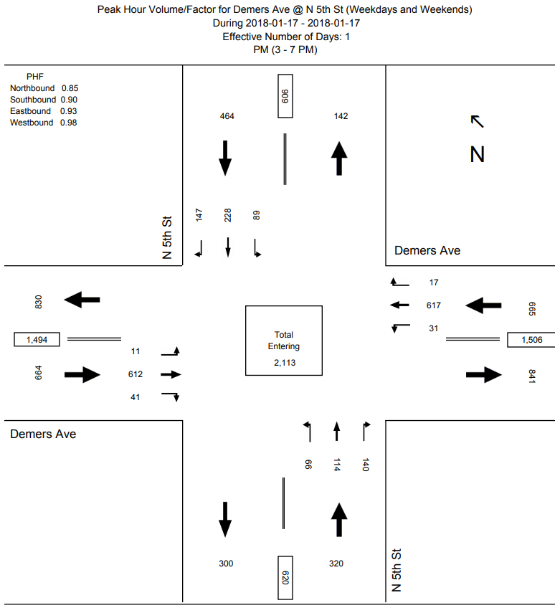

Slide 56
AADT, MADT, & ADT
AADT: Calendar year or last 12 months
MADT: Any month
ADT: Custom days
1TMC type diagram
PDF report & Excel data export

Slide 57
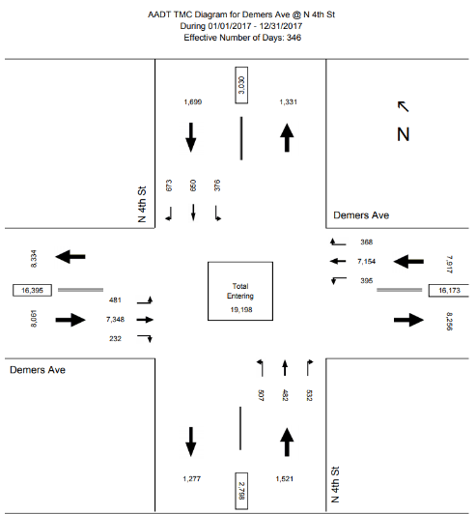
AADT

Slide 58


Slide 59
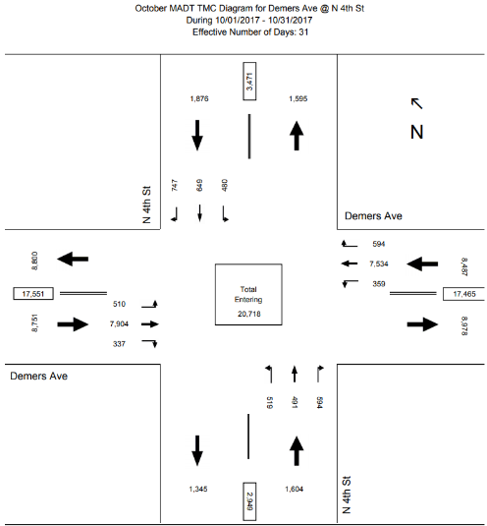
MADT

Slide 60
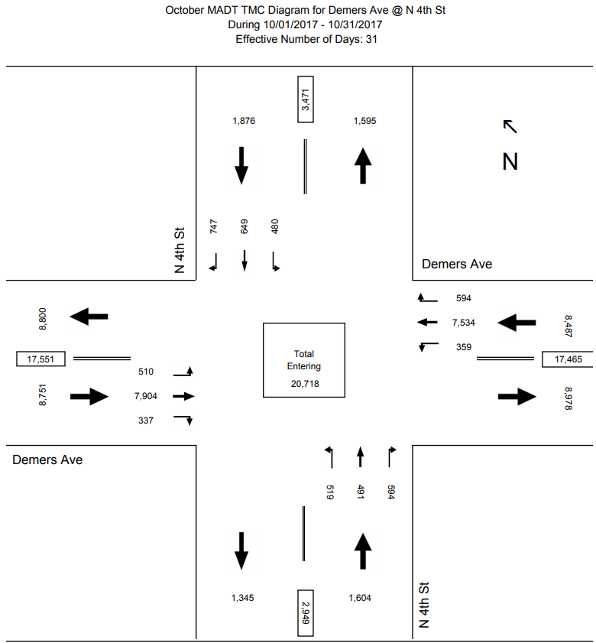

Slide 61
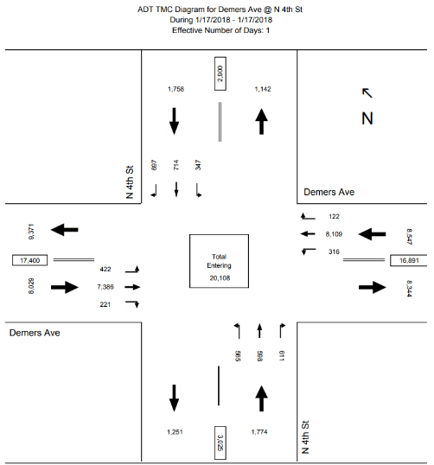
ADT

Slide 62


Slide 63
Use Cases
Transportation Planning (MPO)
  Travel Demand Model
    2015
Traffic Operations (City)
  Signal phasing and timing
    Corridor progression design

Slide 64
Enhancements
Comparative reports
Growth factors

Slide 65
Questions
Brad Wentz, PE
bradley.wentz@ndsu.edu
701.231.7230
Kshitij Sharma
kshitij.sharma@ndsu.edu
701.231.1086

